Slide 1

Criminal Justice Coordinating council
2014 juvenile justice incentive grant Program
Subgrantee Workshop
4/16/14
Notes:
Recovery Act - Victim Services Workshop
1
1
1

Slide 2
Workshop Agenda
Welcome and Logistics
2014 Juvenile Incentive Grant Program (JJIGP) RFP Overview
2014 JIGP Requirements
Program Overview
Break
Finance Overview
Wrap up
Notes:
Recovery Act - Victim Services Workshop
2
2
2
Restrooms/Refreshments location
Today’s workshop will address several different components. We will cover the material rather quickly as the presentation is relatively short and if you’re not able to effectively make note of the important points to remember, you will be able to download and view the presentation at a later time. Also at the end of the presentation, we will be available to answer any questions or address any concerns that you might have .
Please note that the material from today’s presentation will be available to download from our web site at http://cjcc.georgia.gov.

Slide 3
Juvenile Justice Reform
“We know there’s room for dramatic improvement in the results we see in the juvenile justice system.”
– Governor Nathan Deal
Notes:
Overview of the Reform
In 2011, the Special Council on Criminal Justice Reform was formed to study Georgia’s criminal justice system and was charged by Governor Nathan Deal with recommending policy changes. On December 18, 2012, the Council released their final report to the Governor …..
Discuss the total amount available via the Governor’s recommendation and approval by the legislature.:
5 Million State
1 Million Fed
1.25 Additional State funds appropriated
1.6 Million (DJJ) to be spread out to those courts who did not receive a grant. (Regionally based CSB)

Slide 4
About Us
The Criminal Justice Coordinating Council (CJCC) represents the culmination of many efforts to establish a statewide body that would build consensus and unity among the State's diverse and interdependent criminal justice system components. CJCC is charged with fiscal oversight of the Juvenile Justice Incentive Grant Program.
Notes:
Quick Overview of the GOCF Juvenile Justice Division moving to CJCC and now administering all of the Juvenile Incentive Grant Program Grants.

Slide 5
Juvenile Incentive Grant Program RFP
In keeping with Governor Deal’s goal of increasing public safety through a more effective juvenile system, CJCC and the Juvenile Justice Incentive Funding Committee offers this request for proposals seeking local juvenile projects that aim to reduce the number of youth served out of home.
Notes:
This goal can be realized by using available grant funds to develop programs that address the needs of youth who are typically committed to the Department of Juvenile Justice.
For 2014, applicants are required to include evidence-based program models that have demonstrated a reduction in juvenile recidivism. Pgs. 13-14 of RFP (List of EB programs). Program's that currently have an EB intervention in place, but that is not listed on the RFP, are still allowed to carry on with that service.

Slide 6
Eligibility - Who can apply:
An eligible applicant must meet all the following criteria:
Be a public government entity;
Serve as the fiscal agent for the grant and point of contact to CJCC;
Be responsible, liable, and oversee financial, program and post-award reporting requirements.
Applicants are strongly encouraged to apply directly to the Council at http://cjcc.georgia.gov/funding-opportunities
Notes:
Via Adobe Form-
If there are any concerns around upload the application via adobe form please contact Matthew Pitts or Reginald Boyd. (new for GOCF grantees)

Slide 7
Eligibility Criteria
Applications to support juvenile court projects must be made by county commissions/boards of commissioners on behalf of the juvenile court
All local units of government are required in compliance with the Georgia Service Delivery Strategy Act in order to be eligible for state-administered financial assistance

Slide 8
Application Details
Applications are due April 28, 2014
Award Notification will be June 16, 2014
Grant Award Amount
Grant Award Period: July 1, 2014- June 30, 2015
Continuation Funding
Notes:
Grant award amount- Applicants are applying for year one of funding through this RFP.
Applicants are eligible to apply for a maximum of $300,000 for this grant year, a 12 month period. (Last years grant award amount for continuation)
Grant Ward Period- The grant award period covers 12 months, from July 1, 2014, June 30, 2015.
All new or enhanced services must be fully implemented within sixty (60) days
of the grant award agreement beginning date. All continuation services must be fully implemented within thirty (30) days of the grant award agreement beginning date.
Continuation Funding- A continuation proposal is required annually. An initial grant does not guarantee continued funding.
1. Professional management of grant funds and compliance with administrative requirements;
2. Accurate and prompt submission of required program and financial data and reports;
3. Positive performance history with achievement of program goals and objectives; and
4. Cohesive continuation plan for their program.

Slide 9
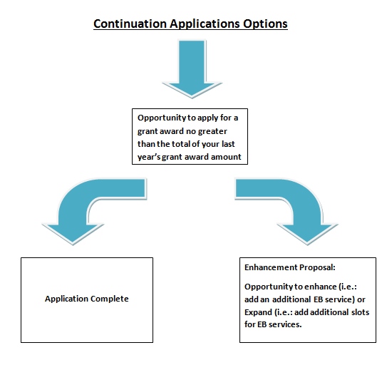
Notes:
Elaborate on each option
Continue providing current EB Services OR
Make changes to current EB services
Whether continuing to provide EB services or making changes in EB services, the applicant MUST submit a budget no greater than their first year grant award amount
Enhancement Opportunity
Continuation applications should continue to report on the evidence-based interventions implemented in Year One. If applicant plans to make a change to a different intervention in Year Two, please detail this change and why it is being made. Applicants switching interventions MUST select an intervention from the table below. If the applicant chooses to switch interventions, the applicant MUST submit a budget no greater than their first year grant award amount. Continuation applicants wishing to expand or enhance evidence based services which results in a need for additional funding will be allowed to apply for additional funding through a separate Enhancement Request process. Applicants who are starting a new EB service will be allowed a 2 month implementation period for that service, if needed. Continuation applications are allowed to continue current interventions in Year Two if they so choose. Evidence based services on pages 13 and 14 of the RFP.

Slide 10
Application Details (Continuation Only)
Enhancement Proposal:
Enhancement
Expansion
Grant Award Period for Enhancement:
The grant award period covers 12 months, from July 1, 2014, June 30, 2015
Notes:
Enhancement: Adding capacity for current services i.e. more slots-Elaborate
Expansion: Adding an additional EB service to the existing menu.-Elaborate
If awarded an enhancement opportunity, programs must adhere to all guidelines
and regulations set forth in the 2014 Juvenile Incentive Grant Program RFP.

Slide 11
Program Design
In order to demonstrate potential cost savings to taxpayers by incentivizing evidence-based options, the overarching goal of this offering is the reduction of felony commitments to the Department of Juvenile Justice and Short-Term Program Admissions.
Notes:
The purpose of this grant opportunity is to provide funding for local programs designed to serve youth in the community who would otherwise be committed to Georgia’s Department of Juvenile Justice (DJJ).
Applicants are encouraged to examine their local data from the previous fiscal year in order to understand the profiles of youth who were committed to DJJ before, and who, with appropriate community-based services, could be served at home.

Slide 12
Assessment Tools:
Department of Juvenile Justice’s Pre-Disposition Risk Assessment (PDRA)
    Participant Youth MUST score MED-HIGH on the PDRA
Detention Assessment Instrument (DAI),
Criminogenic Needs Assessment (CNA).
Notes:
Applicant counties will have the benefit of utilizing a standardized risk assessments to aid in decision-making. The instruments include, at a minimum, the: PDRA,DAI, CNA
Considerable evidence has been found to show that assessing each youth’s risk of re-arrest can help with classifying youth for both appropriate levels/types of programming, as well as, the necessary intensiveness of services. Therefore, applicant counties will have the benefit of utilizing a standardized risk assessments to aid in decision-making.

Slide 13
Priority Areas for 2014
High Priority will be given to applications that specifically formulate strategies that address:
Reducing the applicant county’s annual felony commitment rate to the Department of Juvenile Justice
Reducing the applicant county’s annual number of Short Term Program admissions*
Notes:
CJCC and the Juvenile Justice Incentive Funding Committee ask that applicants fully describe how their project will reduce risk factors of participants through the use of an evidence model that addresses family engagement, reduces negative peer association, increases pro-social activities, and is tailored to the individual cognitive and maturational levels of their participants

Slide 14
Applicant Goals
Goals
Reduce felony commitments to Department of Juvenile Justice and Short Term Program (STP) admissions in the target county.
Increase the use of evidence-based practices in Georgia's juvenile justice system by initiating community-based juvenile justice programs.
Reduce the recidivism rate of youth involved with Georgia's juvenile justice system.
Reduce annual secure detention rate of target county.
Reduce annual secure confinement rate of target county.
Demonstrate a cost-savings to citizens of Georgia through provision of research-informed services to youth in juvenile justice system.
Notes:
Same as last year

Slide 15
Applicant Objectives
All Projects
Project will demonstrate a 20% reduction from fiscal year 2012 in the rate of annual felony commitments to DJJ and Short Term Program (STP) admissions. Counties can find 2012 numbers in order to calculate target at: http://juveniledata.georgia.gov/RgpReports.aspx?report=2012DataTargets
Project will demonstrate reduction in annual Secure Confinement rate.
Project will demonstrate reduction in annual Secure Detention rate.
Notes:
Same as last year

Slide 16
Applicant Objectives
At least 75% of project participants will complete program requirements.
At least 55% of youth completing services will not re-offend as calculated using recidivism definition*.
    A new charge (within 3 years of the initial post-adjudication community placement) which results in a juvenile court delinquency adjudication OR adult criminal court conviction.
Project will report cost-savings per youth by calculating average cost to provide targeted intervention subtracted from average cost to detain youth. (Selected projects will be provided a marginal cost rate in order to perform this calculation).

Slide 17
Submission Requirements
The application must be submitted electronically using the link on the Council’s website at http://cjcc.georgia.gov/.
The application should be submitted via an adobe form.
Applications must be submitted by 5:00pm on April 28, 2014.
Notes:
The application must follow the outline as described on page 20 of the RFP
All of proposal documents are also required to be submitted electronically by scanning and uploading the documents to the online application.
The proposal package must be completed and submitted in accordance with RFP guidelines for submission listed on page 7 of the RFP

Slide 18
Disqualification Factors
Any application electronically time-stamped after 5:00pm on the April 28, 2014
Additionally, CJCC may not consider funding any applicant that fails to comply with all application requirements.
Notes:
Disqualification factors may include any of the following:
Failure to include application narrative, application budget, and application attachments;
Failure to provide appropriate number of copies and format requested;
Applicant is not a public government entity;
Submission fails to include an original signature of the applicant’s executive officer on the application face sheet; or
Application lacks original signatures where appropriate.

Slide 19
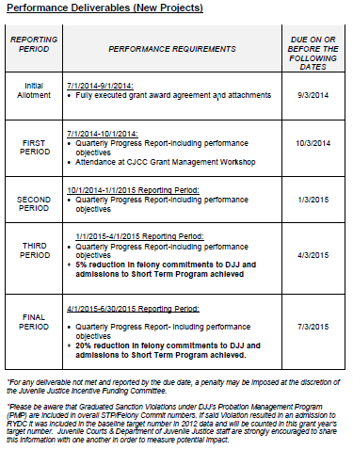
Notes:
Explain the Graduated Sanctions Note

Slide 20
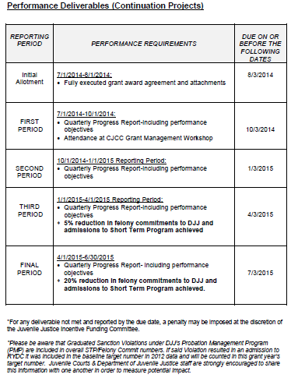
Notes:
Explain the Graduated Sanctions Note

Slide 21
Questions:

Slide 22
RFP Format
Number of every page submitted as part of your application
Use type that is 12-point font size and one inch margins
The application narrative should be typed on white paper that is 8 ½ x 11 inches
Include a footer identifying the applying agency
Adhere to page limits

Slide 23
Proposal Narrative
The narrative is a detailed statement of the work to be undertaken and answers who, what, when, where, why, and how statements about the grant proposal.
CJCC requires that applicants restate and number each Narrative Section followed by the response.
Notes:
Limit the narrative to eleven (11) pages

Slide 24
1a. Statement of Need/Summary
1. Statement of the community problem
For the purpose of this RFP applicants are instructed, at a minimum, to use each of the following metrics as justification of need for programming:
    At-Risk Population
    New Instances of Secure Detention (RYDC)
    Cases Resulting in Commitment to DJJ
    New Instances of Confinement in Secure Juvenile Correctional Facilities (YDC)
This information for each county can be found at-
http://juveniledata.georgia.gov/DataReports.aspx?report=RRIDataEntryReport
Notes:
Page limit for this section- ½ page

Slide 25
1a. Statement of Need/Summary
2. A description of how the problem relates to the mission of the implementing agency.
3. Overview of the Target Population to be served.
4. Description of the chosen evidence-based intervention for proposal and why it was selected.
5. Brief description of the activities requesting CJCC funds.

Slide 26
1b. Administration
Name the implementing agency
Agency qualifications
Community Partners
Quarterly cash flow
Notes:
Name the implementing agency. Provide a brief description of the implementing agency. Name the applicant and fiscal agents, if these agencies are different from the implementing agency. .
List the agency’s qualifications and experience with managing grants.
List the Community Partners and their description and contribution, if any, to the proposed program.
Does the fiscal agent have the ability to maintain a quarterly cash flow?
Page limit for this section- ½ page

Slide 27
1c. Target Population
Target group/age range
Projected youth to be served
How and Why?
Gender
Service area
Other demographics
Assessment instruments
Notes:
Page limit for this section- ½ page
Provide a detailed description of the clearly defined target population to be served in the grant period,
including the following:
Target group/age range: a) middle school; b) high school; or c) both middle and high schools;
Number of projected youth to be served;
How and Why Target Population selected?
Gender: a) male only; b) female only; or c) male and female;
County or counties to be served; and
Other demographics, including at-risk population(s).
List assessment instruments to be used for selected target population(More fully described in Section 4.d.4.-Intake)

Slide 28
1d. Methods and Procedures
A. Describe the overall format and design of the program, addressing the following:
  Program type
  Program time
  Program frequency
  Program duration
  Program hours
Notes:
Page limit for this section- 6 pages
A. Describe the overall format and design of the program, addressing the following:
Program type (i.e., Youth Reporting Center, community-based, school-based, or other);
Program time (i.e., during school hours, after school, weekends, summer, and/or year-round);
Program frequency (i.e., the number of times the program is implemented or, in other words, the number of program cycles);
Program duration (i.e., the length of the program in days, weeks, and/or months)
Program hours (i.e., the minimum number of program hours per youth).

Slide 29
1d. Methods and Procedures cont.
B. Complete the Program Timeline (Attachment A-2).
C. List the specific site(s) where programming will occur (i.e., the site name and the street address).
D. Fully describe the intake process. List criteria to determine which individuals will be offered program services.
Notes:
B. Provide a detailed timeline from July 1, 2014 – June 30, 2015 of planned grant activities, including, but not limited to, program start and end dates for each site, special events, and planning.
C. Describe how the proposed program site is a safe and convenient location for youth and parents to receive services. Attach any Memorandum(s) of Understanding for sites not under the jurisdiction of the applying or implementing agency (Attachment A-3).
D. Applicant must provide a detailed description of how the DJJ Detention Assessment Instruments (DAI), Pre-Disposition Risk Assessment (PDRA) will be utilized to ensure consistency and uniformity in decision-making.

Slide 30
1d. Methods and Procedures Cont.
http://www.djj.state.ga.us/Policies/DJJPolicies/Chapter20/DJJ20.11DetentionDecision.pdf
E. Describe how parental consent is obtained for youth to participate in the program. Explain if additional information (e.g., intake form, participant application, and/or needs assessment) is obtained for a youth to be enrolled in the program.
F. Describe the services and supports provided to all individuals in the target population using CJCC grant funds and which agencies will provide these services.
Notes:
F. State the proposed primary curriculum or evidence-based interventions that will be employed during this grant period. Describe how this will be implemented.
Any new evidence based intervention must come from the list on pages 14 and 15 of the RFP
State and describe any other developmental activities program participants will receive in addition to the curriculum or intervention listed above. Explain how each of these developmental activities will be implemented.
Insert a chart that indicates the activity, the type of activity, and the number of hours per activity per youth that will be supported, in whole or part, by these grant funds.

Slide 31
Methods and Procedures Cont.
  G. Describe the CJCC grant-funded services and supports provided to subsets of the target population and/or to youth in the target group who may or may not be receiving intensive services, if applicable.
  H. Describe the parent involvement and/or community awareness activities provided using GOCF grant funds, if applicable.
  Staffing:
  I. Describe the primary roles and responsibilities for each grant-funded position. Attach a job description for each position discussed (Attachment A-4).
  J. Explain the plan for orientation and training of grant-funded staff.

Slide 32
Goals, Objectives, and Evaluation
a. List the required program goals as outlined in the RFP.
b. List the required program objectives as outlined in the RFP.
c. Explain fully how all stated goals and objectives will be reached and evaluated.
d. Applicants will be required to explain how they currently collect data on youth served and how they plan to expand this collection to include source of referral information.
Notes:
Page limit for this section- 2 pages

Slide 33
Sustainability
Specific activities
Current funding sources
Potential funding streams
Volunteers
Building evidence-based capacity
Notes:
a. Describe the specific activities that will take place during this upcoming grant period to ensure sustainability.
b. List the current funding sources and amount of funding for your organization.
c. Identify potential state, federal, and or/private funding streams for program support.
d. Identify any staff or volunteers that have assigned, dedicated efforts towards sustainability.
e. Identify potential ways to increase current evidence-based service capacity for target population.
f. Describe any local actions taken to specifically support evidence-based services
(1 page Cont. Only)

Slide 34
Previous Accomplishments
Successful Interventions
Summary of activities
Previous problems
Notes:
Provide a detailed description of any previous successful interventions or grant funding received for similar programs. Include a detailed summary of activities, number/percent of youth served to-date, and supporting data to demonstrate whether or not the project objectives and goals were met.
If problems were encountered in previous grants or objectives were not fully achieved, please provide a full description detailing issues and corrective action(s) taken to address.

Slide 35
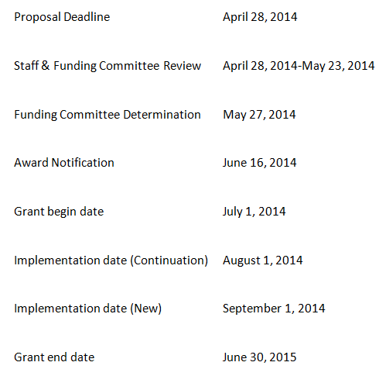
Timeline
Notes:
Review of timeline

Slide 36
Juvenile Justice Reform
Fiscal Overview

Slide 37

Accepting Your Award

Slide 38
Award Packet Activation
Accepting Your Award
  Award notifications will be announced on
  June 16, 2014 and all awards packages are due back to CJCC by
  July 31, 2014 (45 days after date of execution)
  Refer to the enclosed instructions when completing your award package
  Carefully review special conditions
  Be sure to have all award documents signed by the appropriate authorized official.
  Funds cannot be drawn down until all documentation is received and approved by CJCC.
Notes:
Although we will allow 45 days for the award packet to be returned, it is not a requirement to wait the full 45 days before returning the packet. We would encourage you to return the award packet as soon as possible.

Slide 39
Authorized Official
Government Agencies
  County Commission Chair or Mayor
Delegating Signing Authority
  Signature Authorization Letter
  Delegated signing authority will specifically apply to this grant for the current grant cycle.
Notes:
Authorized officials for government agencies is the County Commission Chair or the Mayor.
Once the award has been accepted the authorized official may delegate signing authority. Signing authority can be delegated by submitting a formal request on your agency’s letterhead to CJCC.
Signing authority can only be delegated for the day-to day operations of administering the grant. The signature authorization letter only permits signing authority for the current grant period that applies to this particular grant.

Slide 40
Accepting Your Award (cont.)
Documents in the award packet to complete:
  Subgrant Award Form
  Special Conditions
  Reimbursement Selection Form
  Subgrant Adjustment Request (SAR) #1
  Subgrant Expenditure Report/Request for Funds
  Request for Initial Advance Payment Form
  Designation of Grant Officials
Notes:
Subgrant Award Form should be signed by the Authorized Official.
Special conditions must be initialed and signed by the Authorized Official.
Reimbursement Selection Form should be signed by the Authorized Official.
Request for Initial Advance Payment must be signed by Authorized Official..
SERs must be signed by the Authorized Official or appropriate designee and returned by mail with original signatures.
SARs must be signed by the project director or the financial officer.

Slide 41
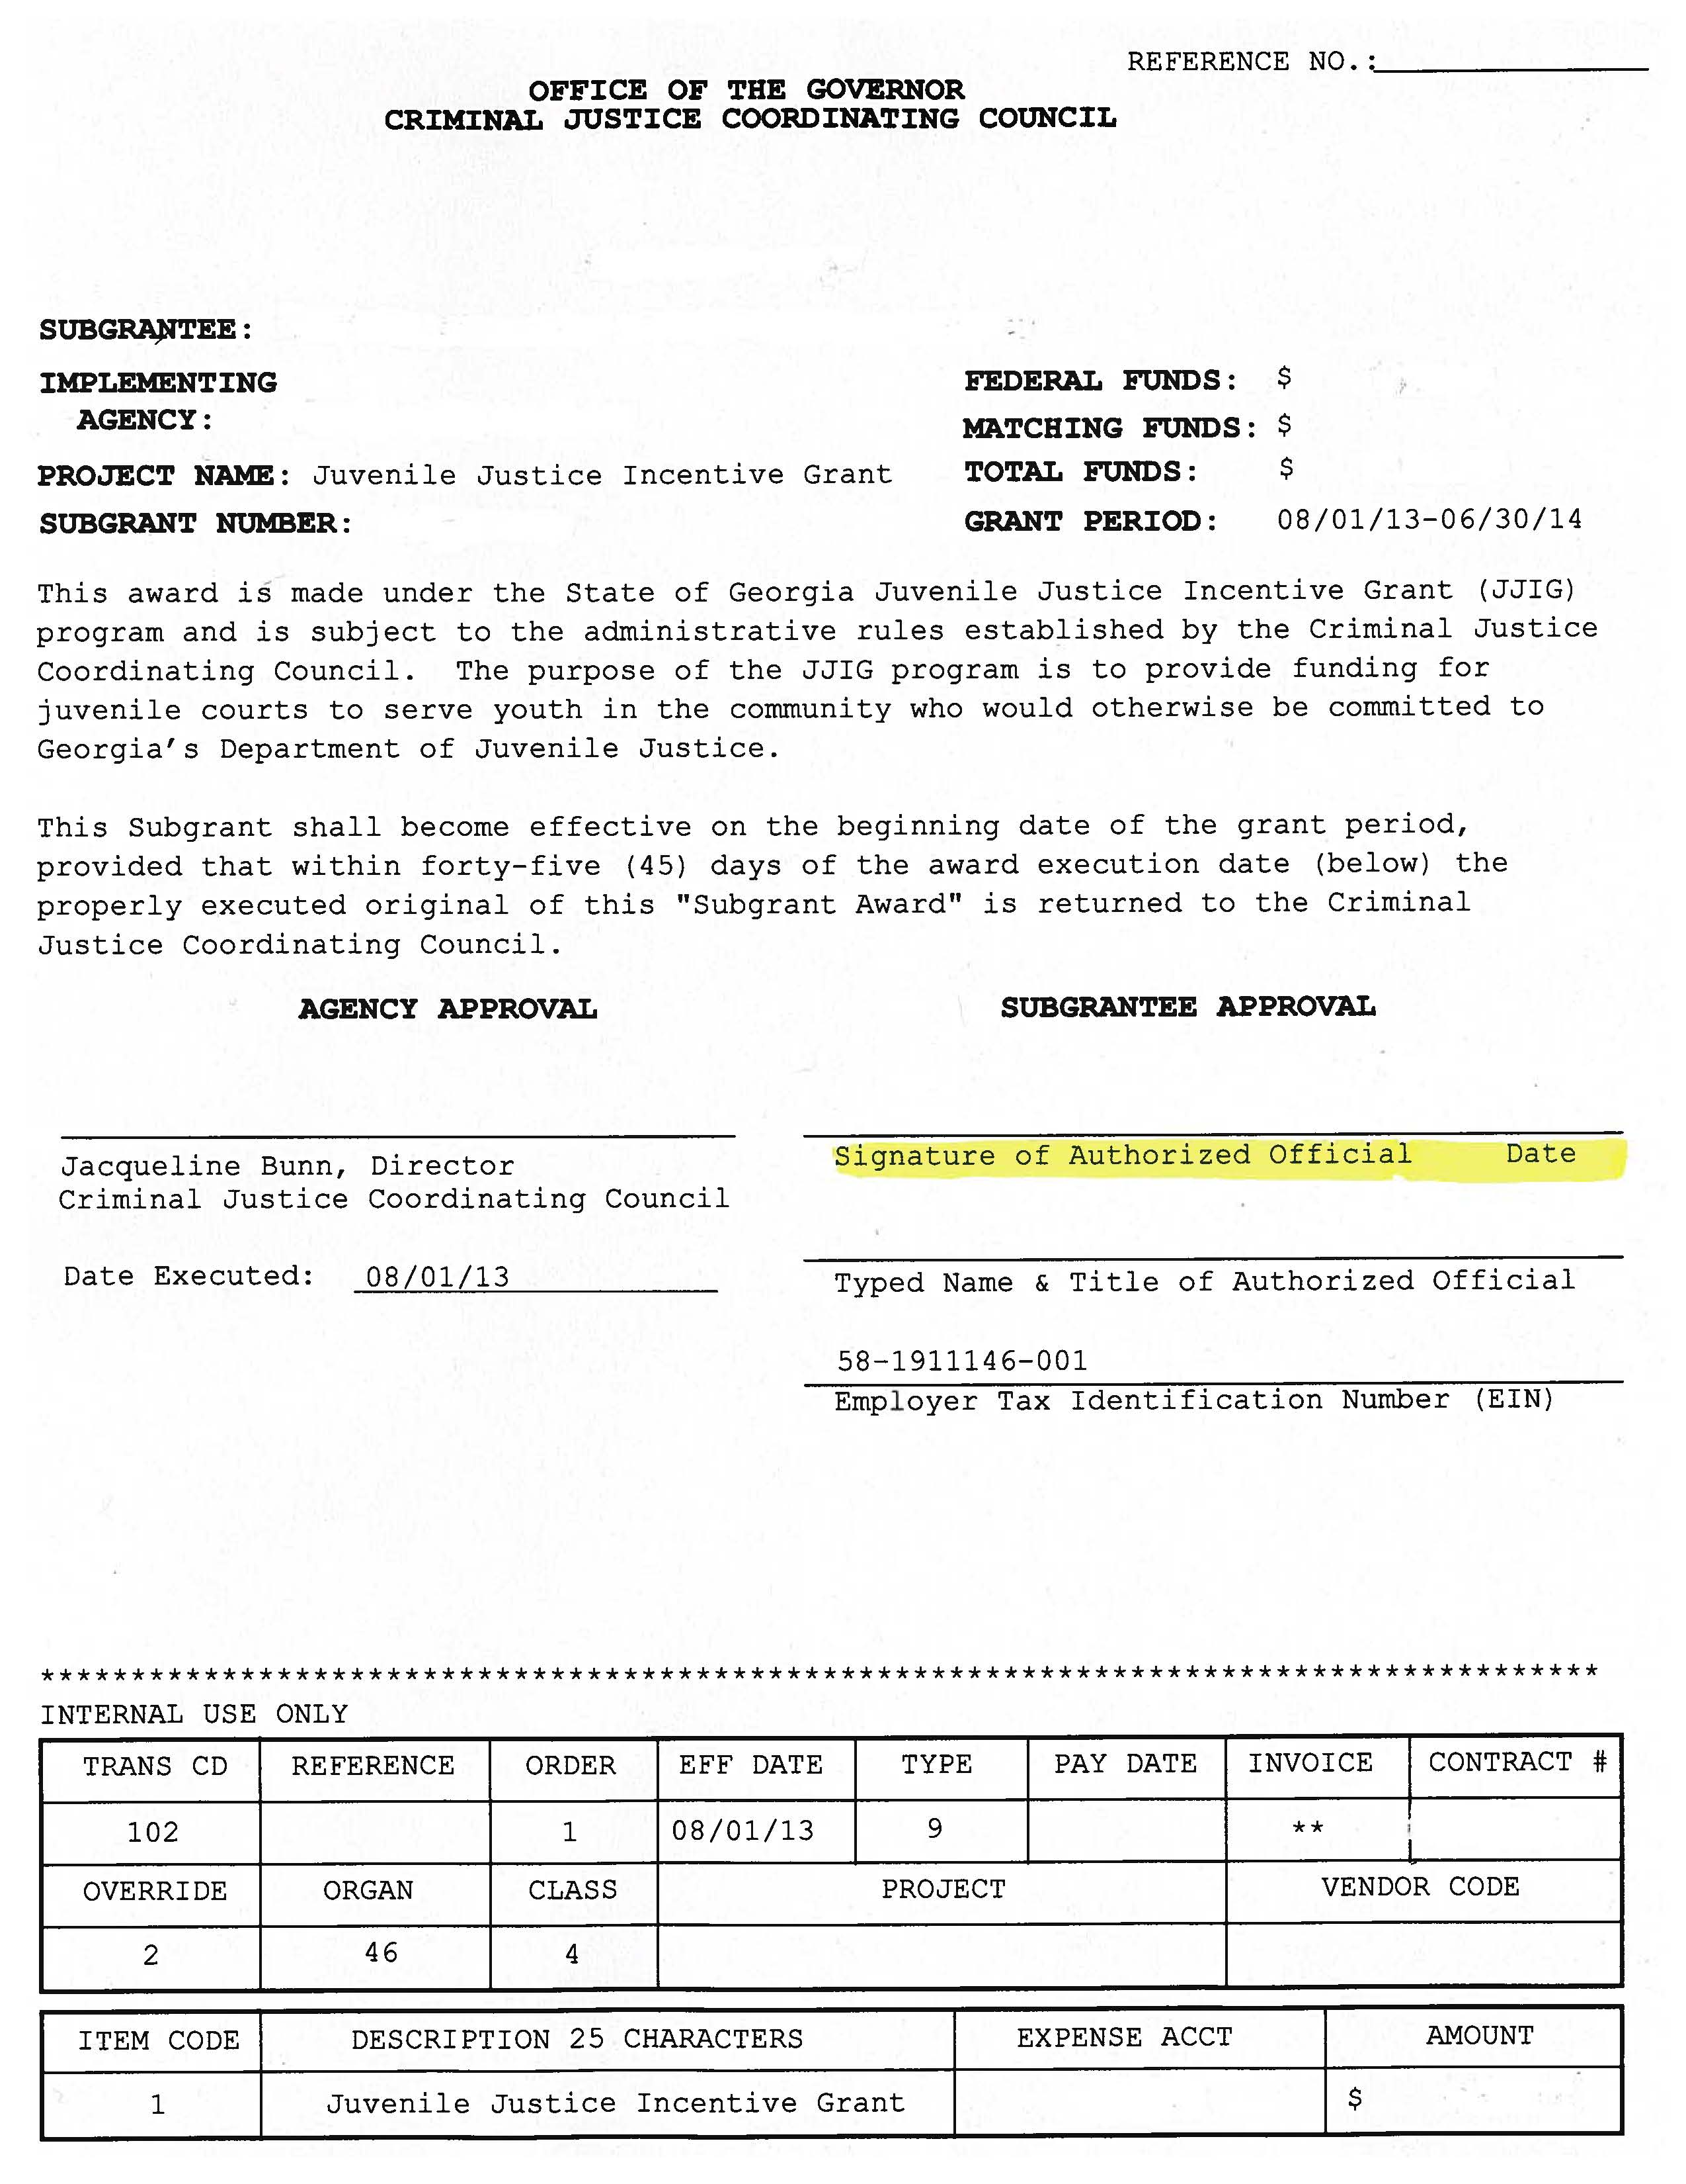
Notes:
Subgrant Award Form – Along with the special conditions this document must be signed by your authorized official and returned along with the documents included in the award packet.

Slide 42
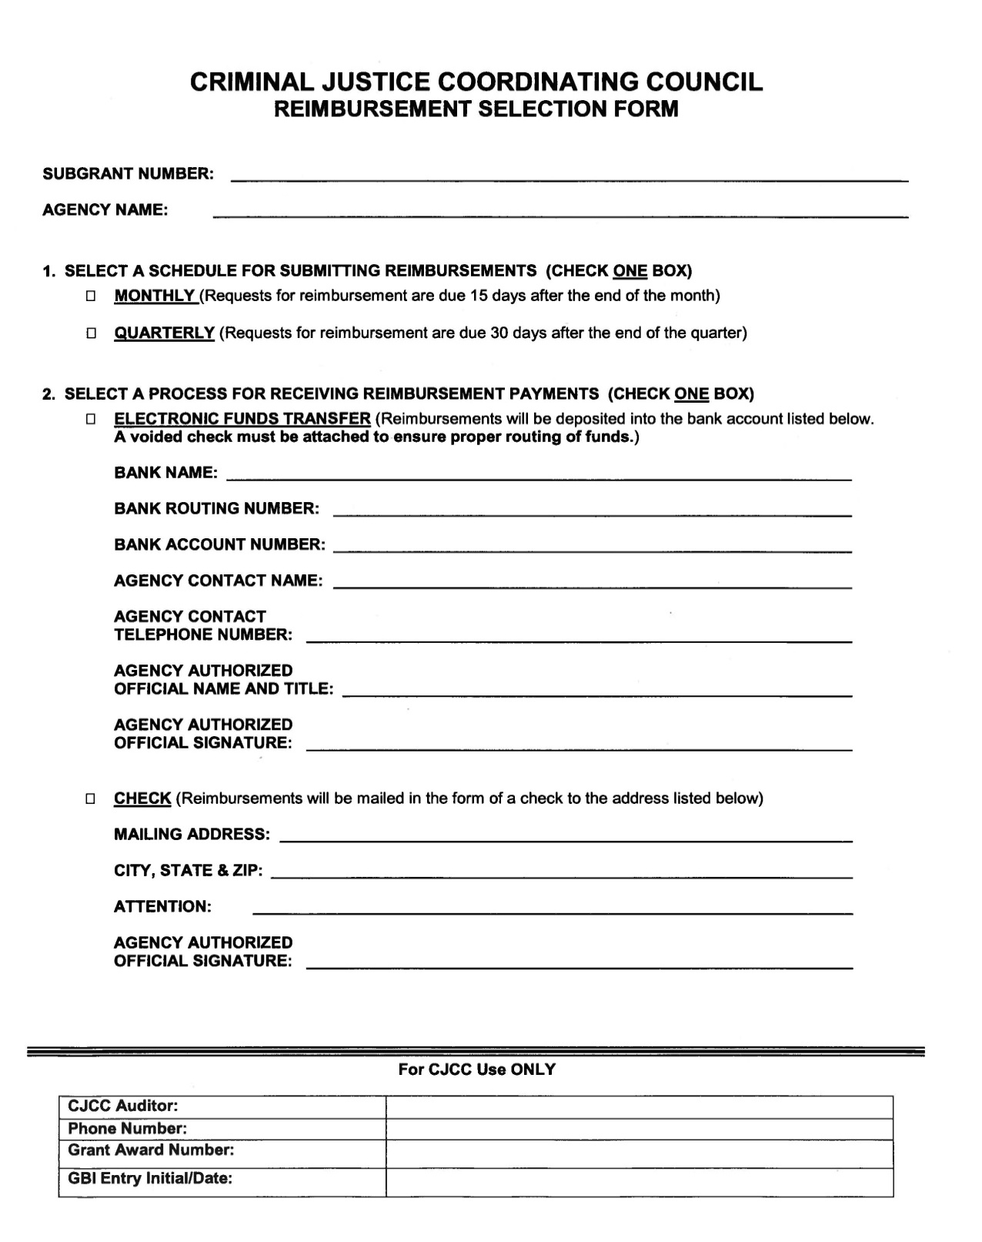
Notes:
The Reimbursement Selection Form must be completed to identify the method of payment your court chooses for reimbursement. This document must also be signed by your authorized official.
For agencies that have had a change of address or any other changes relevant to agency’s financial information the submission of a new vendor management form will be required. The vendor management form will also be included as part of the award packet.
Reimbursements can be issued via check or Electronic Funds Transfer (EFT). Please make sure this form is completed and provides the most accurate information.
Also, if your court elects to receive reimbursements via EFT, a voided check must be attached and submitted with this form.

Slide 43
Notes:
Designating Grant Officials: This form must be completed with name, title, address and phone number for the project director, the financial officer and the authorized official for the grant.
We would suggest designating someone other than the Judge as the project director. Designating someone who is readily available at any given time to discuss the day to day operations of the grant would be ideal.

Slide 44
Subgrant Adjustment Requests

Slide 45
Subgrant Adjustment Requests (SAR)
Submit SAR #1 with your Award Package
A formal request must be submitted when requesting revisions for the following:
  Budget Adjustments
  Change of Project Officials/Addresses
  Project Personnel
  Goals and Objectives of program
Notes:
SAR #1 must be returned with your award packet before the grant can be activated. Once you receive the award packet you will notice that the all awarded funds are listed in the personnel category. (Default action of grant management system)
Before returning the SAR to CJCC you will need to request to move the funds to the appropriate category. Once a final budget is approved by the funding committee the budget should be used as a basis for categorizing funds appropriately.
For the counties who decide to use a vendor to provide contract services on the behalf of the county, please complete SAR # 1 as your request to have all funds move to the “OTHER” category.
The Subgrant Adjustment Request must be submitted to revise your budget, to change project officials and addresses, to change project personnel as well as modifying goals and objectives. Any request for new budget items must be justified in detail using section IV of the document.

Slide 46
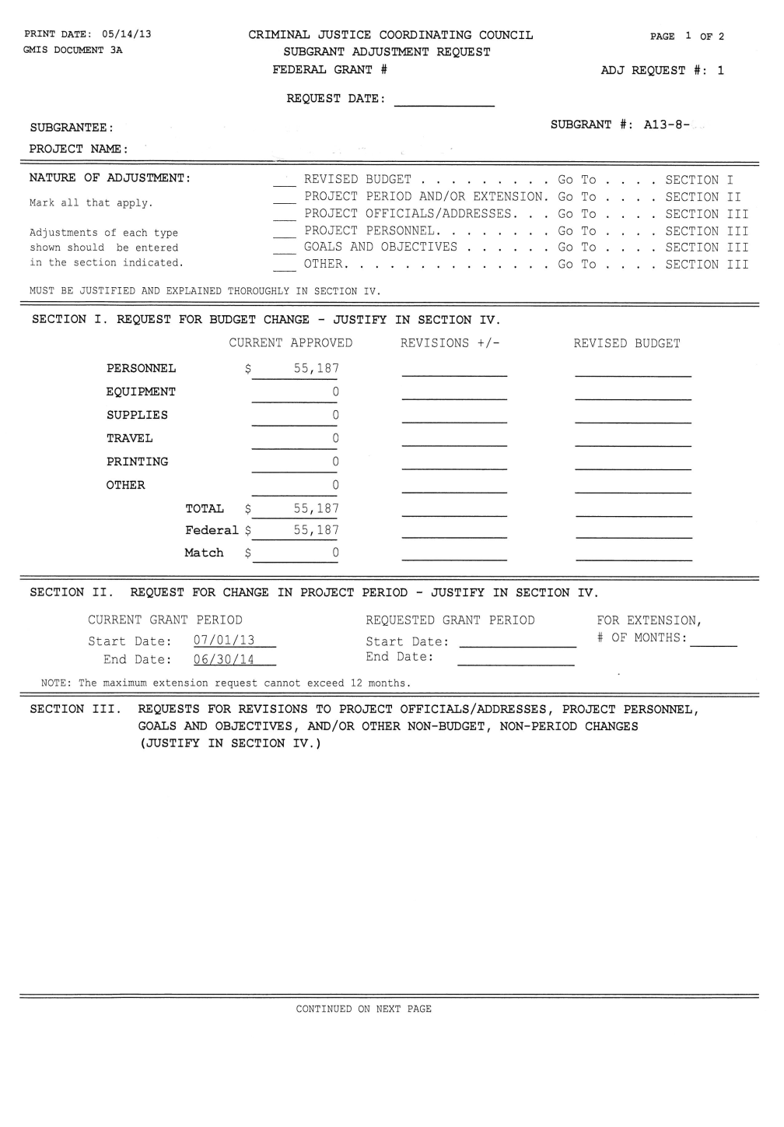
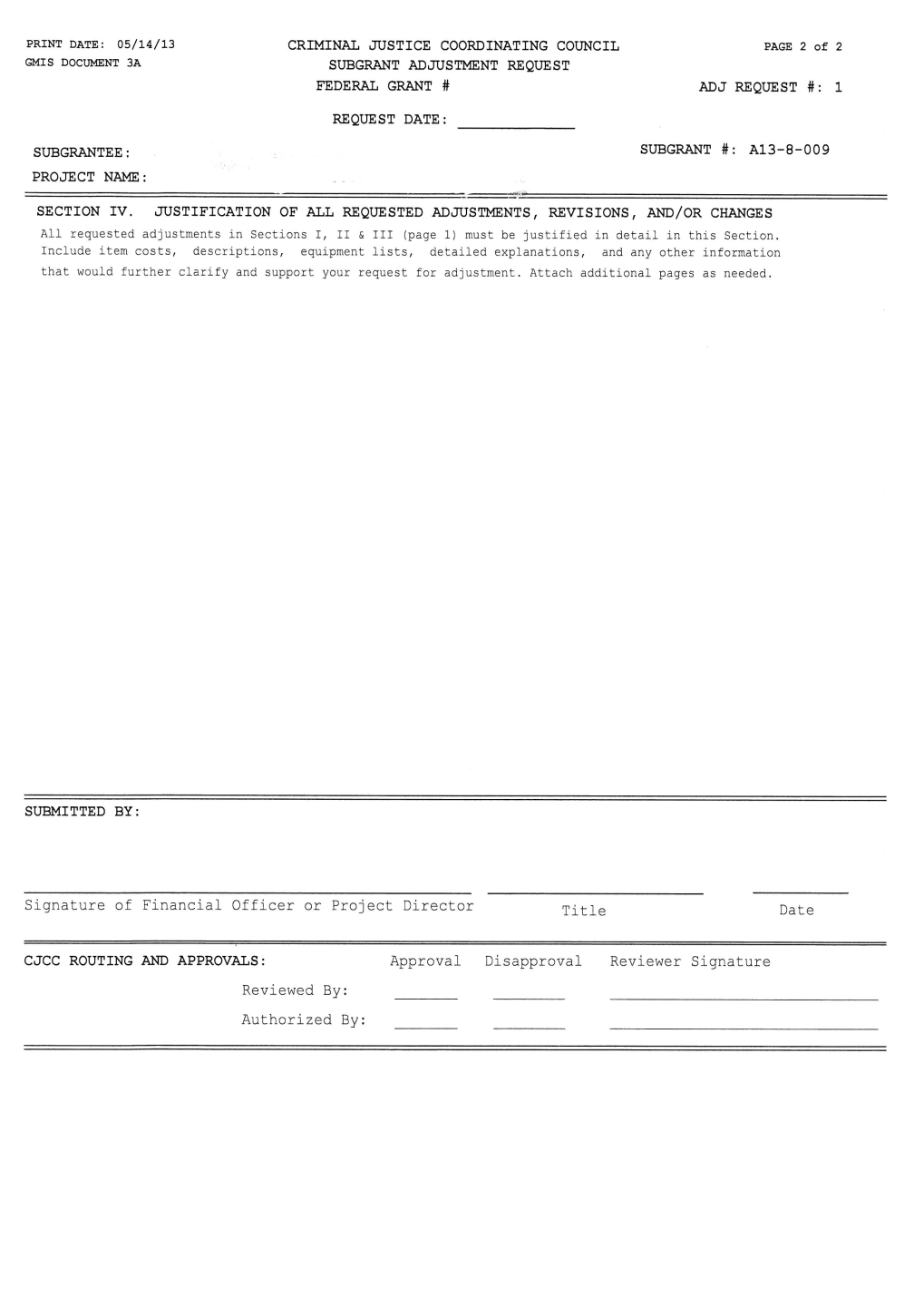
Notes:
Subgrant Adjustment Request illustration

Slide 47

Subgrant Expenditure Report

Slide 48
Subgrant Expenditure Reports (SERs)
Schedule for Submitting Reimbursements:
  Quarterly reports are due 15 days after the end of each quarter
  Monthly reports are 15 days after the end of each month
  All grant-related expenses incurred for the quarter must be listed on submitted SERs to obtain reimbursement
  Expenses must be incurred during the grant period
  (SERs) must be signed by the authorized official or the appropriate designee

Slide 49
Notes:
This illustration shows the form that CJCC must receive back into our office for all reimbursement requests.
The form is commonly referred to as a “turn around document”. Meaning once you submit one, the next SER will automatically be sent to you. So, once you submit SER #1, #2 will be automatically generated and sent to you for future use.

Slide 50
Request for Initial Advance Payment

Slide 51
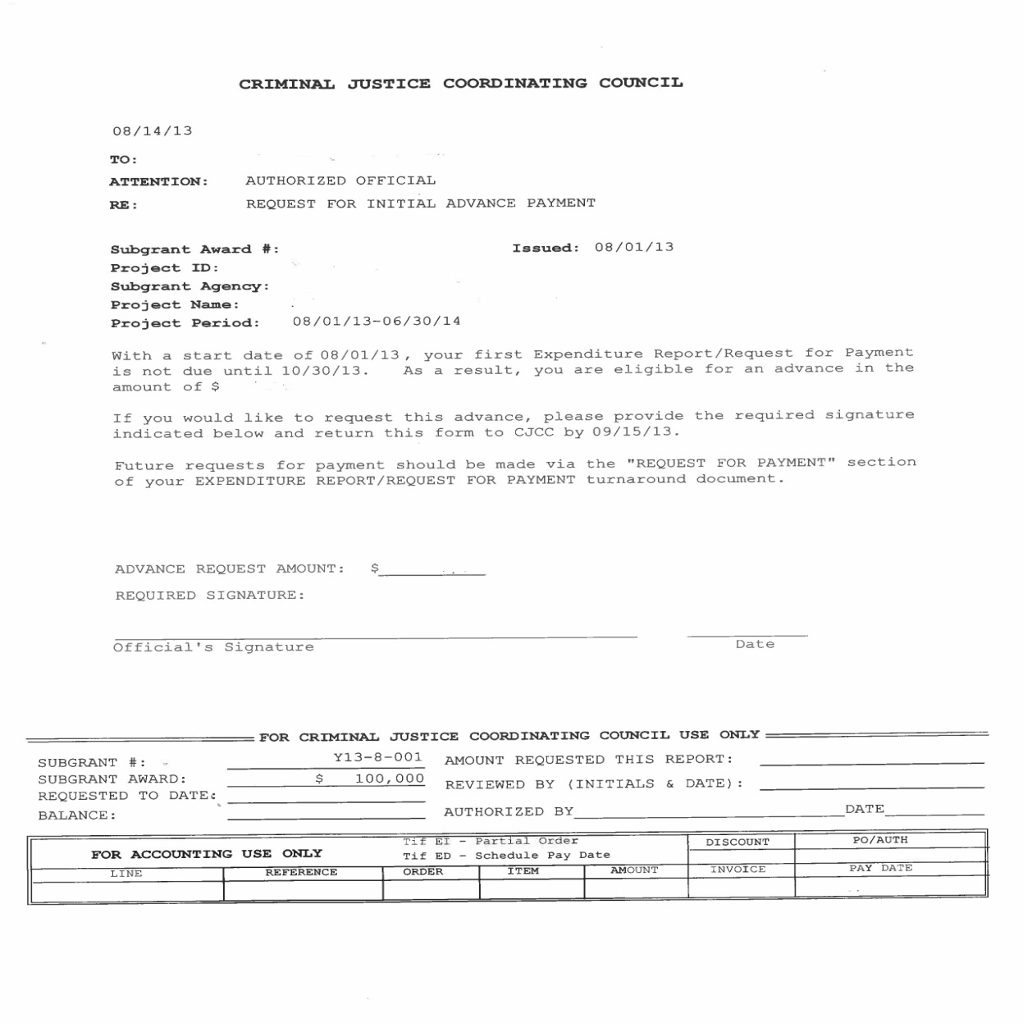
Request for Initial Advance Payment
Notes:
This form will only be included in the award packets for new applicants.
This option will not be available for continuation and enhancement programs.
The Request for Initial Advance Payment allows your court to request an initial advance payment that is equal to 25% of the total award amount recommended by the Juvenile Justice Funding Committee.
If you would like to request this advance please have the document signed by your authorized official and return it to CJCC by the date indicated on the document.

Slide 52
Reimbursement Key Notes
Notes:
Reimbursement Key Notes

Slide 53
If the expense is not listed in your approved budget, you cannot claim it!
Notes:
Recovery Act - Victim Services Workshop
53
One of the most important key notes to remember…. If an expense is not listed in your approved budget, you cannot claim it. Please do not submit any expenses that have not been approved in your budget.

Slide 54
Tips for Successfully Submitting Your Reimbursement Request
Submit the following with each request:
  Subgrant Expenditure Report/Request for Funds Form (turnaround document) signed by the authorized
  official /designee
  Supporting documents
    Categorize all expenses with totals
    Purchase Orders
    Invoices
    Proof of Payment (i.e., check copies)
Notes:
Recovery Act - Victim Services Workshop
54
54
SERs (with original signature) should always be sent via mail.
Please be sure to include supporting documents with your signed SER. Supporting documentation should include purchase orders, invoices, and proof of payment, etc.
Failure to submit supporting documentation may result in an expense being denied.

Slide 55
Links and Resources

Slide 56
Helpful Links & Resources
Criminal Justice Coordinating Council
http://cjcc.georgia.gov
Juvenile Justice Incentive Grant
http://cjcc.georgia.gov/funding-opportunities
Notes:
These are some helpful links and resources.

Slide 57
Contact Information
Matthew Pitts, Grant Specialist
  404-656-5160 Office
  404-656-5601 Fax
  Matthew.Pitts@children.ga.gov
Reginald Boyd, Grant Specialist
  404-657-2073 Office
  404-657-1957 Fax
  Reginald.Boyd@cjcc.ga.gov
Notes:
For questions related to financial reporting please feel free to contact any of the above staff and your questions will be answered in a timely manner.

Slide 58
Contact Information
Website Address
http://cjcc.georgia.gov
Mail: Juvenile Justice Incentive Grant
    Criminal Justice Coordinating Council
    104 Marietta Street, NW, Suite 440
Atlanta, Georgia 30303-2743
Phone: 404-657-1956
Fax: 404-657-1957
Notes:
Recovery Act - Victim Services Workshop
58
58
58
Please make note of CJCC’s website and mailing address as well as our phone and fax number. When sending mail to our office please address it to one of us directly or to the attention of our Grants Division. The agency does receive a large volume of mail for a variety of areas so this is not only important but also helpful when submitting expenditure reports. Please make sure you place your grant number within the context of the mail you are sending.
We also ask that you be mindful of the amount of time it takes to receive mail which in some instances is longer than you actually anticipate, so please allow yourself enough time to get it to us by the deadlines.
When calling please feel free to phone either of us directly. If you’re unsuccessful in your attempt to reach either of us directly, as an option you may call our main line at 404-657-1956 and your call will be directed to an available staff member who can assist you.

Slide 59
Questions?

