Slide 1

Services, Training, Officers, Prosecution Violence Against Women (S.T.O.P. VAWA)
Grant Program
2014 Continuation Application Webinar
Criminal Justice Coordinating Council
Victim Assistance Unit
May 13, 2014

Slide 2
Agenda
Overview
Eligibility
Program Requirements
Budgeting & Allowable Costs
Application Instructions
Timeline
Q & A

Slide 3
Overview
STOP VAWA Formula Grant Program was created under the 1995 Violence Against Women Act
By statute, the STOP Formula Grant Program…
  supports communities in their efforts to develop and strengthen effective law enforcement and prosecution strategies to combat violent crimes against women
  develop and strengthen victim services in cases involving violent crimes against women.
  ONLY covers the crimes of domestic violence, dating violence, sexual assault and stalking

Slide 4
New Allocation Requirements
Notes:
New sexual assault requirement of 20% spread out over at least two allocations that are not “discretionary.” Please remember to highlight your sexual assault programs, which must fit the guidelines and priorities on p.17-18. We’ll be working with GNESA to make sure we meet this allocation per the new VAWA guidelines.

Slide 5
Eligibility
Awards are limited to 2013 Competitive Award recipient organizations
that provide services to victims of or CJ activities to combat DV, dating violence, sexual assault and stalking
and are operated by a public agency, a nonprofit organization, or a combination of such agencies or organizations.

Slide 6
Eligibility (cont.)
Criminal justice agencies
Victim services organizations
Culturally specific organizations
Population specific organizations
Rape Crisis Centers
Religiously-affiliated organizations
Notes:
Criminal Justice Agencies – Law enforcement agencies, prosecutors’ offices, corrections departments, and probation and paroling authorities are eligible to receive VAWA funds to help pay for victims’ services and Criminal Justice Systems Improvement (CJSI) programs dedicated exclusively to cases involving domestic violence, dating violence, sexual assault and stalking. Criminal Justice agencies must collaborate with victim service providers to ensure victim safety, confidentiality and autonomy, and to promote victims’ economic independence.
Per the 2013 VAWA Reauthorization, CJCC must award at least 5% of S.T.O.P. VAWA funds to courts. The “courts” allocation is “to” courts, rather than “for” courts, so the money must be awarded to a court entity. This includes state, local, tribal, and juvenile courts.
“Court” is defined in VAWA as “any civil, criminal, tribal, and Alaska Native Village, federal, state, local, or territorial court having jurisdiction to address domestic violence, dating violence, sexual assault, or stalking, including immigration, family, juvenile, and dependency courts, and the judicial officers serving in those courts, including judges, magistrate judges, commissioners, justices of the peace, or any other persons with decision making authority.” Examples could include a state administrative office of the courts, a state supreme court, a local domestic violence court, a local probation project (in a state where probation is part of the courts). Funds initially awarded to a court can be subcontracted by the subrecipient to other entities for all or part of the grant project.
Victim Service Organizations – Applicants for VAWA Victim Services programs must be a victim service provider as defined in the 2013 VAWA Reauthorization statute. “Victim service provider” means a nonprofit, nongovernmental or tribal organization or rape crisis center, including a State or tribal coalition, that assists or advocates for domestic violence, dating violence, sexual assault, or stalking victims, including domestic violence shelters, faith-based organizations, and other organizations, with a documented history of effective work concerning domestic violence, dating violence, sexual assault, or stalking.
“Victim services” and “services” mean services provided to victims of domestic violence, dating violence, sexual assault, or stalking, including telephonic or web-based hotlines, legal advocacy, economic advocacy, emergency and transitional shelter, accompaniment and advocacy through medical, civil or criminal justice, immigration, and social support systems, crisis intervention, short-term individual and group support services, information and referrals, culturally specific services, population specific services, and other related supportive services.
• Culturally Specific Organizations – “Culturally specific” means “primarily directed toward racial and ethnic minority groups.” The term “racial and ethnic minorities” as defined in section 1707(d) of the Public Health Service Act (42 U.S.C. 300u-6(g)), which means “American Indians (including Alaska Natives, Eskimos, and Aleuts); Asian Americans; Native Hawaiians and other Pacific Islanders; Blacks; and Hispanics1.” Culturally specific services means “community-based services that include culturally relevant and linguistically specific services and resources to culturally specific communities.’’
o Community-Based Organizations - Community-Based Organizations are nonprofit, nongovernmental, or tribal organization that serves a specific geographic community.
• Population Specific Organizations – “Population specific organization” means a nonprofit, nongovernmental organization that primarily serves members of a specific underserved
population and has demonstrated experience and expertise providing targeted services to members of that specific underserved population. “Population specific services” means victim-centered services that address the safety, health, economic, legal, housing, workplace, immigration, confidentiality, or other needs of victims of domestic violence, dating violence, sexual assault, or stalking, and that are designed primarily for and are targeted to a specific underserved population.
• Rape Crisis Centers – “Rape crisis center” means a nonprofit, nongovernmental, or tribal organization, or governmental entity in a State other than a Territory that provides intervention and related assistance to victims of sexual assault without regard to their age. In the case of a governmental entity, the entity may not be part of the criminal justice system (such as a law enforcement agency) and must be able to offer a comparable level of confidentiality as a nonprofit entity that provides similar victim services.’’
• Religiously-Affiliated Organizations – Organizations receiving VAWA funds must ensure that services are offered to all crime victims of domestic violence, dating violence, sexual assault or stalking without regard to religious affiliation and that the receipt of services is not contingent upon participation in a religious activity or event. Faith-based and community organizations will be considered for awards as are other eligible applicants, and if they receive assistance awards, will be treated on an equal basis with all other grantees in the administration of such awards. No eligible applicant or grantee will be discriminated against on the basis of its religious character or affiliation, or religious name. Faith-based and community organizations are required to abide by the same regulations and requirements specifically associated with the program under which they are awarded a grant, as any other agency awarded funding.

Slide 7
Other Eligibility Highlights
25% match for criminal justice agencies
Help applying for CVCP
Compliance with federal and state regulations
Services to victims of federal crimes
Promote victim safety
Prohibit polygraph testing
Notes:
Mention fiscal accountability; EEOP; Civil rights; LEP plan; Nondiscrimination; federal forms and assurances; CJCC compliance policies and award packet forms

Slide 8
Other Eligibility Highlights
Record of effective services
Promote community efforts to aid victims
No charges to victims receiving VAWA-funded services
Nondisclosure of confidential and private information
LVAP 5% certification
Legal assistance requirements
Notes:
• Legal assistance - Under purpose area 5, as amended, states can now provide a full range of legal services, such as housing, family law, public benefits, and other similar matters. Any subgrantee providing legal assistance must certify that:
1) any person providing legal assistance with STOP funds
a. has demonstrated expertise in providing legal assistance to victims of domestic violence dating violence, sexual assault, or stalking in the targeted population; or
b. i. is partnered with an entity or person that has such demonstrated expertise and
ii. has completed or will complete training in connection with domestic violence, dating violence, stalking, sexual assault, and related legal issues, including training on evidence-based risk factors for domestic and dating violence homicide;
2) any training program conducted in satisfaction of the requirement of paragraph (1) has been or will be developed with input from and in collaboration with a tribal, state, territorial, or local domestic violence, dating violence, sexual assault, or stalking victim service provider or coalition, as well as appropriate tribal, state, territorial, and local law enforcement officials;
3) any person or organization providing legal assistance through the STOP program has informed and will continue to inform state, local, or tribal domestic violence, dating violence, or sexual assault programs and coalitions, as well as appropriate state and local law enforcement officials of their work; and
4) the subgrantee’s organizational policies do not require mediation or counseling involving offenders and victims physically together, in cases where sexual assault, domestic violence, dating violence, or child sexual abuse is an issue.

Slide 9
Program Requirements
All VAWA Subgrantees | Victim Services projects only | CJSI and Discretionary projects only
Subgrant Expenditure Requests (SER) Select monthly or quarterly | Victim Services Statistical Report (VSSR) Due January 30, April 30, July 30 and October 30 | Criminal Justice Services Statistical Report (CJSSR) Due January 30 and July 30
Annual report Due February 15 | Outcome Performance Measures (OPM) Due May 30 and November 30

Slide 10
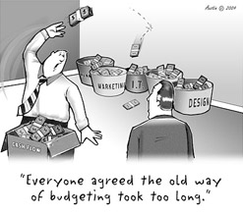
Budgeting and Allowable Costs

Slide 11
What is the purpose of a budget?
Accountability
Ensures that your agency’s plans are communicated clearly to CJCC
Should be consistent with your narrative and proposed goals
Must use Excel Worksheet this year
***CJCC will not pay for expenses that are not in the approved budget***

Slide 12
Personnel
Includes employees, volunteer time and over-time
Gross Pay, FICA & Fringe benefits (e.g. Retirement)
Amount claimed this period
      Gross pay x % of time = amount claimed
      ($1,000 x 80% = 800.00)
Volunteer time valued at $12 per hour
Volunteer dollars recorded in “Volunteer” column carried over from Volunteer Monthly Time Record
Notes:
Recovery Act - Victim Services Workshop
12
12
The Personnel budget line item include all expenses related to employees, volunteer time and overtime. This includes all gross and fringe benefits. Gross is determined by the percentage of time an employee spends on this grant. Excel calculates this by multiplying the gross pay times the percentage of time spent working on the grant.
Additionally, please note that volunteer time is valued at $12 an hour and volunteer dollars recorded in the volunteer column should be carried over from the volunteer monthly time record. If an agency is interested in increasing the value of volunteer time, a formal request must be submitted, with substantial evidence of why the value should be increased.

Slide 13
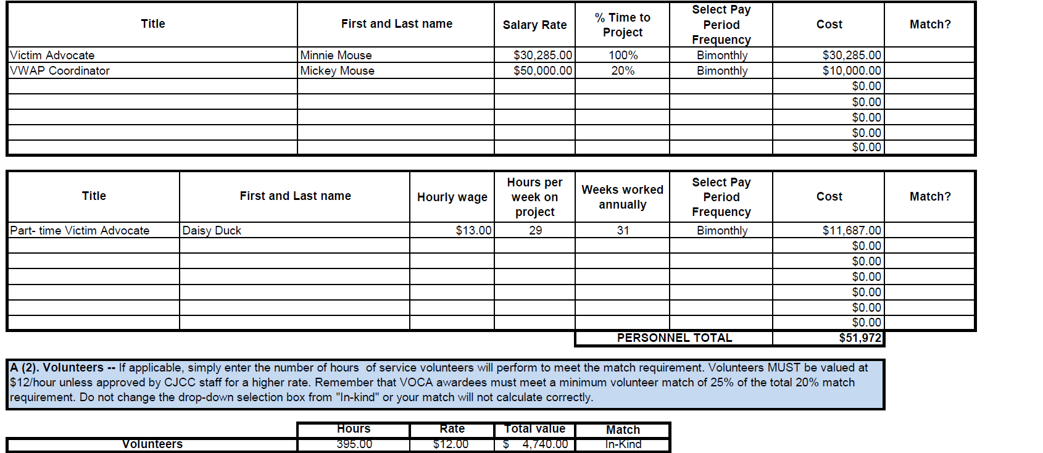
A. (1) Personnel/Salaries

Slide 14
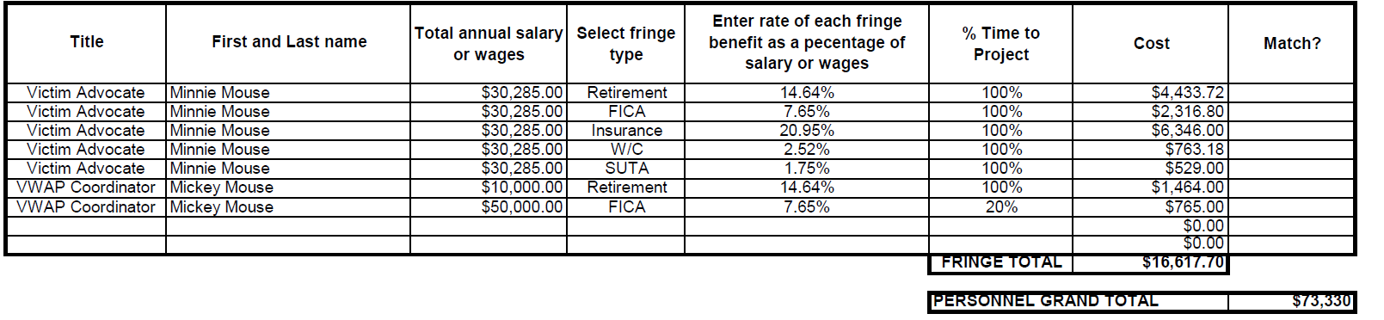
A. (2) Personnel/Fringe Benefits
Notes:
Had to play around with the numbers for the VWAP Coordinator’s Retirement benefit. May be a good time to point out to the subgrantees that they will have to play around with the numbers to ensure that they get the correct percentages for each benefit.

Slide 15
Travel Expenses
Must abide by State of Georgia Travel Regulations/Local/Federal Travel Regulations
    http://sao.georgia.gov/state-travel-policy
    http://gsa.gov/perdiem
Prior approval for out-of-state travel
Lodging, airfare, transportation/cab fare and meals
Mileage – show number of miles x approved rate
Expenses must be supported with receipts
Record Mileage log
Training related expenses – all trainings for which you would like to be reimbursed submitted 30 days prior to paying registration
Notes:
Recovery Act - Victim Services Workshop
15
15
All travel expenses must abide by state travel regulations and local policy. Please keep in mind that you must abide by WHICHEVER policy IS MOST STRICT. Lodging, airfare, transportation/cab fare and meals should be claimed as travel expenses. You may only claim expenses that you have a line item for in your budget. If you were approved for miscellaneous conferences/trainings, you must receive prior approval from CJCC to attend. The description for mileage needs to show the # of miles times the approved rate, the approved state rate for Georgia is currently $ .51 a mile (effective 1-1-11). Also, the description must indicate who traveled and why the employee was traveling. If an agency mileage rate changes, you must submit a copy of the new travel policy to CJCC. All expenses must be supported with detailed receipts. The receipts may be kept on file at your office. Do not send these items with your report unless you have been specifically asked to do so. Your mileage logs must show dates of travel, the # of miles traveled, the name of the person traveling and for what reason. The Travel tab in the excel worksheet should be completed just as the Supply tab.

Slide 16
Travel Guidelines- Things to Remember!!
Funding is not authorized for lodging within 50 miles of the subgrantees’ place of business
Funding is not authorized for meals within thirty (30) miles of the subgrantees’ places of business, and when traveling outide a thrity-mile radius, the employee must be away for more than 12 hours
According to the Federal Travel Regulation (FTR), travelers are entitled to 75% of the prescribed meals and incidental expenses for the first and last day of travel.
Notes:
Monique will provide an activity that will show how travel guidelines effect the submission of SERs.

Slide 17
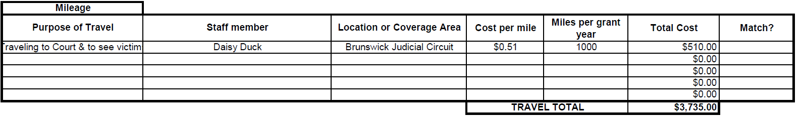
B. Travel

Slide 18
Equipment Expenses
Item must cost $5,000 or more to be considered as equipment
Copy of invoice for equipment must be attached to the reimbursement
Equipment inventory list maintained
Equipment purchases must be approved before purchasing
Cost of equipment not exclusively used for VOCA activities must be prorated
Notes:
Recovery Act - Victim Services Workshop
18
The Equipment tab follows the Personnel tab. Equipment expenses capture expenses that cost $5,000 or more. To be reimbursed for equipment expenses a copy of the invoice must be attached to the reimbursement. In addition, all equipment purchases must be approved before the purchase and an equipment inventory list must be maintained for your files. The Equipment tab should be completed just as the Supply tab.

Slide 19
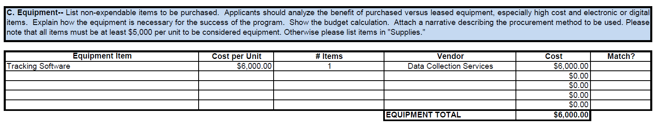
C. Equipment

Slide 20
Supplies
Description of expense
    “Office supplies” – listed in budget detail
    Postage
    All “equipment” under $5,000
Receipts for expenses must be maintained at your agency
Notes:
Recovery Act - Victim Services Workshop
20
20
The Supplies tab follows the Personnel tab. Supplies only includes the list of approved items listed in the application packet. If an item for which you are seeking reimbursement is not on that list or not specifically approved as an additional line item in your budget, you cannot claim the expense.

Slide 21
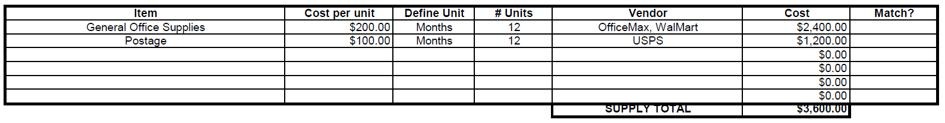
D. Supplies

Slide 22

Printing/Media
Acknowledge funding source
      Wording located in subgrantee manual – may depend on whether entire publication or only portions are funded --“This project is supported by Award No. _____ awarded by the Office for Victims of Crime, office of Justice Programs and administered by the Criminal Justice Coordinating Council”
Provide example 30 days before purchase for budget approval
Submit copy of final brochures, etc with request for reimbursement
Notes:
Recovery Act - Victim Services Workshop
22
22
All printed materials must include an acknowledgement of the funding source. An example of the material must be submitted to CJCC to receive budget approval of all printing. For a printing expense to be approved for reimbursement the final copy of the printed material must be submitted with your SER. The Printing tab should be completed just as the Supply tab.

Slide 23
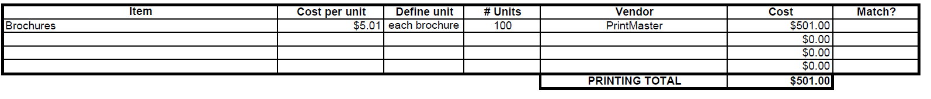
E. Printing

Slide 24
Other
Rent, Local/Long distance, Cell phone, Utility bill (time periods should be noted in description)
Copy of contractual/consultant agreement should be submitted to CJCC and kept on file
Notes:
Recovery Act - Victim Services Workshop
24
24
The last tab of the Excel SER is labeled Other. Other expenses include items such as rent, local/long distance, cell phone, and utility bills. The period for each of these expenses should be noted in the Description column. A copy of the contract for all professional services must be on file prior to reimbursing contractual related expenditures. For all contractual services, the description column should also include the number of hours being claimed times the approved rate. The Other tab should be completed just as the Supply tab.

Slide 25
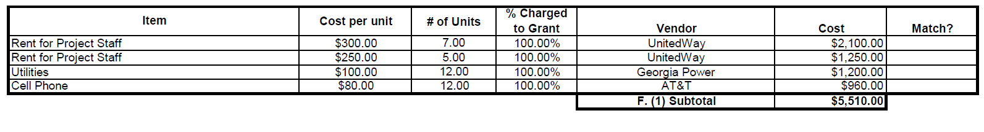
F. (1) Other/Costs

Slide 26
Contractual/Consultant Policies
Fees cannot exceed $450/day or $56.25/hour
Written contract
      Services to be performed
      Rate of compensation – should be reasonable according to past billing history or market rate (submit samples to CJCC)
      Length of time services will be provided
Payment for services rendered
Services during contract period
Notes:
Recovery Act - Victim Services Workshop
26
26
Fees for services cannot exceed $450 a day. A written contract must be submitted prior to being able to receive reimbursement for the contractual expense. All contracts must outline the scope of services, the rate of compensation and length of time the services will be provided. Additionally, all payments for contractual services must be supported by statements or invoices for services rendered. Please note that all services must be performed during the contract period.

Slide 27

F. (2) Other/Consultants

Slide 28
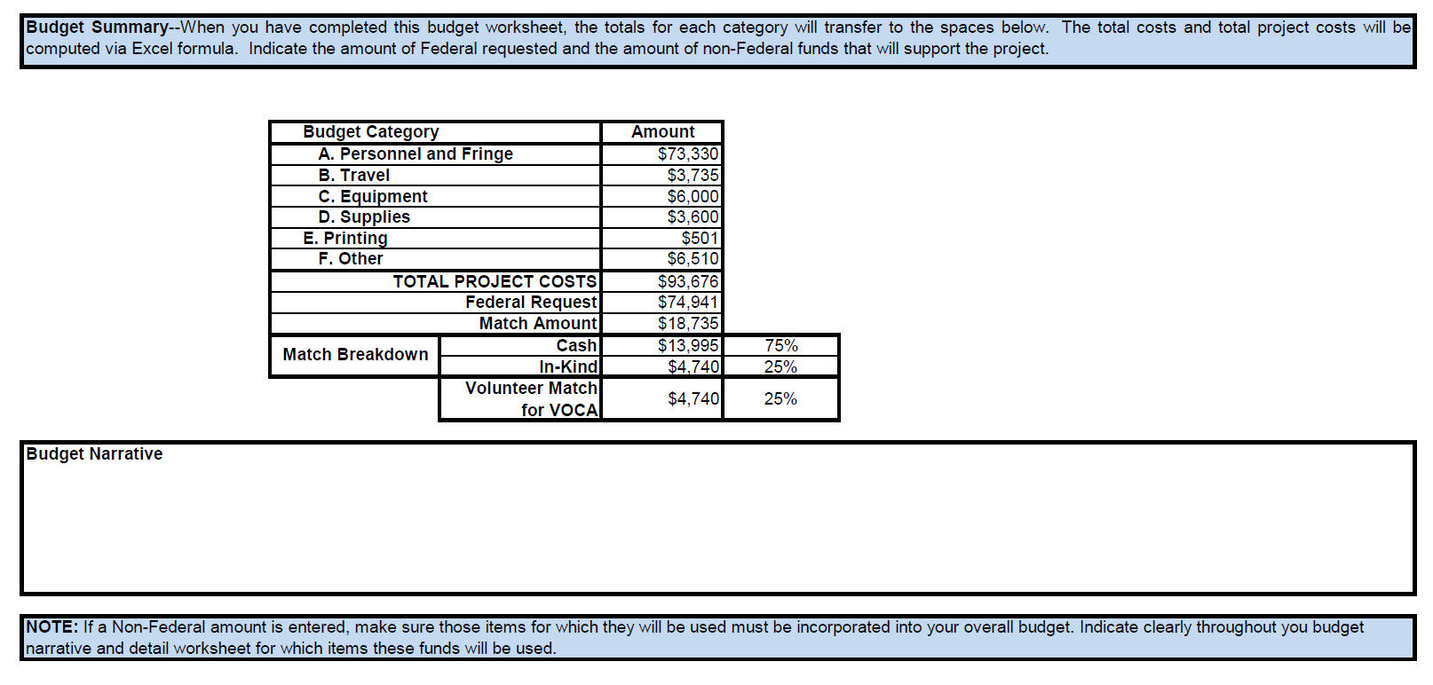
Budget Summary

Slide 29
Matching Funds – VAWA Criminal Justice Agencies ONLY
Situation | Match is waived for the subgrantee | 25% match is required
Award to victim service provider for victim services | X
Award to victim service provider for another purpose (for example law enforcement training) | X
Award to tribe | X
Awards to courts, law enforcement, prosecution |  | X
Notes:
Recovery Act - Victim Services Workshop
29
29
VOCA sub-grantees are the only sub-grantees required to submit 20% match. Anything used as local match is subject to the same restrictions as federal funds. Cash and in kind match are acceptable for your victim services grant. Cash match is any allowable item or service paid for by the agency. In-kind match is a donation of tangible goods, services or work space including allowable volunteer time. Please note match needs to be included in the budget when you complete your first budget adjustment. Your first budget adjustment form can be found in your award packet.

Slide 30
Matching Funds (cont.)
Same use as federal funds
Expended/obtained during contract period
Records of match maintained
    Source
    Amount
    Period used
    Contracts should be current
Notes:
Recovery Act - Victim Services Workshop
30
All match must be expensed during the contract period of this grant and meet all federal regulations. In addition, match records must show the source of matching funds and services, the amount of matching funds, and the period in which match was expensed. All volunteers must complete a volunteer contract and the contract must be current. Volunteer contracts are available for you on our website. Also, please remember to report local match as expenses are incurred, this includes volunteer match. If local match reported is insufficient at the end of the contract period, your agency will have to repay CJCC the amount of federal funds that were overpaid to your organization.

Slide 31
Matching Funds (cont.)
25% of Total Project Cost
  Cash – any allowable item or service paid for by the agency.
  In-Kind – a donation of tangible expendable goods, services or work space including allowable volunteer time.
Notes:
Recovery Act - Victim Services Workshop
31
31
VOCA sub-grantees are the only sub-grantees required to submit 20% match. Anything used as local match is subject to the same restrictions as federal funds. Cash and in kind match are acceptable for your victim services grant. Cash match is any allowable item or service paid for by the agency. In-kind match is a donation of tangible goods, services or work space including allowable volunteer time. Please note match needs to be included in the budget when you complete your first budget adjustment. Your first budget adjustment form can be found in your award packet.

Slide 32
Unallowable Expenses
Non-budgeted items
Bonuses
Entertainment (including food)
Alcohol
Fundraising
Non-grant related Accounting/Bookkeeping expense
Renovations/construction – unless making services ADA compliant (e.g. wheelchair ramp)
See p. 22-23 of RFA for more allowable and unallowable costs
Notes:
Recovery Act - Victim Services Workshop
32
Bonuses, entertainment, alcohol, fundraising costs, accounting and bookkeeping as well as renovation expenses are some of the expenses NOT allowable for both the VOCA and STOP VAWA grants.

Slide 33
Online Application Instructions
Agencies with more than one 2013 award must submit an application for each grant number to receive continuation funding for that award
Applicants will not be able to log out or log back in once the application is started
CJCC recommends that each applicant compile all information requested in this RFP before beginning the online application
Allow 2-3 hours for completion

Slide 34
Online Application Instructions
Technical difficulties or emergency circumstances? Contact Shontel Wright immediately at Shontel.Wright@cjcc.ga.gov or 404.657.1961
Applications must be submitted by 11:59pm on Saturday, May 31, 2014.
There is no commitment on the part of CJCC to fund an application or to fund it at the amount requested.

Slide 35

Completing the Online Application

Slide 36

Common Errors
Wrong grant number
Budget format
Miscalculating match
Wrong agency name
Unallowable and unreasonable costs
Not submitting the attachment(s)
“Mixing” victim services and CJSI

Slide 37
Continuation Award Timeline
Milestone | Target Date
Release RFA and open application | May 1, 2014 (Done May 2, 2014)
Application closes | May 31, 2014
CJCC staff review | June 1-30, 2014
Target dates for Committee and Council Meetings | July 1-15, 2014
CJCC sends award packets to subgrantees | August 1, 2014
Award packets due to CJCC | September 15, 2014
Start of VOCA grant year | October 1, 2014
Start of VAWA and SASP grant year | January 1, 2015

Slide 38
Q & A
?

Slide 39
Conclusion
Remember to read the RFA carefully and CONTACT us! We’re here for you!
Betty Barnard – betty.barnard@cjcc.ga.gov – 404-654-5691
Jonathan Peart – peart.jonathan@cjcc.ga.gov – 404-657-1973
Shontel Wright – shontel.wright@cjcc.ga.gov – 404-657-1961
Thank you - we appreciate your service and dedication to victims in Georgia

