Slide 1
Criminal Justice Coordinating Council
THE STATE OF GEORGIA
OUTCOME PERFORMANCE MEASURES REPORT WEBINAR
Semhal Hadgu, Statistical Analysis Center Research Analyst

Slide 2
CJCC | Today’s Objectives
Outcome Performance Measures (OPM) Overview
What is the OPM and why is it important?
Who’s required to report?
Measures collected
Standardized survey tools
Survey Administration
OPM Due Date
Using OPM Data
Helpful Tips
Report Demo
Resources
Q & A

Slide 3
CJCC | OPM Overview
What is the Outcome Performance Measures Report (OPM)?
The OPM is a report administered by CJCC that collects aggregated agency performance outcome and client satisfaction data.
What are Outcomes?
The desired results of programs
The difference made
Changes in victims’…
Knowledge
Skills
Attitudes
Behaviors
Conditions

Slide 4
CJCC | OPM Overview cont.
Why is the OPM Report important?
Shows program effectiveness
Determines need for service improvement
Allows for benchmarking data
Who’s required to complete this report?
All VOCA, VAWA, and SASP subgrantees who deliver direct services to clients who are victims of crime, and whose contact with clients is more extensive than a single telephone call or other distribution of information (hotlines).
Notes:
Monitoring, accountability and case for continued and increased funding
Measuring results is as important as measuring our efforts
Determining how well our programs perform is as important as documenting how hard we work
We can document whether (and how) victims are improving
We can show the program is effective

Slide 5
CJCC | OPM Measures
CJCC outcome measures address the four core purposes for services under the Victims of Crime Act:
Emotional Needs: respond to the emotional and physical needs of crime victims;
Life Stability: assist primary and secondary victims of crime to stabilize their lives after a victimization;
Understanding/Participating in Justice System: assist victims to understand and participate in the criminal justice system; and
Safety and Security: provide victims of crime with a measure of safety and security such as boarding-up broken windows and replacing or repairing locks.
The fifth measure addressed is Service Quality

Slide 6
CJCC | OPM Surveys
14 Survey Types
Adult Victim Counseling
Court Appointed Special Advocates
Domestic Violence Shelter
Family/Child Counseling
Legal Advocate
Legal Services
Law Enforcement Victim Witness Assistance Program
Prosecution Victim Witness Assistance Program
Sexual Assault Center
Child Advocacy Center/Sexual Assault Center
University Domestic Violence Shelter
University Sexual Assault Center
CJCC OPM Mentoring Program for Children
CJCC OPM Mentoring Program for Young Adults
How were the surveys created?
10-month long developmental process
Advisory groups represented each major type of program
Feedback from individual subgrantees incorporated
Notes:
Spanish translations available

Slide 7
CJCC | OPM Survey Administration
Survey Administration Guidelines:
Okay to customize the survey layouts to make it your own
Okay to add agency name and/or logo
Okay to include additional measures
Okay to use different surveys for different service types or for children and adult clients
Okay to help respondent by explaining and/or reading the question(s)
NOT okay to change the wording of the surveys
NOT okay to change the 5-point scale
NOT okay to delete any questions
NOT okay to answer questions on behalf of the client(s)
Notes:
If you have suggestions for edits, let CJCC know. We’re always open to feedback, but revisions take time, coordination and a great deal of consideration.
If a victim you served in the past returns to your agency as the result of a new victimization/occurrence, you would give another survey once they “substantially completed the program of service” again
Explain that the survey is confidential, not mandatory, has no bearing on service delivery and carries no penalties

Slide 8
CJCC | OPM Survey Administration cont.
Give to all clients “who have substantially completed the program of service” your agency offers
“Substantial completion” is defined by program’s design
If you require assistance to determine what your program design is, or build your logic model we are here to help
Distribute surveys to all clients, not just grant-funded clients
If a client returns to agency as a result of a new victimization/occurrence, you would give him/her another survey once the program has been completed again.
Explain that the survey is confidential, not mandatory, has no bearing on service delivery and carries no penalties
Notes:
If you have suggestions for edits, let CJCC know. We’re always open to feedback, but revisions take time, coordination and a great deal of consideration.
If a victim you served in the past returns to your agency as the result of a new victimization/occurrence, you would give another survey once they “substantially completed the program of service” again
Explain that the survey is confidential, not mandatory, has no bearing on service delivery and carries no penalties

Slide 9
CJCC | OPM Survey Administration cont.
How should the surveys be collected?
Give to client to complete at near-final in-person contact (best)
Avoid using staff, have volunteers or interns provide in-person (best)
Phone interview with client (good)
[NOTE: For best chance of honest self-report, please have a staff who is not the person with whom the victim worked most closely call]
Provide online and Email to client (OK, and easy to follow-up)
Mail to client (not recommended because of low response rates)
In writing or verbally – if client has literacy barriers, please read to him/her
In sum, whatever works best for the victim and is feasible for your agency

Slide 10
CJCC | OPM Survey Administration cont.
What if client is a child/LEP/has a disability?
Third parties such as non-offending caregivers (NOCs), guardian ad litems (GALs), and interpreters may assist clients
Avoid having agency staff complete for the victim (compromises credibility)
Volunteer coordinators are responsible for completing CASA surveys
Spanish translations available
Notes:
A “guardian ad litem” (GAL) is a person the court appoints to investigate what solutions would be in the “best interests of a child.” . CASA outcome surveys are a measure of volunteer’s ability to intervene on the child’s behalf and provide that child with services in their best interest.

Slide 11
CJCC | OPM Due Date
Reporting Period | Due Date
October 1 – September 30 | October 30
Repeated lateness or failure to complete may result in penalties such as reductions to your award.
A notification email is sent to EDs on or around the 1st of the month prior to the reporting deadline.
User IDs and passwords are assigned to each newly awarded agency. These credentials are permanent and are used for both your OPM and VSSR.
Notes:
Note: The process for PAC offices differs slightly, in that PAC distributes the login information to each individual PAC office.

Slide 12
CJCC | Utilizing OPM Data
How should OPM data be used?
Discuss results at staff meetings
Develop your program
Launch a formal evaluation
Use in strategic plans
Cite in grant proposals

Slide 13
CJCC | Helpful Tips
If you did not collect or receive any surveys this reporting period, you must still complete the report. Just enter “0” for all fields.
OPMs are for CJCC’s info and your agency’s quality control. We do not penalize you for lack of data or poor outcomes!
If you cannot complete the entire survey in one session, you can return where you left off.
Once you close your web browser, the system will remember where you left off, but you must wait at least 10 minutes before logging on again. If you do NOT close your web browser and leave your session idle, your report will be timed out. You will need to contact Semhal Hadgu to refresh your report.
If your agency has multiple programs, all programs should use the same login. Multiple reporters will need to coordinate entering in data.

Slide 14
CJCC | OPM DEMO
OPM DEMO
Notes:
The OPM has just 3 main sections – agency information, use of survey results, and the data reporting section

Slide 15
CJCC | Administering and Tracking
Mailed and offered online
Mostly over the phone, or a combination
Tracking through CaseWorthy, the tracking spreadsheet, or a quarterly report

Slide 16
CJCC | Questions and Concerns
Language barriers
1-25% complete the OPM
Difficulty knowing when to administer the survey
Finding a better fit for your agency/more flexibility

Slide 17
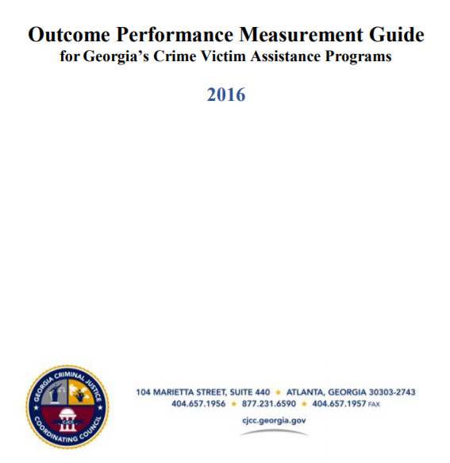
CJCC | Resources: OPM Guide
Surveys located in OPM Guide and on CJCC website.

Slide 18
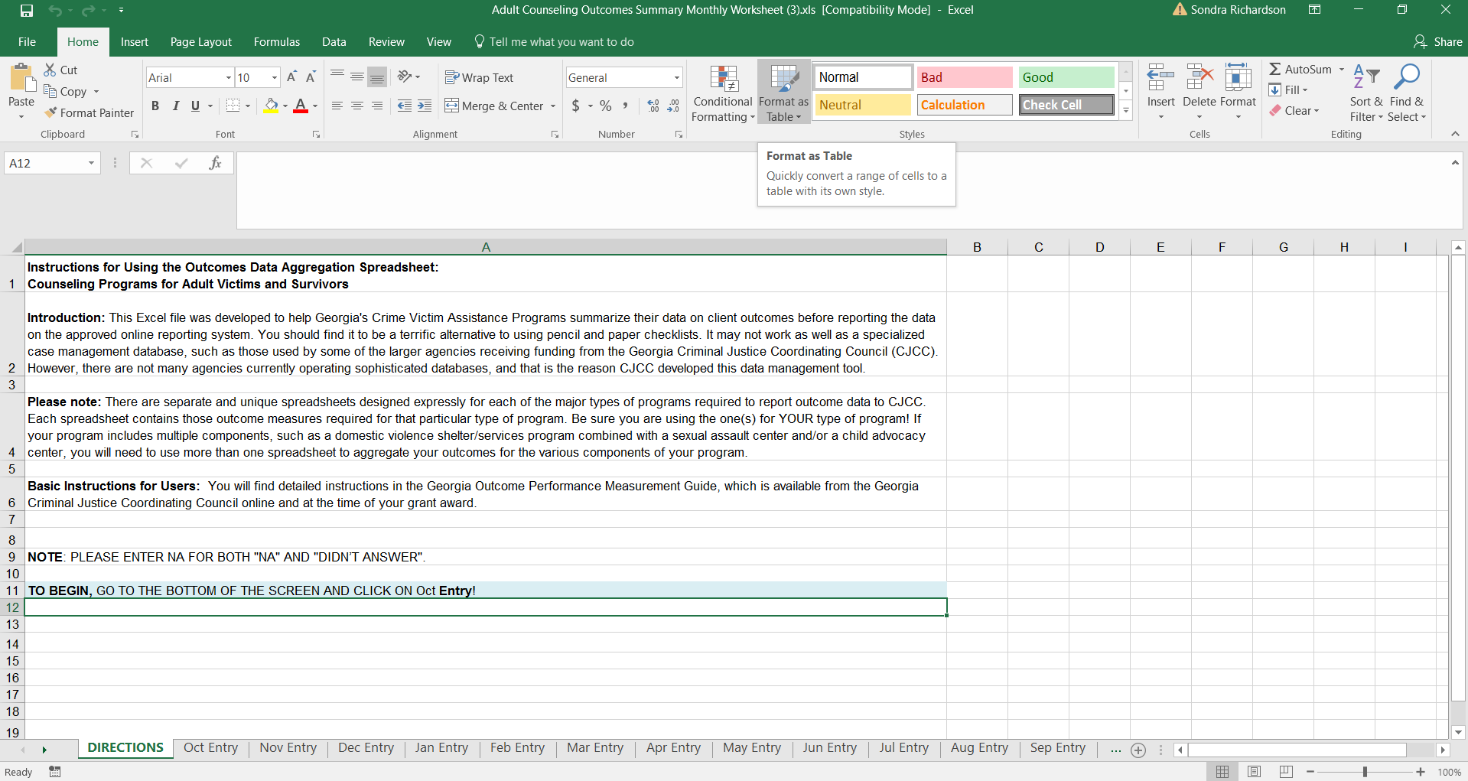
CJCC | Resources: OPM Monthly Summary Worksheets
Excel “Monthly Summary” spreadsheets available on CJCC website
to assist with tracking outcomes.

Slide 19
CJCC | Resources: CJCC Website
https://cjcc.georgia.gov/outcome-performance-tools-2

Slide 20
Criminal Justice Coordinating Council | THE STATE OF GEORGIA
Questions?
Semhal Hadgu
Research Analyst, Statistical Analysis Center
Semhal.hadgu@cjcc.ga.gov
Scott Burnett
Research Analyst, Statistical Analysis Center
scott.burnett@cjcc.ga.gov

Slide 21
Criminal Justice Coordinating Council | THE STATE OF GEORGIA

