Slide 1
Breakout Session
Financial Reporting (SERs)
October 2013
Notes:
Recovery Act - Victim Services Workshop
1
1
All sub-grantees are required to submit a monthly or quarterly expenditure report which basically lets us know what your expenditures were for the month, or the quarter, and how much we owe you. When you receive your award packet you’ll have an opportunity to select whether you wish to submit your expenditures on a monthly or quarterly basis.
There are 2 forms you’ll have to work with on regular basis if your VAWA, 4 if you’re a VOCA recipient:
SER form (VAWA/VOCA)
SER Excel Spreadsheet (VAWA/VOCA)
Volunteer Time Record (VOCA)
Contracts (VOCA)
1

Slide 2
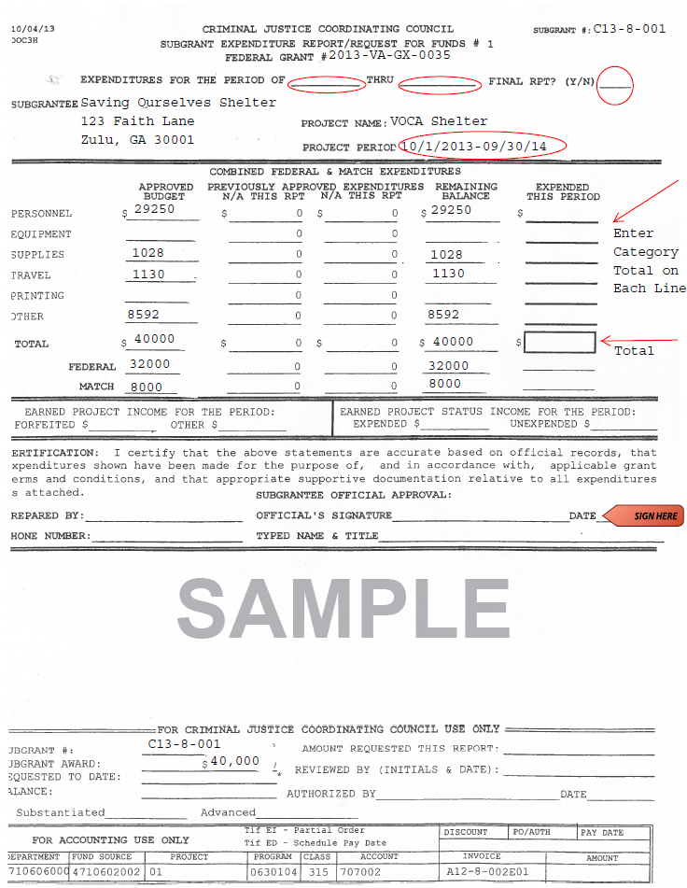
Notes:
SER Form – must sign/date and submit original hardcopy in person or by via mail:
Only the Authorized Official can sign this form; or the individual who has been granted signing authority by the Authorized Official.

Slide 3
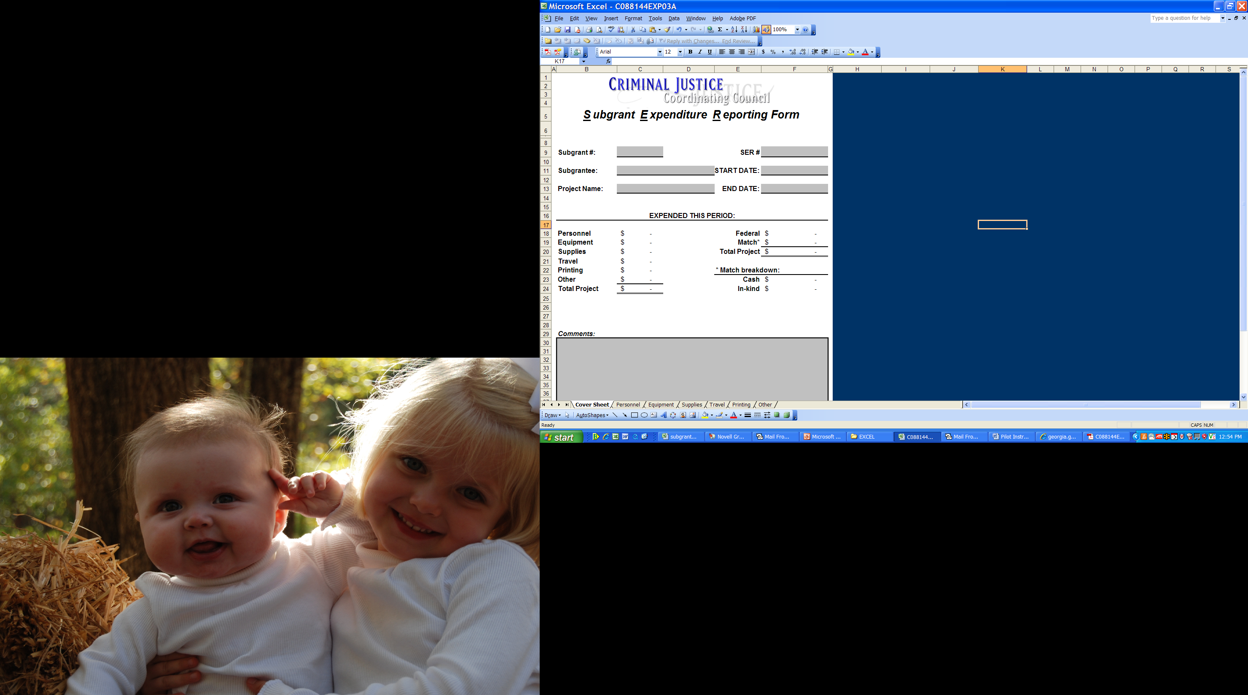
Notes:
SER Excel Spreadsheet – you should e-mail this spreadsheet to your assigned auditor/grants specialist and/or can mail this document along with the SER form

Slide 4
Notes:
If you have a VOCA award, you’re required to submit 25%, of the total 20% match requirement, in volunteer in-kind match. So, at some point you’ll need to complete a volunteer time sheet and volunteer contract; you may mail and/or e-mail this document

Slide 5
CJCC Grants Administration
Agency Name:
Month & Year:
Subgrant No.:
Date | Volunteer Name & Description of Duties in "Other" Category | Hours

Slide 6
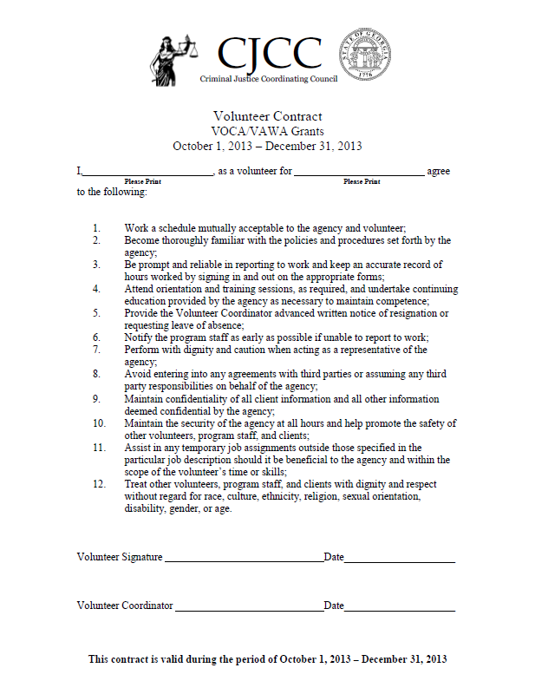
Notes:
Keep note that your volunteer contracts should be current

Slide 7
Documentation Requirements
Timesheets are required for all grant funded personnel
Timesheets must capture:
  Activities/duties performed during time worked
  All time worked
Maintain all records at your agency including
  Employee Timesheets
  Invoices
  Receipts
  Travel Logs
Keep grant-related records for at least 3 years after grant closes
Notes:
Recovery Act - Victim Services Workshop
7
7
We don’t require documentation up front along with your SER (which includes grant funded employee timesheets, receipts, invoices, travel logs) but you should keep those documents on file in we ask for it or have them readily available during a site visit or desk review;
After the end of the grant year you must keep all grant-related records for at least 3 years

Slide 8
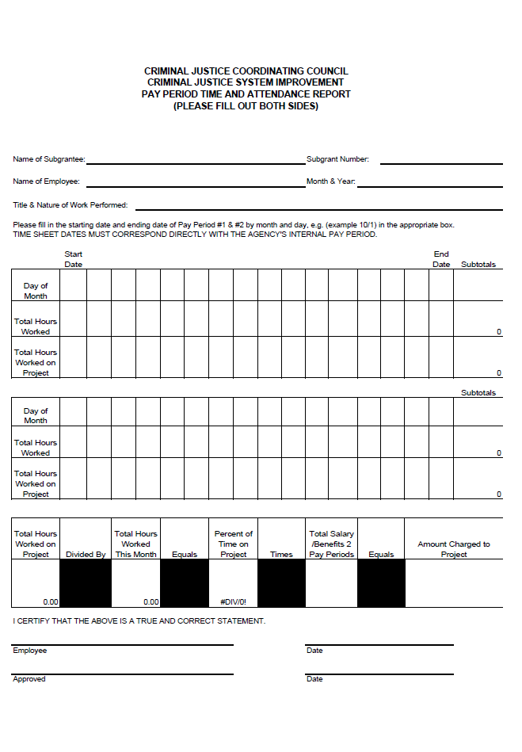
Notes:
All personnel on the grant are required to keep detailed timesheets. These timesheets must list the activities being performed. The timesheet should include all of the person’s time, not just the time spent on grant funded activities. There is a sample timesheet you may use, available on our website if applicable, or you may develop one for your agency.
Employee Time Sheet
Hours worked on project and total hours – it’s important to remember report all your hours worked for the pay period even if those hours were not dedicated to the project. The hours you wish to report under the grant should be reflected in the hours worked on project; your timesheets should mirror the hours submitted in your SER

Slide 9
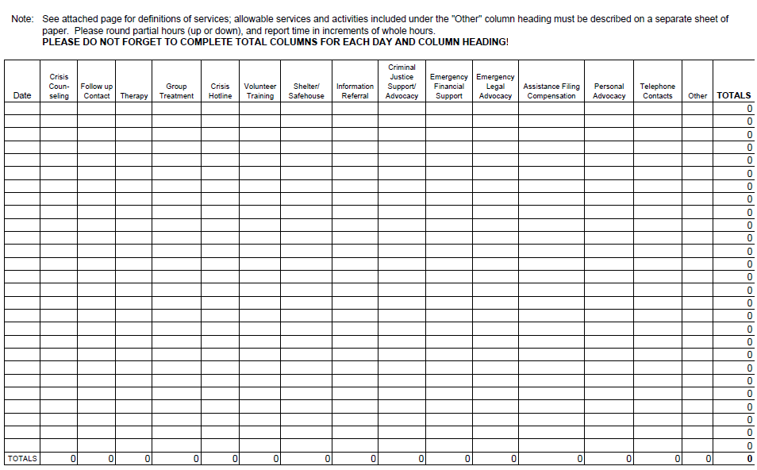

Slide 10
Subgrant Expenditure Report [SER]
Transfer Excel expenditure category totals to the SER/Request for Funds form
All grant related expenses incurred for the month/quarter must be listed on this form to obtain reimbursement
Expenses must be incurred during the grant period
Notes:
Recovery Act - Victim Services Workshop
10
To complete your SER, transfer your Excel expenditure category totals to the SER form. All grant related expenses incurred for the month or quarter must be listed on this form to obtain reimbursement. Expenses must be incurred during the grant period. This form must be signed by the authorized grant official.
Overlap Time Periods – When submitting your first and your last SER make sure to verify that the first pay period does not include hours incurred before the beginning of the grant cycle and that the final pay period doesn’t include hours incurred after the end of the grant cycle. If we see this we’ll reduce the hours submitted to the standard 8 hr per day, 40 hour week.

Slide 11
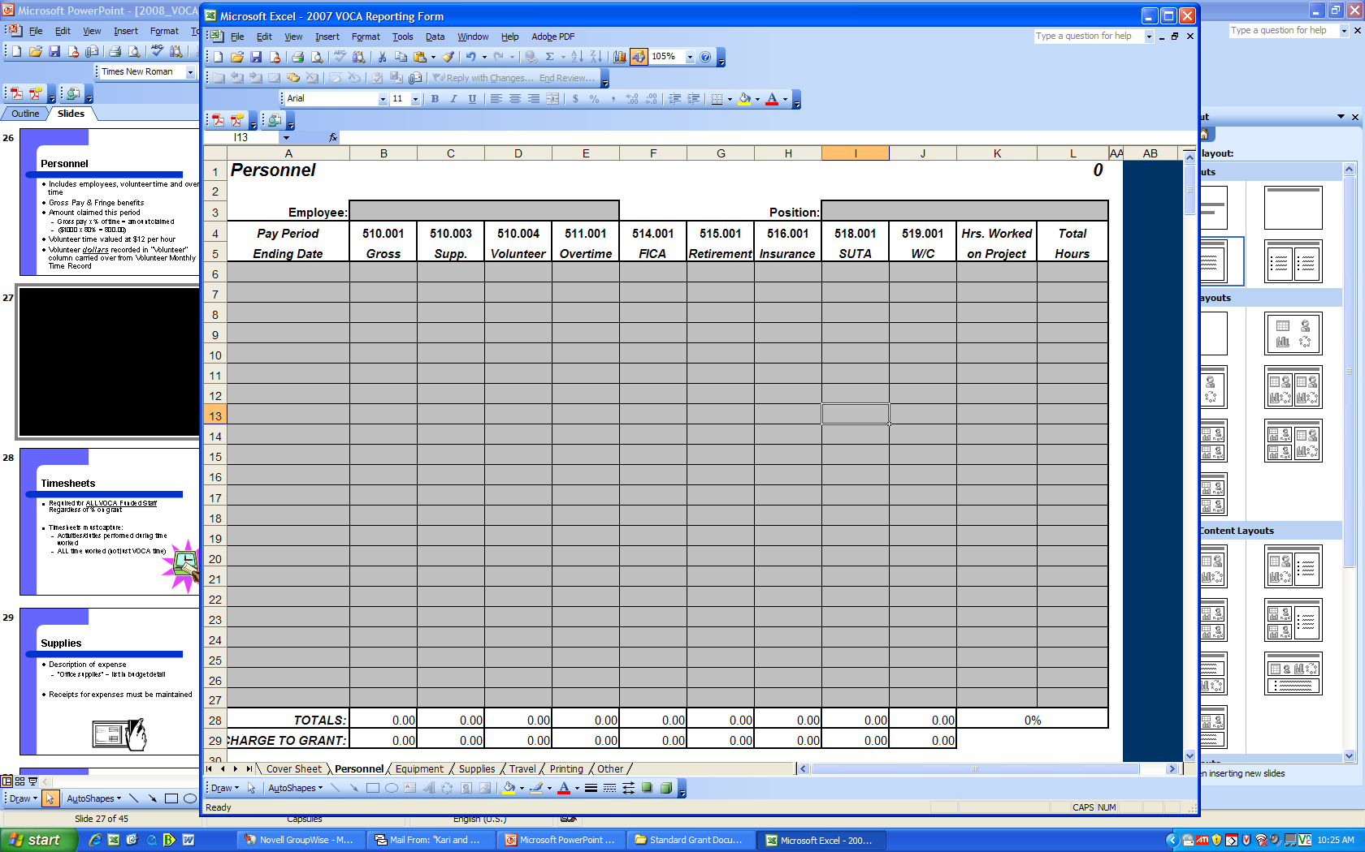
Notes:
Recovery Act - Victim Services Workshop
11
To complete the SER Personnel tab, the employee’s name must be entered at the top of each chart on the left-side of the screen. The employee’s position must be added to the right of his or her name on the right-side of the screen.
The time period for each pay check needs to be listed in the far left column of each chart for each employee. In the next column, titled gross pay, enter the gross amount paid per pay period. This information must be entered for each employee on grant. If the employee received overtime pay during a particular pay period, please list the overtime pay in the overtime column. Please do not count the overtime pay twice. Overtime pay should be subtracted from the gross amount in this case. In addition, FICA, retirement, Insurance, SUTA, and Worker’s Comp needs to be entered for each employee for each pay period if budgeted.
The last two columns of each chart assist in determining the amount of time an employee spends working on this grant. The amount of hours an employee works on this grant should be added to the column titled “hours worked on project.” The total hours worked during the pay period should be added in the last column to the right, titled “total hours”. These numbers will calculate the total percentage an employee worked on this grant. The total percentage of time an employee works on this grant must equal the amount of time the employee is approved to work in the budget. If the percentage is higher than the approved amount, the difference will be denied for reimbursement.
Volunteer time should be shown in a separate chart in the 4th column. Do not list each volunteer individually. All volunteer hours need to be combined for each month and listed together. The total volunteer dollars recorded in the “volunteer” column are carried over from the CJCC monthly volunteer time record. There should be one entry for each month.

Slide 12
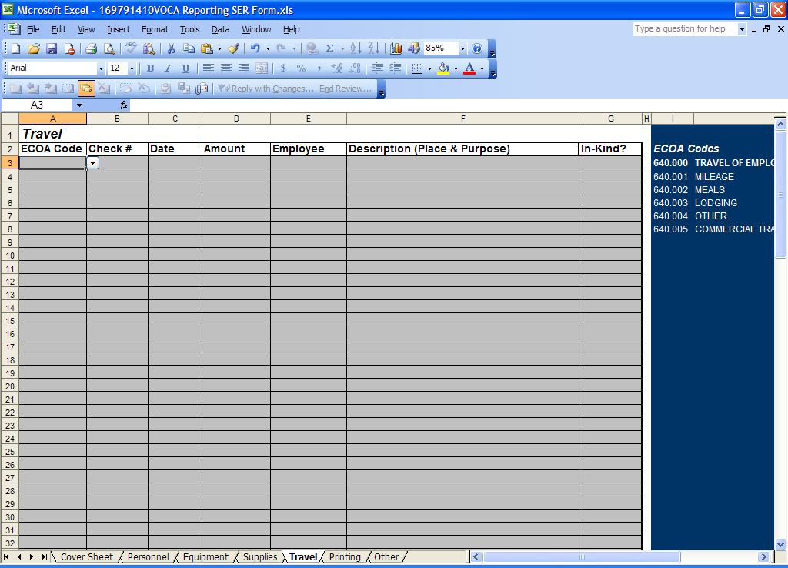

Slide 13
Travel Expense Statement Form

Slide 14
Travel Expense Form- Page 2

Slide 15
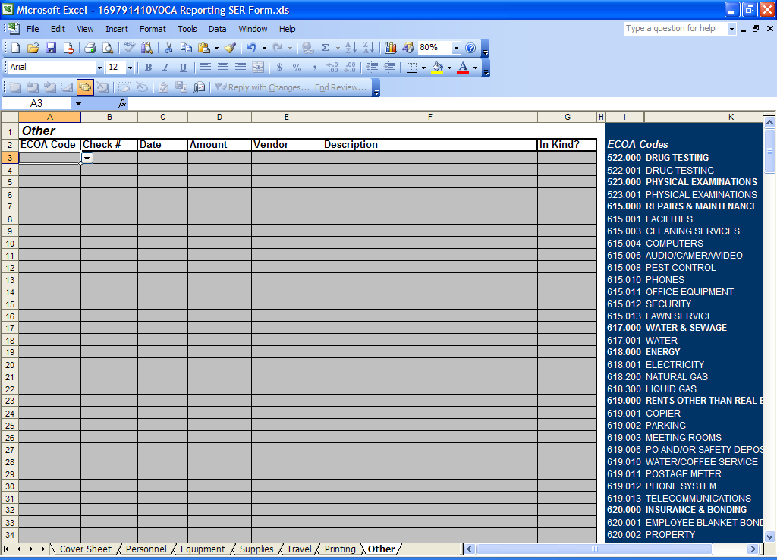

Slide 17
SER Excel Report
If it’s not listed in your approved budget, you cannot claim it!
Notes:
Recovery Act - Victim Services Workshop
17
Please do not submit any expenses that have not been approved in your budget.

Slide 18
Why is My Reimbursement Check Less Than I Requested?
Mathematical Errors
Not Signed by Authorized Official or Designee
Expenses outside of grant period
Expenditures submitted not on approved grant budget
Notes:
Recovery Act - Victim Services Workshop
18
Some common reasons a reimbursement check may be less than the amount requested include mathematical errors, expenses that fall outside of the grant period, the expenditures submitted are not listed on the approved budget, or there is a lack of supporting documentation. Missing support documentation often include professional or consultant agreements, invoices, final printing materials, or volunteer contracts.
Only report employer costs; not employee costs

