Slide 1
OVW Annual Report Webinar VAWA CJSI
Criminal Justice Coordinating Council
Betty Barnard, Planner

Slide 2
Agenda
Purposes of reporting
Deadlines
Communications process
Completing more than one report
Common errors
Helpful resources
Q & A

Slide 3
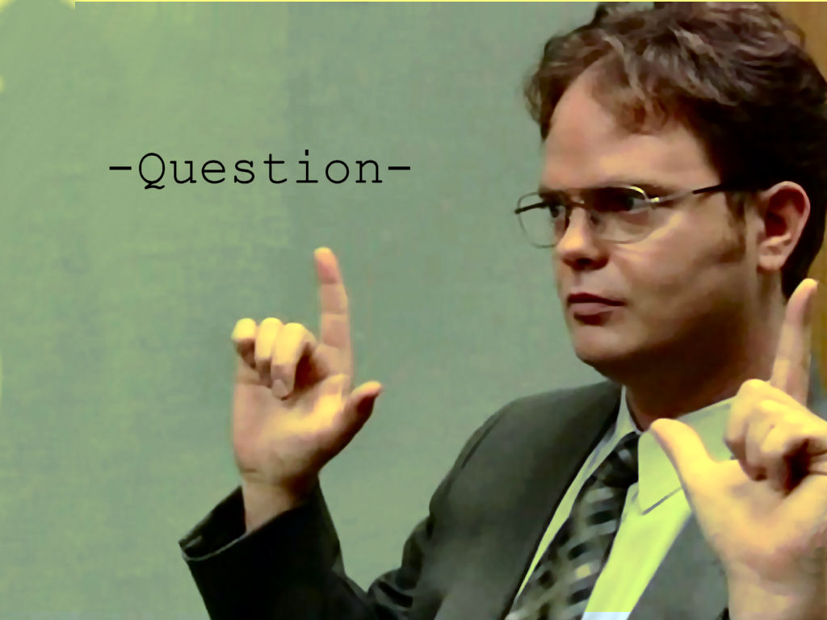
Quick poll
Have you done an annual report before?
Does your agency have more than one VAWA or SASP grant from CJCC?

Slide 4
Purposes of reporting
Notes:
Monitoring, accountability and case for continued and increased funding

Slide 5
Deadlines – Don’t Miss ‘Em
Submit your Annual Report to CJCC by February 15 annually.
Don’t confuse with the OPM, CJSSR or VSSR deadlines!

Slide 6
Tips for Deadline Compliance
Refer to special conditions
Communicate with Project Director
CJCC will not process SERs until the Annual Report is submitted
Repeated lateness or failure to complete may result in penalties such as reductions to your award

Slide 7
Communication with CJCC
Planner sends instructions and login info at least 30 days before the report is due
Info goes to Project Director ONLY. Ask them to forward to you if you report but are not the PD.
NO User ID or Password!
Make sure you can access MailChimp via your email system
Contact Betty with questions
Prefer email – include your grant number(s) for expedited service
Don’t contact anyone else – I’m your gal!

Slide 8
When Do I Complete More than One Report?
ONLY for different funding
streams!
VAWA and a SASP award
Ex: all VAWA data can be entered on one annual report regardless of program type or grant year

Slide 9
What Do I Report?
Basic agency information
Staff information
Percentages of victimization types addressed by the grant-funded project
Program purpose areas
CCR activities, if applicable
Outputs for all VAWA or SASP-funded project activities during the reporting quarter. This may mean you need to prorate.
Narrative questions

Slide 10
Prorating Data: Example #1
Johnny Law is an officer funded through Justice County’s VAWA grant at 80% of his time. Johnny investigated 40 DV cases this grant year. You should report the following:
40 cases x 0.8 (proportion of time Johnny’s paid through VAWA funds) = 32 investigations

Slide 11
Prorating Data: Example #2
Tameka Trial-Lawyer is a prosecutor funded through Justice County’s VAWA grant at 75% of her time. During this grant year, Tameka received 30 referrals for sexual assault cases, accepted 20, declined 9 and 1 was transferred outside jurisdiction. You should report the following:
30 cases x 0.75 (proportion of time Tameka is paid through VAWA funds) = 23 (round up from 22.5) case referrals
20 cases x 0.75 = 15 cases accepted
9 cases x 0.75 = 7 (round up from 6.75) cases declined
1 case x 0.75 = 1 transferred (just round up whenever needed)

Slide 12
Prorating Data: Example #3
Your agency’s budget breakdown is the following:
VAWA Grant – 15%
County Funds – 75%
5% Funding – 10%
During the VAWA grant year (January 1-December 31) your agency worked on 183 cases of domestic violence, 40 sexual assault cases and 38 stalking cases. You would report the following:
0.15 x 183 = 28 domestic violence cases
0.15 x 40 = 6 sexual assault cases
0.15 x 38 = 6 stalking cases

Slide 13
Accurate Reporting is Important
No matter how you do it, your data MUST only reflect VAWA or SASP funded activities!

Slide 14
Completing the Annual Report http://muskie.usm.maine.edu/vawamei/attachments/forms/STOPSubgranteeFormGMS.pdf

Slide 15
Remember….
You should only report data on the use of VAWA or SASP funds
Click the blue question mark boxes to get help for each question
Refer to the instructions for help if the blue question boxes don’t answer your question
If you need technical assistance with the .pdf form, contact Muskie at 1-800-922-VAWA (8292) or vawamei@usm.maine.edu
If you have questions after reviewing the instructions or calling Muskie, please email Betty at betty.barnard@cjcc.ga.gov
Submit to CJCC via the Adobe form by February 15

Slide 16
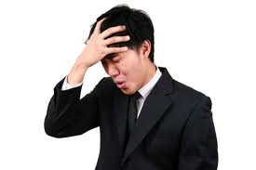
Common Errors
Failure to prorate data based on use of VAWA or SASP funds
Data validation errors
Incorrect Purpose Areas

Slide 17
Q & A
?

Slide 18
Conclusion
Remember to look at the instructions and CONTACT us for help! We’re here for you!
Muskie - vawamei@usm.maine.edu- 1-800-922-VAWA (8292) Betty Barnard – betty.barnard@cjcc.ga.gov – 404-654-5691
Create reminders for deadlines
Delays your reimbursements
Per special conditions, subject to a reduction in your federal award amount
Thanks – this is important and we appreciate you

