Slide 1

DV/SA State Awards FY15
Informational Session
Notes:
Recovery Act - Victim Services Workshop
1
1
1

Slide 2
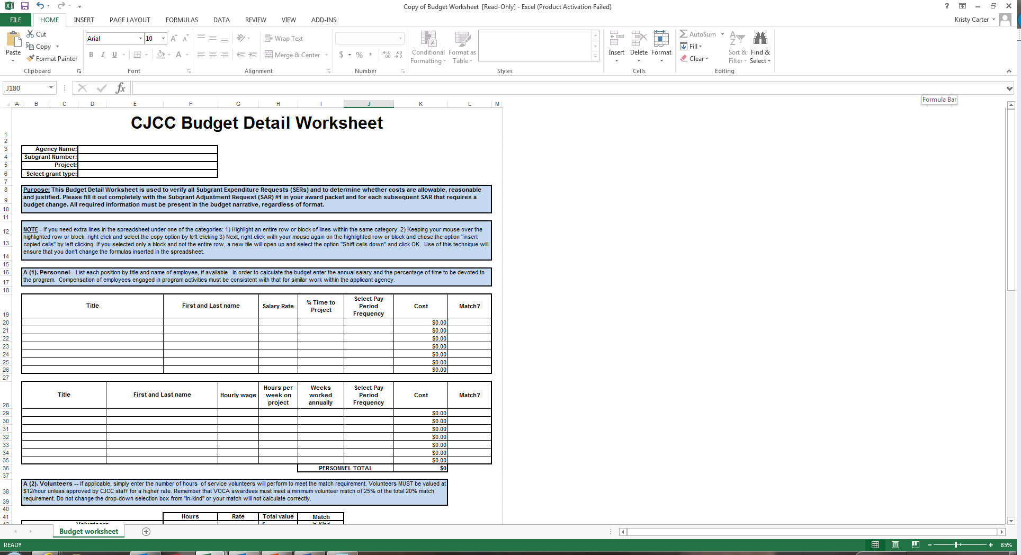
Step 1: Transfer GOCF Budget to CJCC Budget Detail Worksheet and Return Award Packet.

Slide 3
Personnel
Includes employees and over-time
Gross Pay, FICA & Fringe benefits (e.g. Retirement)
Amount claimed this period
      Gross pay x % of time applied to grant = amount claimed
      ($1000 x 80% = 800.00)
Notes:
Recovery Act - Victim Services Workshop
3
3

Slide 4
Travel Expenses –
Employee Travel Expense Statement
Must abide by State of Georgia Travel Regulations/Local/Federal Travel Regulations
You will need prior approval from CJCC for out-of-state travel
Lodging, airfare, transportation/cab fare and meals
Mileage – show number of miles x approved rate
Expenses must be supported with receipts
Record Mileage log
Training related expenses – all trainings for which you would like to be reimbursed submitted 30 days prior to paying registration
Please estimate training costs if you are not sure which your staff will attend
Notes:
Recovery Act - Victim Services Workshop
4
4

Slide 5
Equipment Expenses
Item must cost $5,000 or more to be considered as equipment
Copy of invoice for equipment must be attached to the reimbursement
Equipment inventory list maintained
Equipment purchases must be approved before purchasing
Notes:
Recovery Act - Victim Services Workshop
5

Slide 6
Supplies
Description of expense
    “Office supplies” – listed in budget detail
    Postage
    All “equipment” under $5,000
Receipts for expenses must be maintained at your agency
Notes:
Recovery Act - Victim Services Workshop
6
6

Slide 7

Printing/Media
Acknowledge funding source
Wording located in subgrantee manual – may depend on whether entire publication or only portions are funded – “This project was supported by subgrant No. __________________ awarded by the state administering office for the SA/DV Grant Program. The opinions, findings, conclusions, and recommendations expressed in this publication/program/exhibition are those of the author(s) and do not necessarily reflect the views of the state or the Criminal Justice Coordinating Council.”
Provide example 30 days before purchase for budget approval
Submit copy of final brochures, etc with request for reimbursement
Notes:
Recovery Act - Victim Services Workshop
7
7

Slide 8
Other
Client assistance costs – please break down by line item as much as possible
Conference registration
Local/Long distance, Cell phone, Utility bill (time periods should be noted in description)
Rent- Copy of lease or rental agreement should be submitted to CJCC and kept on file
Cogent Background Checks
Repairs that are not contracted
Notes:
Recovery Act - Victim Services Workshop
8
8

Slide 9
Contractual/Consultant Policies
Fees cannot exceed $650/day or $81.25/hour
Written contract
      Services to be performed
      Rate of compensation – should be reasonable according to past billing history or market rate (submit samples to CJCC)
      Length of time services will be provided
Payment for services rendered
Services during contract period
Notes:
Recovery Act - Victim Services Workshop
9
9

Slide 10
Unallowable Expenses
Non-budgeted items
Bonuses
Entertainment
Alcohol
Fundraising
Renovations or other types of construction – unless making services ADA compliant (e.g. wheelchair ramp)
Notes:
Recovery Act - Victim Services Workshop
10

Slide 11


Questions?!

Slide 12
Step 2: Complete a SAR

Slide 13
Subgrant Adjustment Requests [SAR] :
When should a SAR be submitted?
Submit a formal request when requesting revisions for the following changes:
  Project Officials and any contact information (emails, addresses, phone numbers)
  Grant-funded staff
  Budget line items or categories
  Grant-funded program activities and services
  Signature authorization for grant-related documents
Notes:
Recovery Act - Victim Services Workshop
13

Slide 14
Subgrant Adjustment Requests [SAR] :
When should a SAR be submitted? (cont.)
All requests should be submitted no later than 14 calendar days after the effective date of the change
No budget adjustments may be submitted during the last 60 days of the subgrant period (per your special conditions)
Submit SAR #1 with your Award Package
      Attach a corrected Budget Worksheet (form on website)
Notes:
Recovery Act - Victim Services Workshop
14

Slide 15
Notes:
Original signature not required – subgrantees can email or fax a copy.

Slide 16
Subgrant Adjustment Requests:
Supporting Documents
Supporting Documents Should be Included with your Adjustment:
    Personnel Action Forms/Salary Authorization Forms
    Revised Detailed Budget (if requested)
    Effective Date of the Change
    Updated Designation of Grant Officials Form
    Updated Signature Authorization Letter
  Provide as much detail as possible!!

Slide 17
Questions?!

Slide 18
Step 3: Reporting Expenditures for Reimbursement:
2 Options for Reporting Expenditures:
1st Option- Send in the SER and a printed accounting system report that details expenses by fund source.
2nd Option- Use the Excel Subgrant DV/SA State Expenditure Reporting Form.

Slide 19
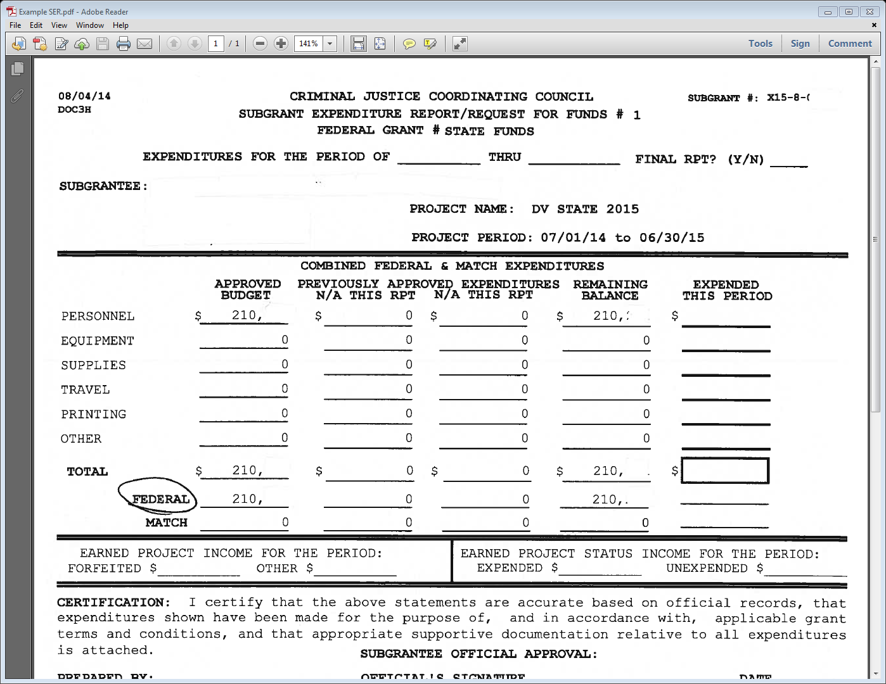
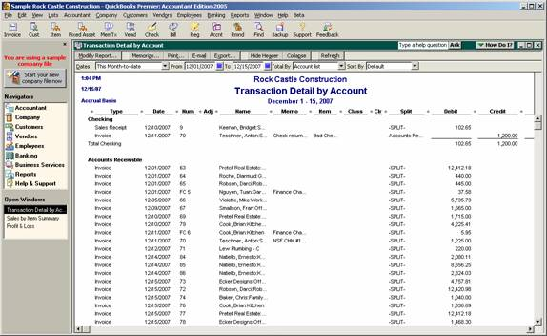
Option 1: Send in the SER and a printed accounting system report that details expenses by fund source.

Slide 20
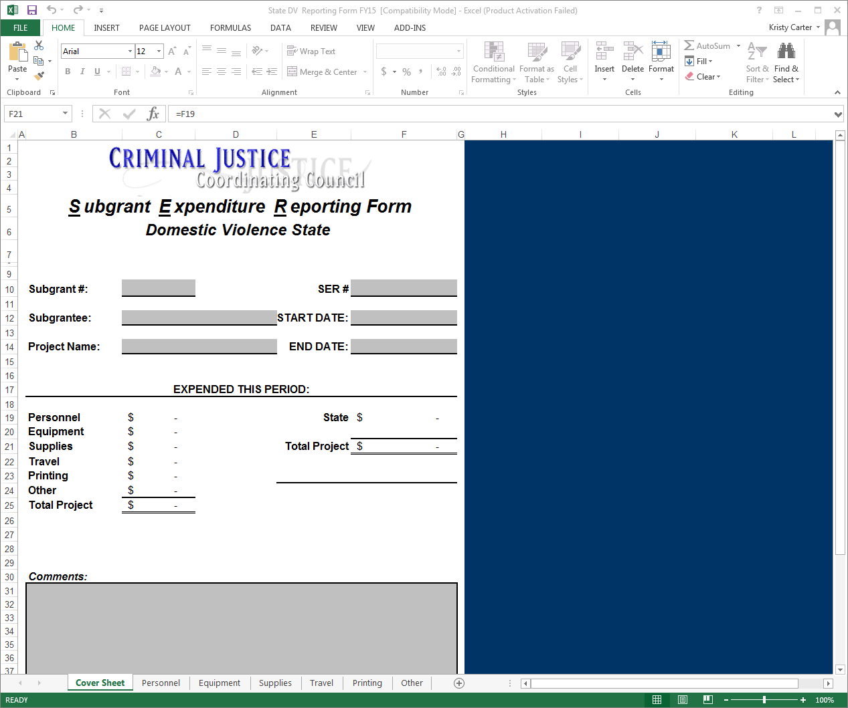

Option 2: Send in SER and Use the Excel Subgrant DV/SA State Expenditure Reporting Form.

Slide 21
Dates for Reporting Expenditures:
Monthly Deadlines- The 10th and 25th of each month. (*Exception is the month of August. The reporting dates are the 15th and 25th.)
Quarterly Deadlines-
October 10th or October 25th
January 10th or January 25th
April 10th or April 25th
July 10th or July 25th
***Mail SER with original signatures to CJCC. Supporting documentation may be emailed to your assigned grants specialist.

Slide 22
Step 4: Performance Report Schedule
Quarter | Reporting Period | Due Date
Quarter 1 | July 1 - September 30 | October 30
Quarter 2 | October 1 - December 31 | January 30
Quarter 3 | January 1 - March 31 | April 30
Quarter 4 | April 1 - June 30 | July 30
Please upload ALICE/SA Access database quarterly reports by the reporting due dates above. If you have any community awareness activities or events that are completed during the reporting period, please report those as well. All performance deliverables must be completed by June 30, 2015.

Slide 23
Questions?!

Slide 24

Thank you for your time!!
Please feel free to contact us with any questions:
Kristy Carter, Grants Specialist
404.657.2061
Kristy.Carter@cjcc.ga.gov
Natalie Williams, Grants Specialist
404.657.2224
Natalie.Williams@cjcc.ga.gov
Quincie McKibben, Grants Specialist
404-657-2083
Quincie.McKibben@cjcc.ga.gov

