Slide 1
2014
Accountability Court Grant
Subgrantee Workshop
May 29, 2013
Notes:
1
1
1

Slide 2

Workshop Agenda
Welcome & Logistics
Section I
  Award Packet Activation
  Subgrant Adjustment Reports
  Subgrant Expenditure Requests
Section II
  Quarterly Reports
Section III
  Training and Travel Reimbursements
Notes:
2
2
2

Slide 3
Grants and Policy Division
Criminal Justice System Improvement (CJSI)
  Financial management
  Audit activities
  Develops and coordinates processes
  Site Visits and subgrantee compliance
Planning and Policy
  Output & Outcome reporting for grants (subgrantee compliance with programmatic aspects of grants)
  Prepares annual programmatic reports, formula and competitive grant applications
  Track national best practices, training opportunities, and program models
  Help Georgia victim service providers build capacity
Notes:
3
3
3

Slide 4
Grants and Policy Division
Aisha Ford, Program Director
Ursula Kelley, Grants Specialist
Reginald Boyd, Grants Specialist
Notes:
4
4

Slide 5
CJCC Contact Information
Website Address
http://cjcc.georgia.gov
Mail: Attn: Accountability Court Grants
    Criminal Justice Coordinating Council
    104 Marietta Street, NW, Suite 440
Atlanta, Georgia 30303-2743
Phone: 404-657-1956
Fax: 404-657-1957
Notes:
5
5
5

Slide 6
Section I
Accountability Court Grant
Grant Period: July 01, 2013 - June 30, 2014
Notes:
6

Slide 7
Accepting Your Award
Award packages were mailed May 16, 2013 and are due June 28, 2013
Refer to enclosed instructions when completing your award package
Carefully review special conditions associated with grant
Funds can not be drawn until all documentation is received and approved
The Authorized Official for your grant must sign all award package documents

Slide 8
Authorized Official
Government Agencies
  Commission Chair, Mayor
Delegating Signing Authority- Signature Authorization Letter
  Authorized Official must sign award documents
  Can be delegated for reporting purposes via letter
  Authority applies to this grant only

Slide 9
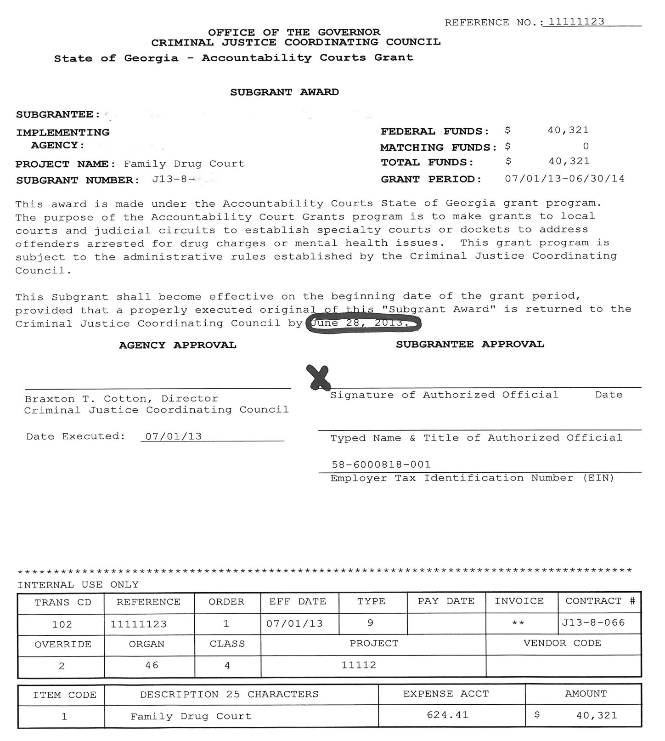

Slide 10
Accepting your Award (cont.)
Documents in award packet to complete:
  Special Conditions
  Reimbursement selection form – quarterly
  Subgrant Adjustment Request (SAR) #1

Slide 11
Notes:
The Reimbursement Selection form is the documentation we use to identify how you would like to be reimbursed.
This form is also important because you identify your method of payment. You can either receive your reimbursements via check or Electronic Funds Transfer (EFT). Please make sure that you fill this form out carefully and provide the most accurate information. Also, if you choose to receive your reimbursements by EFT, you must attach a voided check with this form.

Slide 12
Subgrant Adjustment Requests (SAR)
Submit SAR #1 with your Award Package
Submit a formal request when requesting revisions for the following:
  Budget Adjustment
  Project Officials/Addresses
  Project Personnel
  Goals and Objectives
Notes:
12

Slide 13
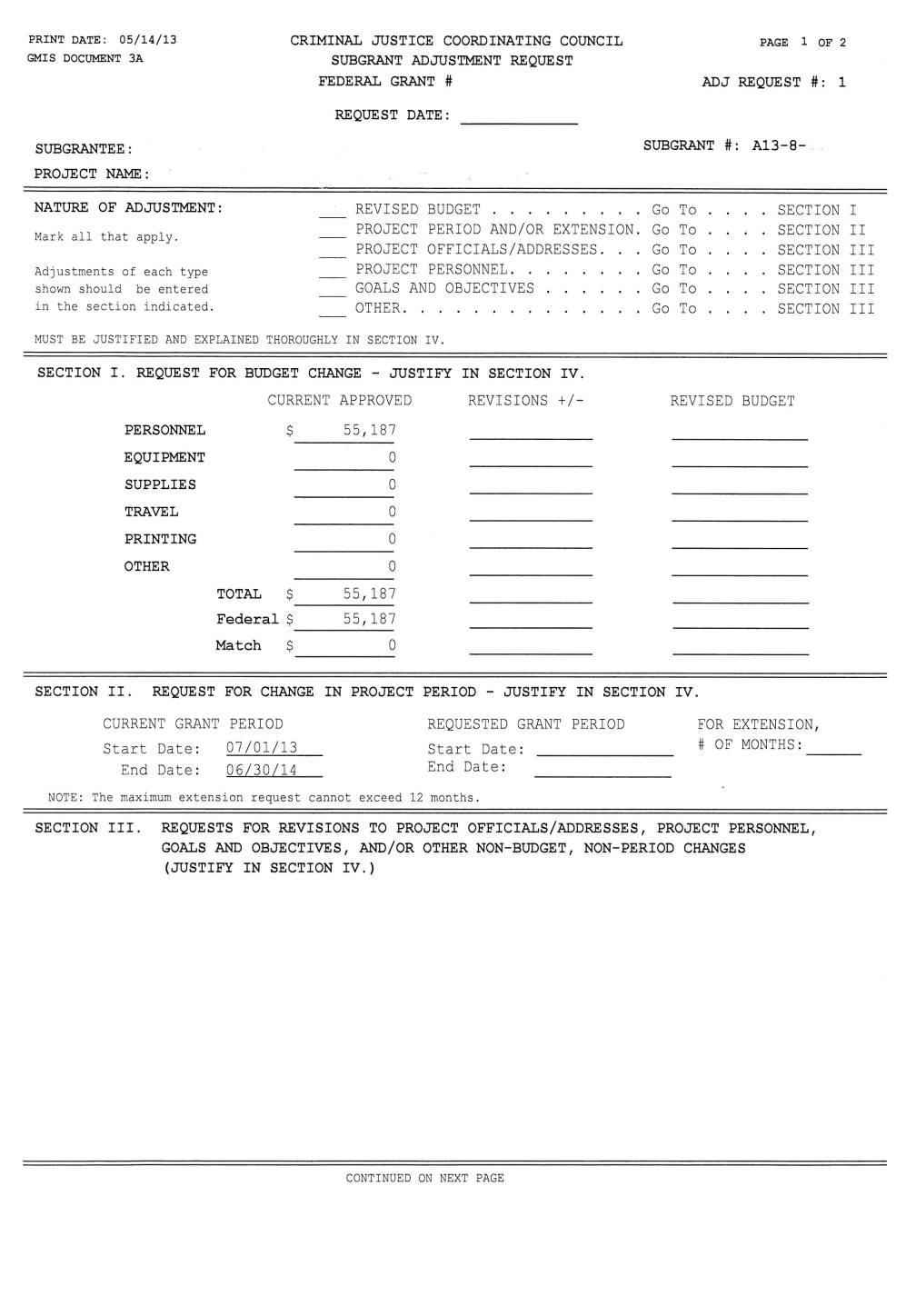
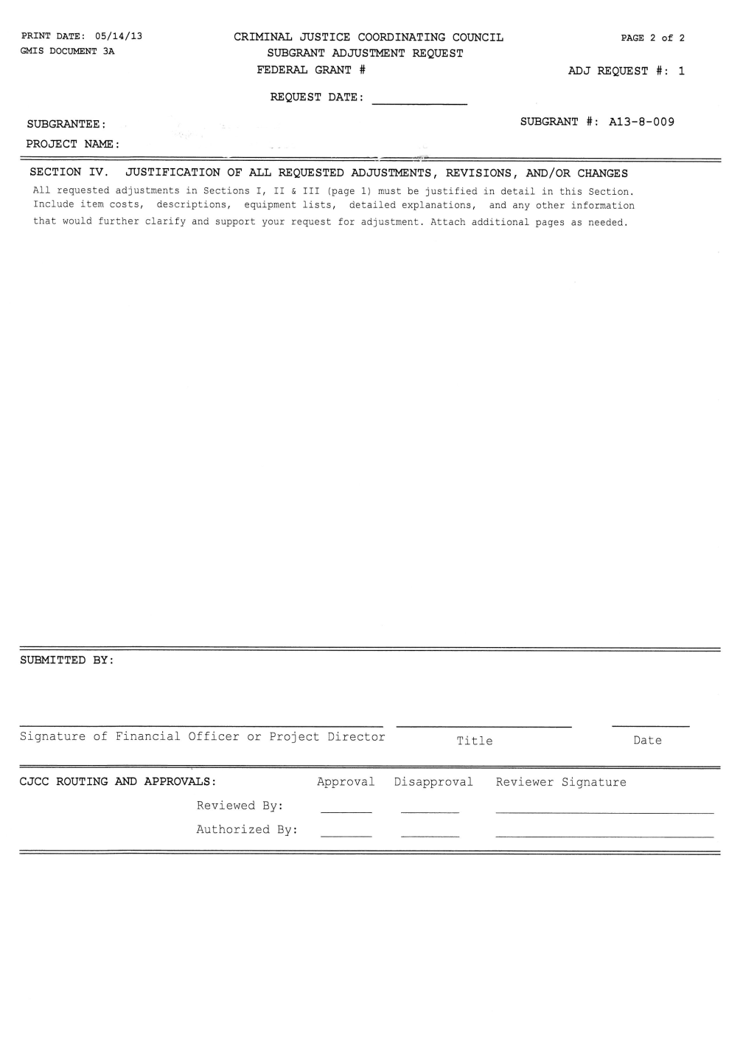

Slide 14
Request for Reimbursements - Requirements
Schedule for Submitting Reimbursements:
  Quarterly - due 15 days after end of quarter
Notes:
14
14

Slide 15
If it’s not listed in your approved budget, you cannot claim it!
Notes:
15

Slide 17
Subgrant Expenditure Report [SER]
All grant related expenses incurred for the month must be listed on this form to obtain reimbursement!
Expenses must be incurred during the grant period
Form must be signed by authorized official
Notes:
17

Slide 18
Tips for Successfully Submitting Your Request
Submit the following with each request:
  Subgrant Expenditure Report/Request for Funds Form – (turnaround document) signed by authorized official /designee
  Supporting documents (if applicable)
    Purchase Orders
    Invoices
    Proof of Payment
Notes:
18
18

Slide 19
Why is My Reimbursement Check Less Than I Requested?
Mathematical Errors
Not Signed by Authorized Official or Designee
Expenses outside of grant period
Expenditures submitted not on approved grant budget
Lack of supporting documentation
Notes:
19

Slide 20
Section II – Reporting
Notes:
20

Slide 21
Why Report to CJCC?
Required by the Accountability Court Funding Committee (*see special conditions)
Assure adherence with Judicial Council standards
End results:
  Assess project performance
  Provide appropriate technical assistance
  Justify continued funding

Slide 22
Court Output Report
Submitted monthly with your SER
  Currently many courts already submitting SID & Offender information reports
  Standardizes the way these are submitted
Output report alerts CJCC about court’s activity and number of offenders served
Ensures grant dollars are going to operational courts

Slide 23
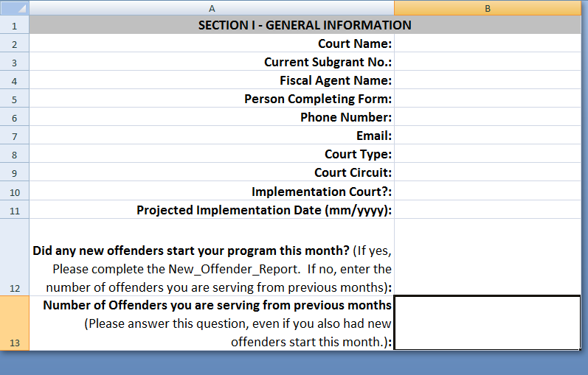
Court Output Report

Slide 24
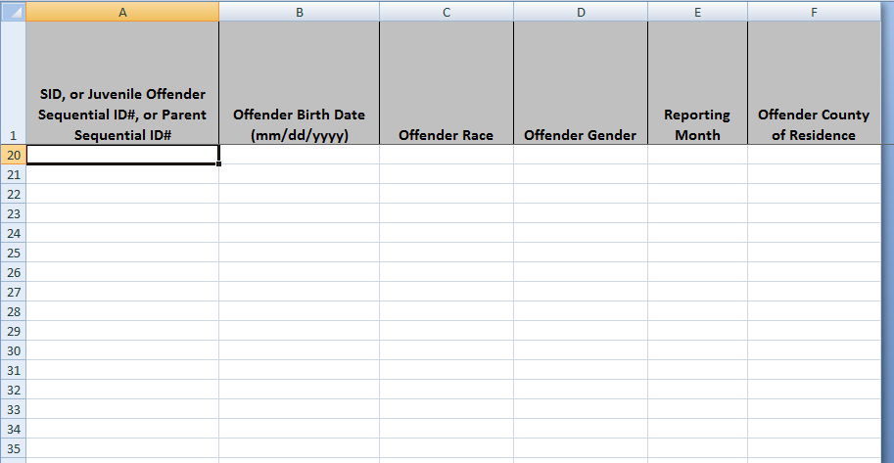
Court Output Report

Slide 25
Submitting Court Output Reports
Please email to courtreports@cjcc.ga.gov
  Put grant number in subject line
  Attach Excel Sheet
    Sheet available at cjcc.georgia.gov: Grants>>Forms & Publications>>Expenditure Reporting Forms
Will receive automatic message that email was received
  Print out and include automatic response message with paper SER you send to us
Properly completing form is important! CJCC will not process reimbursement without a completed form

Slide 26
Quarterly Reports
Report Number | Reporting Period | Due Date
1 | July 1 – September 30, 2013 | October 15, 2013
2 | October 1 – December 31, 2013 | January 15, 2014
3 | January 1 – March 31, 2014 | April 15, 2014
4 | April 1 – June 30, 2014 | July 15, 2014

Slide 27
Training Travel Reimbursement

Slide 28
Training Reimbursement Policy Reminders
If you, or your staff, attend an Accountability Court funded training please fill out the following forms, which will be provided at the training event:
  Employee Travel Expense Statement
  Personal Vehicle Mileage
  Per Diem Calculator Tool
  W-9 TIN and Certification (if you have not filled one out with the State in the past)
If you, or your staff, have questions about these forms please contact the CJCC Finance Office.
  Shawana Ducksworth – (404) 657-1996
  Nathan Branscome – (404) 657-1997

Slide 29
Training Reimbursement Policy Reminders
Please be aware of the following guidelines:
  Hotel stay for multi day training is only compensable if attendee lives more than 50 miles away.
  Mileage is calculated based upon place of origin. If you leave from home then regular commuter miles must be subtracted.
  Meals are compensated on the State Per Diem rate, and provided meals are not reimbursable.
  Only 75% of meal cost on first and last day of training are compensable. Receipts are not required for meal reimbursement.
  Please make sure to sign all forms and include your Social Security Number or TIN. If you are a state employee then please also insure that you include your state ID number.

Slide 30
Links and Resources

Slide 31
Contact Information
Aisha Ford, Program Director
  404-657-2045 Office
  404-657-1957 Fax
  Aisha.Ford@cjcc.ga.gov
Ursula Kelley, Grants Specialist
  404-657-1968 Office
  404-657-1957 Fax
  Ursula.Kelley@cjcc.ga.gov

Slide 32
Helpful Links & Resources
Criminal Justice Coordinating Council
http://cjcc.georgia.gov
Georgia Accountability Courts
http://www.gaaccountabilitycourts.org/

Slide 33
Questions???

