Slide 1
Victim Assistance Competitive Application Workshop May 6 – 8, 2013 – 9 a.m. to 12 p.m.

Slide 2
Agenda
Welcome and Logistics
VOCA/VAWA/SASP
Background Information
Basic Eligibility Requirements
Priority Areas (State)
Application Requirements
Budget Detail Worksheet/Summary
Online Application Submission Steps
Questions & Answers
Notes:
Explain Application Process (there’s only one application)

Slide 3
Criminal Justice Coordinating Council
Designated State Administering Agency (SAA) for grants from the U.S. Dept. of Justice.
CJCC Executive Staff
Braxton T. Cotton – Executive Director
Misty Giles – Deputy Director
Robert Thornton – Grants & Policy Division Director
Nicole Jenkins – Victim Services Division Director
Stefanie Lopez-Howard – Statistical Analysis Center Director
Notes:
CJCC is the designated state administering agency for the U.S. Department of Justice. The Criminal Justice Coordinating Council is comprised of members from all components of the criminal justice system and is responsible for administering grants for criminal justice system improvement, as well as victims assistance and compensation.
While we administer many different grants here, the two major victim service grants are
The Victims of Crime Act commonly known as VOCA and the
Services Training Officers and Prosecutors Violence Against Women Act more commonly known as STOP VAWA.
As we briefly spoke about earlier, our agency is broken up into two divisions. These two divisions are Criminal Justice Services. led by Robert Thornton and Victim Services, led by Nicole Jenkins

Slide 4
Victims Compensation Division
Provides financial assistance to innocent victims of crime
Six funding categories:
Medical Expenses
Counseling Expenses
Funeral Expenses
Economic Loss
Crime Scene Sanitation
Forensic Medical Examinations
Maximum $25,000 per victim
Notes:
DUI Memorial Sign

Slide 5
Grants Division
SAC Division
Planning,
Research, and
Evaluation
Financial Management
Audit/Site Visit Activities
Develops and Coordinates Processes

Slide 6
Grants Division Robert Thornton |Division Director
Victim Assistance Unit
Shontel Wright |Program Director
Auditor/Examiners
Betty Barnard
Ayanna Campbell
Grants Specialist:
Crystal Crews
Tonya Jenkins
Jonathan Peart
Michael Shackelford
Planning & Evaluation
Elizabeth Yates
Criminal Justice Unit
Aisha Ford |Program Director
Auditor/Examiners
Brian Salters
Monique Stevenson
Grants Specialist:
Kristen Kinney
Planning & Evaluation
Jennifer Wade
Notes:
There are two units within the Grants and Policy Division that are responsible for the overall management of the grants administered by CJCC. These units are the Victim Assistance Unit
and the Criminal Justice Unit. Each unit has a specific set of responsibilities associated with administering the grant program.

Slide 7
CJCC Contact Information
Website Address: cjcc.georgia.gov
Mail: Attn: Grants Division or Victims Compensation
Criminal Justice Coordinating Council
104 Marietta Street, NW, Suite 440
Atlanta, GA 30303-2743
Main Phone: 404-657-1956
Victims Compensation Phone: 404-657-2222
Fax Number: 404-657-1957
Email Subscription: Mail Chimp!

Slide 8
VOCA Background
Office for Victims of Crime (OVC) was created by U.S. Department of Justice in 1983
The Victims of Crime Act (VOCA) was established in 1984 by Congress
OVC administers the Crime Victims Fund supported by criminal fines paid in federal court (not taxpayer dollars)
Notes:
One of the funding streams under the umbrella of Victim Services is VOCA. VOCA was established in 1984 by the Victims of Crime Act. This act authorizes federal financial assistance through the Office for Victims of Crime and the United States Department of Justice to states for the purpose of compensating and assisting crime victims, funding trainings and offering technical assistance.
All funds from the Victim of Crime Act are supported by criminal fines paid to in federal court.

Slide 9
Purpose of VOCA
Provide federal funding to support victim assistance and compensation programs to:
Support victims of crime
Provide training for diverse professionals who work with victims
Develop projects to enhance victims’ rights and services
Undertake public education and awareness activities on behalf of crime victims.

Slide 10
S.T.O.P. VAWA Background
The S.T.O.P. (Services/Training/Officers/Prosecutors) Violence Against Women Act (VAWA) Formula Grant Program was established under the Violence Against Women Act (VAWA), which is enacted under Title IV of the Violent Crime Control and Law Enforcement Act of 1994
Administered by the Office on Violence Against Women (OVW), U.S. Dept. of Justice
Notes:
Here you will see a little background on STOP VAWA. STOP VAWA is the acronym for Services Training Officers Prosecution (STOP) Violence Against Women Act was enacted in 1994 and was last re-authorized by Congress in 2005 and 2013. This Act created several grant programs, including the STOP VAWA and SASP programs which we will speak more about today. STOP VAWA is administered by the Office on Violence Against Women (OVW) through the U.S. Dept. of Justice.

Slide 11
Purpose of VAWA
To develop and strengthen effective law enforcement, prosecution and victim services strategies to combat violence against women including domestic violence, sexual assault, stalking, and related crimes
Restructure and strengthen the criminal justice system’s response to be proactive against violence against women
Develop a comprehensive strategy to deal with the complex problem of violence against women
Adopt a coordinated, multi-disciplinary approach to improve the criminal justice system’s response to violence against women
Notes:
The goal of STOP VAWA is to work together to improve the system’s approach to violence against women. While program sustainability is important, STOP VAWA is best when it supports projects that ultimately support a coordinated community response to the crimes affecting women.

Slide 12
SASP Background
The Sexual Assault Services Grant Program (SASP) was established under the Violence Against Women Act and Department of Justice Reauthorization Act of 2005
SASP is the first federal funding stream solely dedicated to the provision of direct intervention and related assistance to victims of sexual assault

Slide 13
Purpose of SASP
To provide intervention, advocacy, victim accompaniment (e.g. to court, medical facilities, police departments etc.), support services, and related assistance for adult, youth, and child sexual assault victims. May also support services to collateral victims.

Slide 14
Basic Eligibility Requirements for VOCA/VAWA/SASP
Applicants are limited to governmental & non-profit agencies that provide services to crime victims
Must be certified as eligible to receive Local Victim Assistance Funding (5%)
Established Program: Demonstrate a record of effective services to crime victims.
Programs: May be eligible if they demonstrate that 25 – 50% of their financial support comes from non-federal sources
Notes:
To be eligible for a victim services grant, you must be a public or non-profit organization. A 501© 3 is not necessary to apply nor is it needed to receive funding. You must be an established program that has a record of providing services to crime victims. However, if you are a new agency and/or program, you must be able to demonstrate support from other sources.
The next 2 slides show some other eligibility requirements that you will need to ensure compliancy with.

Slide 15
Basic Eligibility Requirements for VOCA/VAWA/SASP (cont’d.)
Must utilize volunteers (VOCA only)
Must collaborate with other victim service providers in your service area
Must comply with federal laws and guidelines:
OJP Financial Guide
OMB Circulars
Must comply with Civil Rights Requirements:
EEOP, LEP, etc

Slide 16
Basic Eligibility Requirements for VOCA/VAWA/SASP (cont’d.)
Only non-profit agencies are eligible for victim services grants (S.T.O.P. VAWA only)
Services must be provided to victims of federal crimes
Assist victims in applying for victims compensation
Cannot charge for services to victims
Maintain confidentiality of client-counselor information as well as research information.
Notes:
Many of the requirements listed here and in your RFA are federal requirements and are mandatory for receipt of any federal dollars.

Slide 17
Funding Categories
The CJCC has established two categories to help identify the appropriate types of funding for your agency.
Category 1 - Core Services
Category 2 - Priority Areas
Sub-grantees must identify whether they want to apply for Category 1 and/or Category 2.
If you’re applying for Category 1 and 2 please note that you will be required to submit two separate narratives for each category you apply for.
Notes:
Category 1 is for sub-grantees who want to apply for funding to meet and/or maintain their core services.
Category 2 is for sub-grantees who want to expand on the core services and develop: a) Non-traditional, innovative approaches to areas that have been identified as priorities by the state. b) Sub-grantees should note that just because something has not been identified by the state does not mean you can not apply for money to help fund it c) Sub-grantees will have to explain in the application why it is a priority for their area.

Slide 18
Core Services (Category 1)
Child Advocacy Centers
Court-Appointed Special Advocates (CASA’s)
Counseling Services
Domestic Violence Programs
Legal Service Providers
Sexual Assault Programs
Victim Witness Assistance Programs - Law Enforcement & Prosecution

Slide 19
VOCA Priority Areas (Category 2)
Developing satellite or outreach services
Collaborations between community based, law enforcement, and/or prosecution based victim service agencies (MOUs, protocols, etc.)
Prioritizing basic services such as transportation assistance in addition to core services
Expansion of sexual assault services
Tracking assistance filing victim’s comp claims
Bi-lingual and multi-lingual services
Innovative methods of service delivery
Notes:
What problem are you addressing?
Background & need
Geographic area
Target population
Supporting data
Good sources: UGA County Guide, US Census Quick Facts, GBI, your previous reports, other local facts & information

Slide 20
VAWA Priority Areas (Category 2)
Updated training, including U-Visas, accessing interpreters, economic security, and helping diverse victims in domestic violence, sexual assault, and stalking cases for law enforcement
Increased cross training opportunities for victim service, law enforcement, and legal service agencies
Policies and enforcement for the removal of firearms from defendants who have been convicted of domestic violence misdemeanors or who are subject to temporary orders of protection (TPO’s)
Increased training opportunities for court personnel, Judges, Prosecutors and probation officers
Increase SANE/SAFE training
Notes:
sexual assault forensic examiner (SAFE) or sexual assault nurse examiner (SANE)

Slide 21
SASP Priority Areas (Category 2)
Creative ways to expand into counties with no sexual assault agencies.

Slide 22
Application Requirements

Slide 23
Application Checklist
A. Project Narrative
1. Problem Statement and Data
2. Mission Statement
3. Target Population
4. Project Activities
5. Project Evaluation
B. Budget
C. Additional Attachments
1. Designation of Grant Officials
2. Standard Assurances
3. Certifications
4. Disclosure of Lobbying Activities
5. Audit Requirements
6. Civil Rights Contact
7. Standard Assurances
8. Memoranda of Understanding
9. Organizational Chart (Non-profit applicants)
10. Job Descriptions
11. Non-profit 501(c)(3) certificate
Notes:
Script: There are three basic pieces to the on-line process – if you follow along you should be fine. All of the questions are covered in the RFA. You can also ask staff for assistance about the on-line application.

Slide 24
Project Narrative
Section 1: Problem Statement and Data
Identify the specific problem(s) that will be targeted and support with relevant, cited data.
Section 2: Mission Statement
Provide a mission statement which reflects the overall impact you intend for the project to attain.
Section 3: Target Population
Describe the target area, including geographic and demographic characteristics.

Slide 25
Project Narrative (cont’d.)
Section 4: Project Activities
Should include a sound work plan explaining the activities of the project.
MOUs are not required but are strongly encouraged.
Section 5: Project Evaluation

Slide 26
Applying for Multiple Grants
You will be considered separately for each grant for which you apply
You may be awarded all, some, or none of the grants for which you apply
Be careful of the grant eligibility requirements
S.T.O.P. VAWA Victim Services & SASP are open to non-profit agencies only
S.T.O.P. VAWA CJSI is open to government & non-profit agencies
VOCA is open to government & non-profit agencies
Notes:
If you apply for multiple grants, each narrative will be considered separately. Be aware of the eligibility requirements.

Slide 27
Budget Detail Worksheet & Budget Summary
Notes:
Good Morning (or Afternoon) At this time we will be discussing the allowable costs for victim services as well as how to complete the budget detail worksheet and budget summary document.

Slide 28
Budget Categories
All costs must be identifiable with one of these budget categories:
Personnel
Travel
Equipment
Supplies
Printing
Other
Adhere to State and Federal Guidelines.
All expenditures must be fully detailed, reasonable, necessary and allowable.
A budget narrative/detail and a budget summary sheet was included in the grant application.
Notes:
Budget categories for victim services comprise personnel, travel, equipment, supplies, printing, and other.
All expenses for these categories must be fully detailed, reasonable, necessary, and allowable for the execution of all grant activities.
Additionally, all expenses must adhere to State and Federal guidelines.
At this time we will begin to review how to complete the budget detail worksheet beginning with the personnel and fringe benefits.

Slide 29
Personnel
Salaries must be usual and customary
May cover overtime if allowed under agency policy
Bonuses and/or supplements are not allowable
Updates to salary authorizations and job descriptions should be submitted when changes occur
Volunteer hours are valued at $12.00/hour (VOCA and VAWA only)
Notes:
Bullet #1: Salaries must comply with local service area & agencies policy and procedures.
Remember to reflect the percentage of time paid to the grant. For example, if someone only works half of their time on the grant, or only half of their time is allowable under the grant, only show 50% of the time. Show percentage based on time worked on the grant.
Bullet #2: Overtime is allowable and must be shown on the budget.
Bullet #5: If you would like a higher rate for your volunteer you may submit a letter to CJCC requesting a higher amount.

Slide 30
Travel
All statewide travel must comply with state travel regulations
Mileage can be reimbursable, but only at the current state approved rate of $0.565 per mile
Out-of-state travel must be approved by CJCC prior to travel
All out-of-state travel should be fully explained and justified based on Federal cost guidelines
Include costs for attending professional training
Notes:
Bullet #2: Can include daily travel. If your local policy travel rate amount is less than the state approved rate, you are required to use the local policy rate. In completing your budget ensure conference registrations are listed in the OTHER category and not in the TRAVEL category.
Note: conference registrations should be in the OTHER category, not Travel.

Slide 31
Equipment
Any non-expendable property with a useful life of more than 1 year and a cost of more than $5,000.
Notes:
Equipment is any non-expendable property with a useful life of more than 1 year and a cost of more than $5,000. Please keep in mind that equipment cannot be broken down into smaller components to avoid applicable reporting requirements.

Slide 32
Supplies
Costs related to the project’s day-to-day operation such as:
Office supplies
Paper
Postage
Copier usage
Computer Hardware/Software (under $5,000)
Notes:
Costs related to project’s day-to-day operation which are not included in any of the other categories:
Office supplies
Shared usage costs of office equipment
Paper
Postage
Copier usage
These items can be pro-rated based on the number of employees working under the grant. If you have an office of 4, but only one person is paid under the grant, you must show a pro-rated portion of the cost at 25%. For example, if the copier usage bill is $100, the cost charged to the grant would be $25. There are certain cases where the grant funded person uses the items more than the non grant funded person, in this case let your auditor know the percentage of usage by the employee. Please note that office supplies are all items that total less than $5,000.

Slide 33
Printing
Expenses only for the project.
Business Cards (grant funded personnel)
Letterhead
Program related materials
Brochures to distribute to victims (content must be pre-approved and must contain an acknowledgment of the awarding agency’s assistance)
Notes:
Printing expenses for this direct victim services include Business Cards (grant funded personnel)
Letterhead
Program related materials
Brochures to distribute to victims – state “This project was supported by Award/Grant No. ___________ awarded by the (name, e.g. Criminal Justice Coordinating Council, Office of Justice Programs.”

Slide 34
Other
Consulting or Contractual Costs are limited to $450 per day or $56.25 per hour.
Rent and utilities can be covered if fully justified.
Copier lease and postage meter
Registration for training/conferences
An agency’s annual audit can be covered only if the agency receives more than $500,000 in federal funds (amount must be pro-rated)
Accounting or bookkeeping services cannot be covered
Notes:
Other expenses consist of consulting or contractual costs, which are limited to $450 per day or $56.25 per hour. (Yes, the Federal VAWA guidelines do allow a higher rate of $650 per day or $81.25 per hour, but CJCC policy is to only allow up to $450/day or $56.25/hour. For VAWA sub-grantees, you can request a higher rate than $450/day with appropriate justification.)
Rent, utilities, copier lease, postage meter, and registration for training/conferences are also expenses that fall under the “OTHER” category.
An agency’s annual audit can be covered only if the agency receives more than $500,000 in federal funds. This expense must be pro-rated. Accounting or bookkeeping services CANNOT be covered.

Slide 35
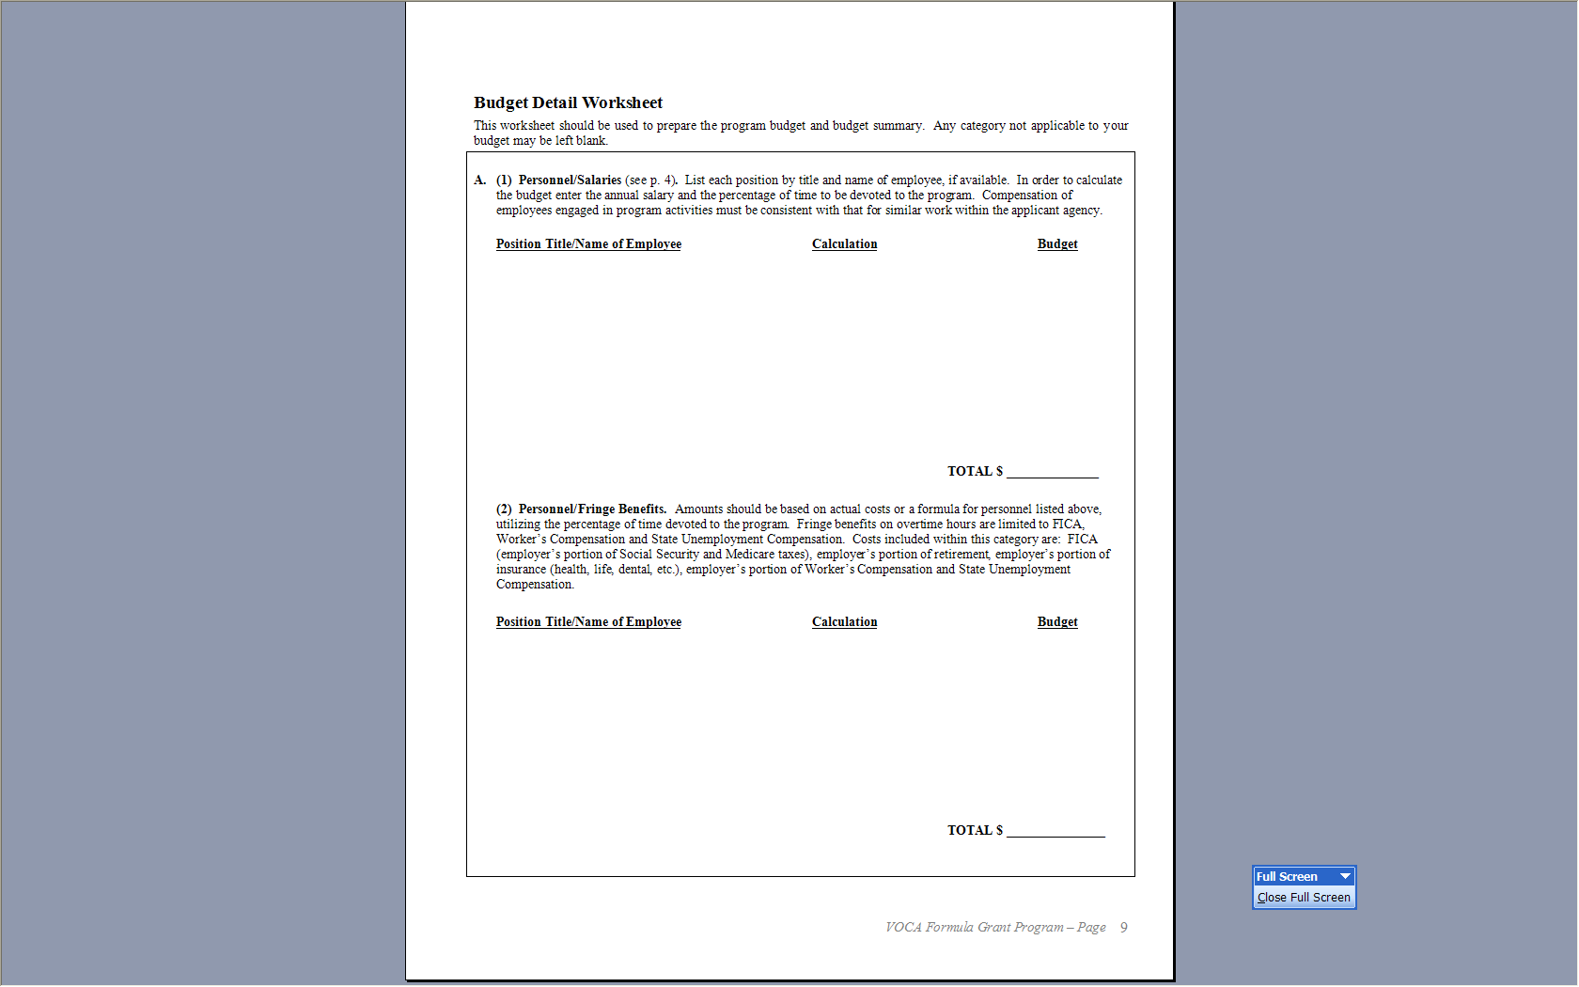

Slide 36
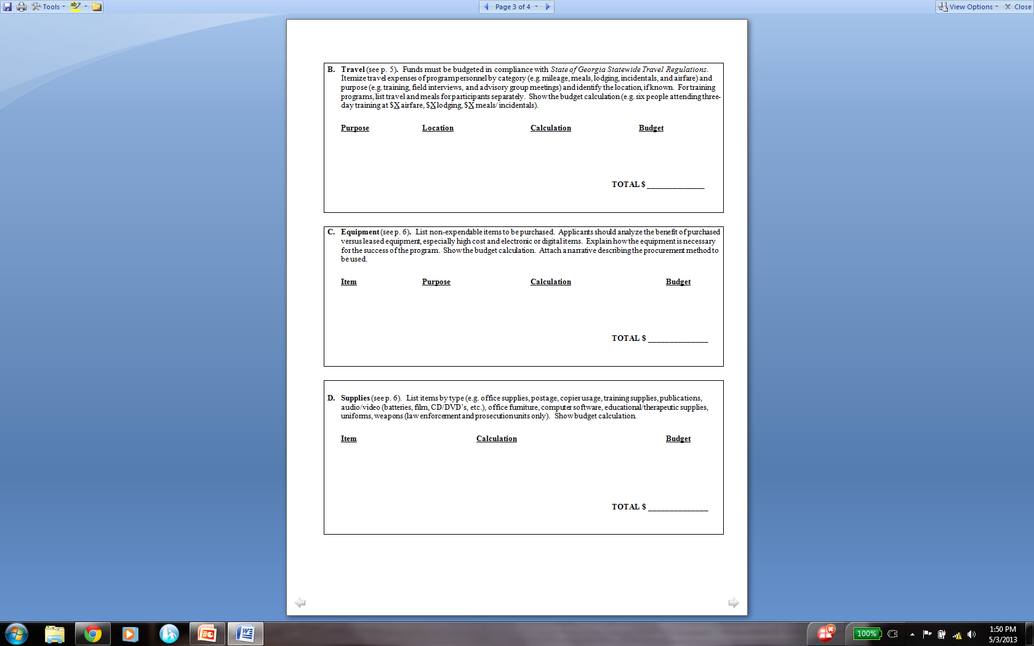

Slide 37
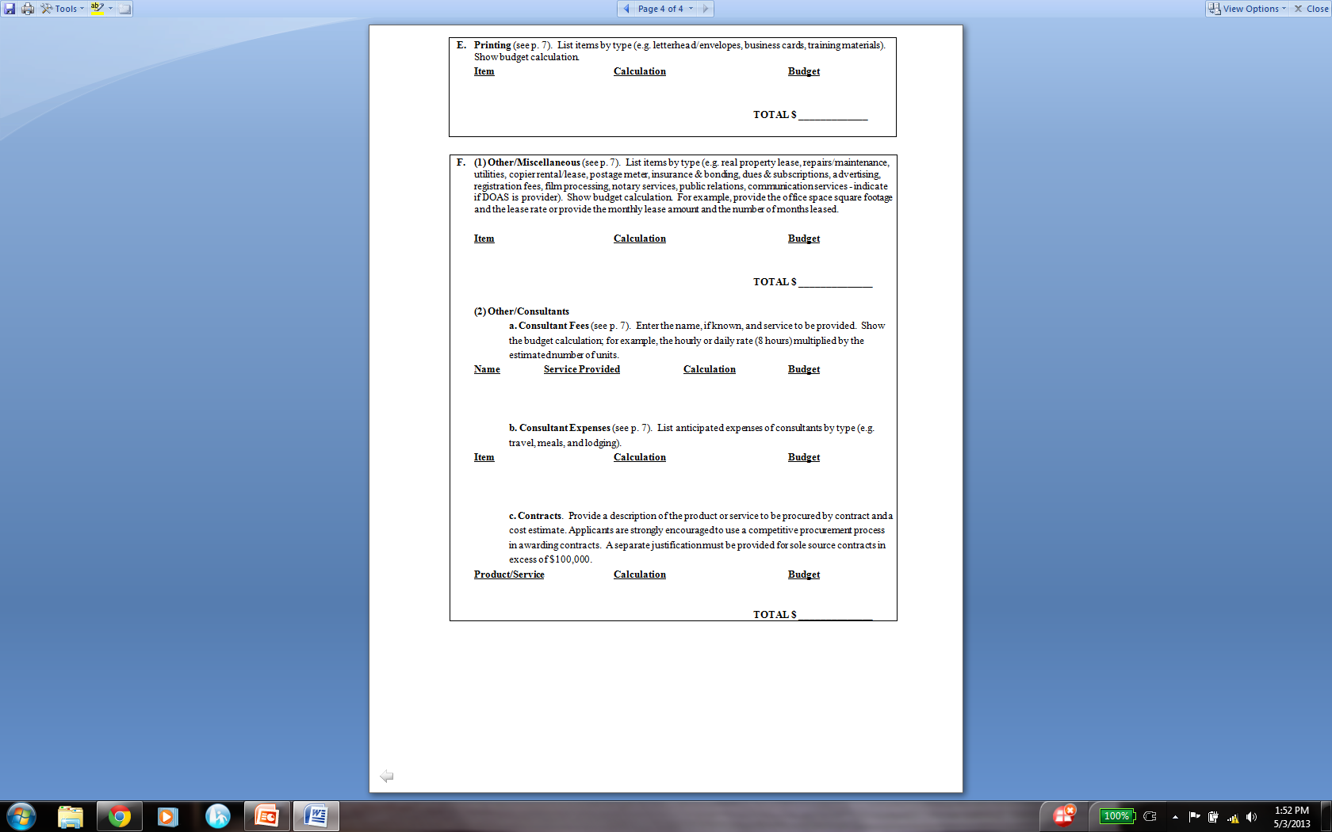

Slide 38
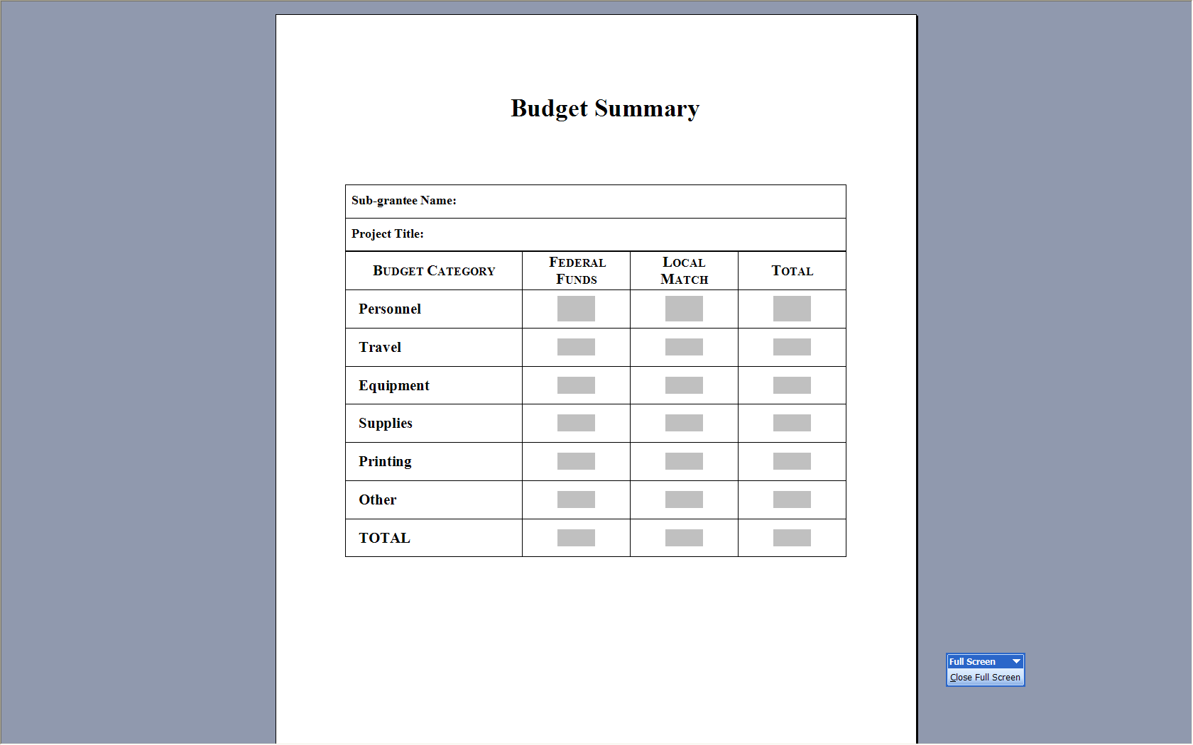

Slide 39
Allowable Costs
Funds can only be used for direct services to crime victims (VOCA Only)
These services include:
Immediate Health & Safety of the Victim
Mental Health Assistance
Assistance with Participation in Criminal Justice Proceedings
Costs Necessary to Provide Direct Services
Special Services
Personnel Costs
Notes:
Funds can only be used for direct services to crime victims. These services include: immediate health and safety of the victim, mental health assistance, assistance with participation in criminal justice proceedings, costs necessary to provide direct services, special services, and personnel costs. Again, funds can only be used for direct services to crime victims.

Slide 40
Allowable Costs
Immediate Health and Safety (excluding Medical Care):
Crisis intervention
Accompaniment to hospitals for medical exams
Hotline counseling
Emergency food, clothing, transportation and shelter
Mental Health Assistance
Counseling, Group Treatment, Therapy
Notes:
Allowable costs include immediate health and safety care. This excludes medical care. However, crisis intervention, accompaniment to hospitals for medical exams, hotline counseling, emergency food, clothing, transportation, and shelter are allowable
Additionally, mental health assistance can be provided to victims. This includes counseling, group treatment, and traditional therapy.

Slide 41
Allowable Costs
Assistance with Participation in Criminal Justice Proceedings
Advocacy on behalf of crime victims
Accompaniment to criminal justice offices and court
Transportation to court
Child care or respite care to enable a victim to attend court
Notification regarding trial dates, case disposition, parole consideration
Assistance with victim impact statements
Notes:
Allowable costs also include assistance with participation in Criminal Justice Proceedings. Some examples of criminal justice proceedings are Advocacy on behalf of crime victims accompaniment to criminal justice offices and court, transportation to court, child care or respite care to enable a victim to attend court, notification regarding trial dates, case disposition, parole consideration, and assistance with victim impact statements.

Slide 42
Allowable Costs
Costs Necessary to Provide Direct Services:
Pro-rated costs of rent and utilities
Transportation costs for victims to receive services
Special Services
Filing for victims compensation
Filing for TANF, Medicaid, and TPOs
Personnel Costs
Salaries and Benefits
Notes:
Allowable costs also include costs necessary to provide direct services, special services, and personnel costs. Here are some examples of those costs.

Slide 43
Other Allowable Costs
Direct Service Training for Staff
Training and Materials
Equipment and Furniture
Operating Costs
Volunteer Coordinators
Notes:
Allowable costs also include direct service training for staff, training and materials, equipment and furniture, operating costs, and volunteer coordinators.

Slide 44
Unallowable Costs
Bonuses
Entertainment
Alcohol
Fundraising Costs
Accounting/Bookkeeping Expenses
Renovations

Slide 45
Unallowable Costs
Forensic Examinations/Interviews
Vehicles
Lobbying
Perpetrator Rehabilitation
Research Evaluations
Indirect Organizational Costs
Prosecution/Investigative Activities (VOCA Only)
Notes:
Unallowable costs consist of forensic examinations/interviews, vehicles, lobbying, perpetrator rehabilitation, research evaluations, indirect organizational costs, prosecution/investigative, activities, and fundraising activities. Prosecution activities are allowable under VAWA Prosecution grant programs.

Slide 46
Unallowable Costs
Property Loss
Medical Costs
Relocation Expenses
Administrative Staff Expense
Activities Exclusively for Crime Prevention
Notes:
Unallowable costs also include property loss, medial costs, relocation expenses, and administrative staff expenses, and activities exclusively for Crime Prevention.

Slide 47
Match Requirement (VOCA)
Calculating Match
VOCA’s match requirement is 20%
25% of the overall 20% match is required for volunteer in-kind match
For a $100,000 grant:
100% - 20% = 80%
$100,000/.80 = $125,000 (total project cost)
$125,000 - $100,000 = $25,000 matching funds
Notes:
Match is the recipient share of the project costs. Match may either be in-kind or cash. Cash match includes actual cash spent by the recipient and must have a cost relationship to the federal award that is being matched. In-Kind match includes the value of donated services. All applicants should be prepared to provide a 20% match. However, 25% of the total required match MUST come from volunteers.
Please note that volunteer time is valued at $12 an hour as volunteer dollars. If an agency is interested in increasing the value of volunteer time, a formal request must be submitted, with substantial evidence of why the value should be increased after you have been awarded.
Direct victim services grants will be awarded under VOCA or VAWA. This will be determined by CJCC staff. If you receive a VAWA victim services grant no match will be required. Only if a NPO -BB

Slide 48
Match Requirement (VAWA)
Calculating Match
VAWA’s match requirement is 25%
For a $100,000 grant:
100% - 25% = 75%
$100,000/.75 = $133,000 (total project cost)
$133,000 - $100,000 = $33,000 matching funds
Notes:
For VAWA Victim Services grants, there is no match requirement.

Slide 49
Match Requirement (SASP)
Match is not required under the SASP grant program

Slide 50
Cash vs. In-kind Match
1. Cash Match – real cash contributed to project by your agency
2. In-kind Match – non-cash contributions
Allowable match must be:
Necessary and reasonable for accomplishment of project objectives.
An allowable cost; i.e., the costs would be allowable if the grantee were to pay for them
Applicable to the grant period to which the cost sharing requirement applies
Match cannot be:
From a Federal source
Program income
Used to match another Federal grant
Notes:
Examples of Cash Match
Cash contributed
Equipment to be purchased by your organization for project activities
Personnel to be hired by the organization to help with the project, who will not be hired if the grant is not funded
Paying for a project brochure and/or its dissemination
Examples of In-Kind Match include donated
Items
Clothing
Services
Rental space
Food

Slide 51
Online Submission
Steps to completing the online Application

Slide 52
Logic Model
The Core of Program Planning and Evaluation

Slide 53
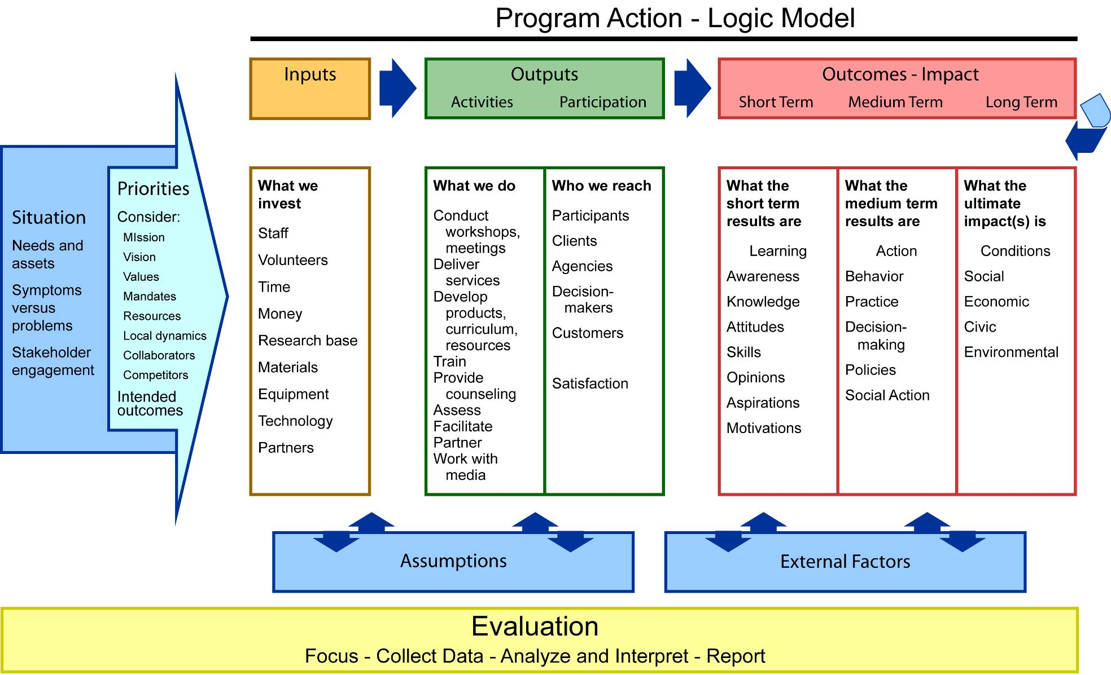
Fully detailed logic model
Notes:
Here we have a full depiction of program development. We see that everything starts with a clear articulation of the originating situation from which priorities are set. This sets into motion the programmatic response – as displayed in the logic model of what is expected to occur…the connections and relationships between inputs-outputs- and outcomes.
Often not included in the graphical LM display but important to articulate are
Assumptions
External factors, for example, do financial institutions exist; are they accessible
(barriers and facilitators)
Evaluation runs over the course of the program and is part of the program design.
Looks linear but is not…

Slide 54
Required Agency Information
DUNS Number
Legal name as registered in the System for Award Management (SAM)database
EIN Number
5% Eligible Certification
Congressional Districts
Notes:
Agencies must be 5% certified by the application deadline of June 14, 2013.

Slide 55
Required Attachments
Designation of Grant Officials
Project Narrative
Budget Detail Worksheet and Budget Summary
Copy of the Assurances, signed by the Authorized Official.
Copy of the Certifications Regarding Lobbying, Debarment, Suspension and other Responsibility Matters signed by the Authorized Official
Copy of the Disclosure of Lobbying Activities signed by the Authorized Official
Audit Requirements
Notes:
- The Project Director and Authorized Official cannot be the same person
- Authorized Official is not the Executive Director – either Chair of Board of Commissioners (County government) or Chair of Agency Board (Non-Profits)

Slide 56
Required Attachments (cont’d.)
Civil Rights Contact
Additional Documents
Standard Assurances
Fully executed Memoranda of Understanding (MOU) and support letters as they demonstrate collaboration and support among stakeholders
Non-profit applicants must submit an organizational chart for the entire program and job descriptions for all employees included in the proposed budget.
Non-profit applicants must submit a copy of their 501(c)(3) certificate
Signatures: must be signed by Authorized Official

Slide 57
Questions & Answers
Notes:
Script: LR
At this time we will address all questions received during the presentation. If you still have questions after we address the questions previously submitted, please raise your hand.

Slide 58
Useful Links
Dun & Bradstreet (D&B)
http://fedgov.dnb.com/webform
System for Award Management (SAM)
https://www.sam.gov/portal/public/SAM/
VAWA/SASP Sub-grantee Manual
http://cjcc.georgia.gov/sites/cjcc.georgia.gov/files/2012STOPVAWASubgranteeManualFINAL.pdf
VAWA/SASP Sub-grantee Manual
http://cjcc.georgia.gov/sites/cjcc.georgia.gov/files/2012VOCASubgranteeManualFINAL.pdf
Office of Justice Programs (OJP) Financial Guide
http://www.ojp.usdoj.gov/financialguide/

Slide 59
Useful Links (cont’d.)
Limited English Proficiency, Federal Interagency Website
http://www.lep.gov/
Office of Civil Rights, U. S. Department of Justice
http://www.ojp.usdoj.gov/about/offices/ocr.htm
Office of Justice, Office of Civil Rights, Equal Employment Opportunity Plans (EEOPs)
http://www.ojp.usdoj.gov/ocr/eeop.htm
U. S. General Services Administration (GSA) – Federal Per Diem Rates
http://www.gsa.gov (Travel Resources)
State of Georgia, State Accounting Office –Travel Regulations
http://sao.georgia.gov/state-travel-policy

