Slide 1
CJSSR Webinar S.T.O.P. VAWA CJSI
Criminal Justice Coordinating Council
Dee Thomas, Operations Analyst
Betty Barnard, Planner

Slide 2
Agenda
Purposes of reporting
Deadlines
Communications process
Completing more than one report
Common errors
Helpful resources
Q & A

Slide 3
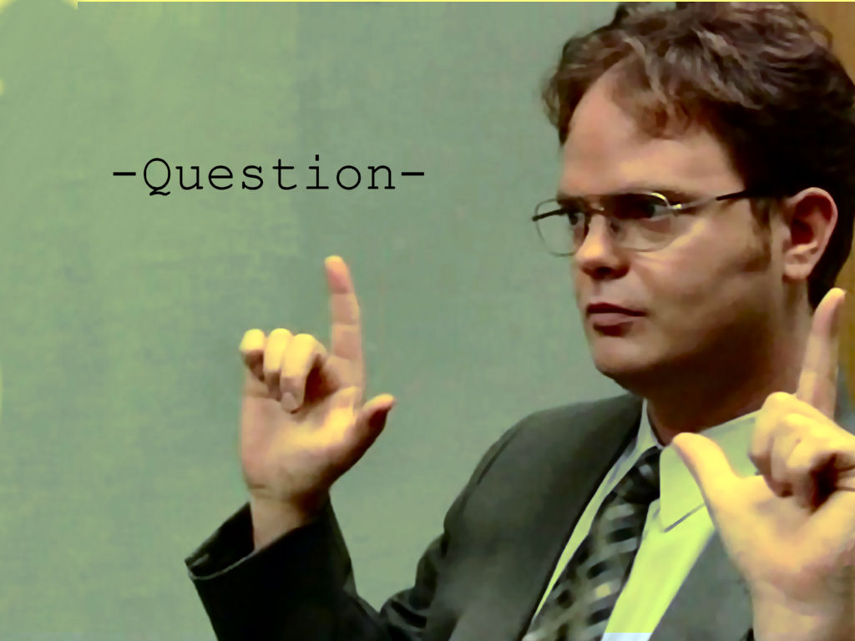
Quick poll
Have you done a CJSSR before?
What is your program type? Ex: prosecution, training, law enforcement, etc.

Slide 4
Purposes of reporting
Notes:
Monitoring, accountability and case for continued and increased funding

Slide 5
Deadlines – Don’t Miss ‘Em
Submit your CJSSR to CJCC by March 30 annually – this year it is due April 15.
Don’t confuse with the Annual Report or other CJCC grant deadlines!

Slide 6
Tips for Deadline Compliance
Refer to special conditions
Communicate with Project Director
CJCC will not process SERs until the report is submitted
Repeated lateness or failure to complete may result in penalties such as reductions to your award

Slide 7
Communication with CJCC
Planner sends instructions and login info at least 30 days before the report is due
Info goes to Project Director ONLY. Ask them to forward to you if you report but are not the PD.
User ID and Password
Make sure you can access MailChimp via your email system
Contact Betty with login questions
Prefer email – include your grant number(s) for expedited service
Don’t contact anyone else – I’m your gal!

Slide 8
When Do I Complete More than One CJSSR?
NEVER!
All VAWA data can be entered on one report regardless of program type or grant year…but you can also submit separate reports if so desired

Slide 9
What Do I Report?
Basic agency information
Staff information
Percentages of victimization types addressed by the grant-funded project
Program purpose areas
CCR activities, if applicable

Slide 10
What Do I Report?
Outputs for all VAWA funded AND match project activities during the reporting period. This may mean you need to prorate.
Narrative questions
Info on protective orders, lethality assessments and repeat offenders

Slide 11
Prorating Data: Example #1
Johnny Law is an officer funded through Justice County’s VAWA grant at 80% of his time. Johnny investigated 40 DV cases this grant year. You should report the following:
40 cases x 0.8 (proportion of time Johnny’s paid through VAWA funds) = 32 investigations

Slide 12
Prorating Data: Example #2
Tameka Trial-Lawyer is a prosecutor funded through Justice County’s VAWA grant at 75% of her time. During this grant year, Tameka received 30 referrals for sexual assault cases, accepted 20, declined 9 and 1 was transferred outside jurisdiction. You should report the following:
30 cases x 0.75 (proportion of time Tameka is paid through VAWA funds) = 23 (round up from 22.5) case referrals
20 cases x 0.75 = 15 cases accepted
9 cases x 0.75 = 7 (round up from 6.75) cases declined
1 case x 0.75 = 1 transferred (just round up whenever needed)
OR, if the other 25% of her time is match, report all data for her cases

Slide 13
Prorating Data: Example #3
Your agency’s budget breakdown is the following:
VAWA Grant – 15%
County Funds – 75%
5% Funding – 10%
During the VAWA grant year (January 1-December 31) your agency worked on 183 cases of domestic violence, 40 sexual assault cases and 38 stalking cases. You would report the following:
0.15 x 183 = 28 domestic violence cases
0.15 x 40 = 6 sexual assault cases
0.15 x 38 = 6 stalking cases

Slide 14
Accurate Reporting is Important
No matter how you do it, your data MUST only reflect VAWA-funded activities!

Slide 15
Completing the CJSSR Click here to login to the CJSSR

Slide 16
Remember….
You should only report data on the use of VAWA federal and match funds
Use your approved S.T.O.P. VAWA report as your worksheet. Contact Betty if you need the file.
You cannot “log out” of the system but if you close the window of the survey, it will save your information. You may login again after 10 minutes.
If your survey is completely broken, frozen, or otherwise on fire, please email Dee (dionna.thomas@cjcc.ga.gov)
If you have questions about how to prorate, accurately report your activities, or other programmatic questions, or just need your login reset, please email Betty (betty.barnard@cjcc.ga.gov)

Slide 17
Common Errors
Failure to prorate data based on use of VAWA funds
Incorrect Purpose Areas
“Logging out”
Not submitting

Slide 18
Resources at cjcc.georgia.gov
VAWA Reporting page http://cjcc.georgia.gov/reporting-1
VAWA Subgrantee Manual http://cjcc.georgia.gov/sites/cjcc.georgia.gov/files/2014%20VAWA%20Subgrantee%20Manual.pdf

Slide 19
Q & A
?

Slide 20
Conclusion
Remember to look at the website and CONTACT us for help! We’re here for you!
Betty Barnard – betty.barnard@cjcc.ga.gov – 404-654-5691
Dee Thomas – dionna.thomas@cjcc.ga.gov – 404-654-5695
Create reminders for deadlines
Delays your reimbursements
Per special conditions, subject to a reduction in your federal award amount
Thanks – this is important and we appreciate you

