Slide 1
VSSR Webinar
Criminal Justice Coordinating Council
Betty Barnard, Planner

Slide 2
Welcome and Introductions
Agenda
Purposes of reporting
Deadlines
Communications process
Completing more than one report
Completing the report online
Common errors
Helpful resources
Q & A

Slide 3
Quick poll
How many have done a VSSR before?
How many of you have more than grant from CJCC?

Slide 4
Purposes of reporting
Notes:
Monitoring, accountability and case for continued and increased funding

Slide 5
Deadlines – Don’t Miss ‘Em

Slide 6
Tips for Deadline Compliance
Refer to special conditions
Communicate with Project Director
CJCC will not process SERs until the VSSR is complete
Repeated lateness or failure to complete may result in penalties such as reductions to your award

Slide 7
Communication with CJCC
Planner sends instructions and login info 30 days before the report is due
Info goes to Project Director ONLY. Ask them to forward to you if you report but are not the PD.
User ID = grant number
Password = 4 digits; will be the same each reporting quarter
Make sure you can access MailChimp via your email system
Contact Betty or Dee with questions. Prefer email – include your grant number(s) for expedited service
Log in problems or programmatic questions = Betty
Technical issues = Dee

Slide 8
When Do I Complete More than One Report?
CJSSR
Different funding
streams
Different project
sites
Different projects
can now complete just one report

Slide 9
What Do I Report?
Outputs for VOCA, VAWA or SASP-funded activities during the reporting quarter. This may mean you need to prorate.
New victim demographics and services by county and victimization type
NB: If you have a new grant you need to report all victims as new this quarter
Existing victim services by county and victimization type

Slide 10
Prorating Data for the VSSR: Example #1
Suzy Advocate is funded through your agency’s VOCA grant at 80% of her time and through your VAWA grant for 20% of her time. Suzy served 40 victims this quarter. You should report the following:
40 victims x 0.8 (proportion of time Suzy is on VOCA Grant) = 32 victims served with VOCA Funds
40 x 0.2 (proportion of time Suzy is on VAWA Grant) = 8 victims served with VAWA funds.

Slide 11
Prorating Data for the VSSR: Example #2
Suzy Advocate is funded through your agency’s VOCA grant at 50% and Norene Counselor is funded through your VAWA grant at 75%. Suzy Advocate served 50 victims and Norene Counselor treated 30 victims. You should report the following.
50 x 0.5 (proportion of Suzy’s time paid for with VOCA funds) = 25 victims served with VOCA funds
30 x 0.75 (proportion of Norene’s time paid for with VAWA funds) = 22.5 (round to 23) victims served with VAWA funds.
The restriction on the kinds of victims that should be reported on your VAWA and/or SASP VSSR applies here as well.

Slide 12
Prorating Data for the VSSR: Example #3
Your agency’s budget breakdown is the following:
VOCA Grant – 35%
SASP Grant – 5%
UnitedWay – 15%
Private Donations – 10%
Community Foundation Grants – 10%
Major Events – 15%
5% Funding – 10%
In the first quarter of your VOCA Grant (October 1-December 31) your agency served 25 child sexual abuse victims and 10 sexual assault victims. You would report:
0.35 x 25 = 9 child sexual abuse victims
0.35 x 10 = 4 adult sexual assault victims

Slide 13
Accurate Reporting is Important
No matter how you do it, your data MUST only reflect VOCA, VAWA or SASP funded activities!

Slide 14
Completing the VSSR

Slide 15
This portion of the webinar will walk you through the Victims Services Statistical Report (VSSR). This report provides CJCC with a screenshot of your agency’s service activities for the reporting period. The screen below is the first you will see after logging into the system
Navigating the VSSR: What to Expect

Slide 16
Pre-Survey Instructions for VSSR:
Optional to read but highly recommended if this is your first VSSR
Can be downloaded by clicking the links contained in this question screen (below)
Will not be penalized for skipping
Navigating the VSSR: What to Expect

Slide 17
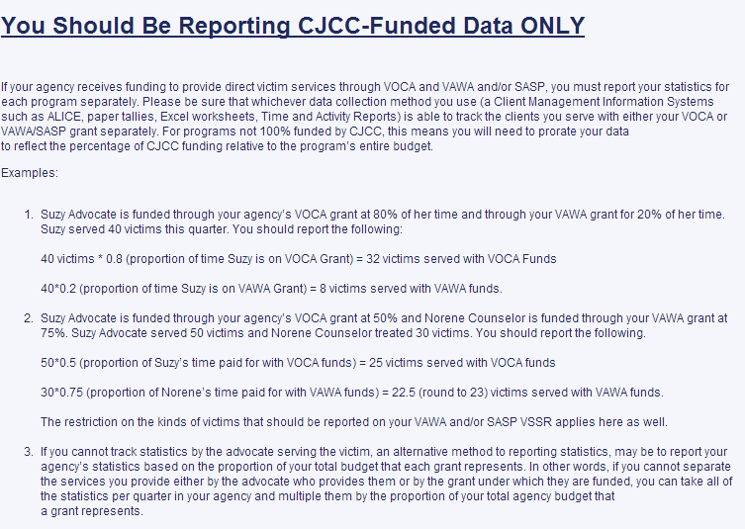
Pre-Survey Instructions for VSSR:
Covers which data should be reported, including how to calculate it
What to expect and how to complete each section
Links to download these instructions and the data dictionary
Navigating the VSSR: What to Expect

Slide 18
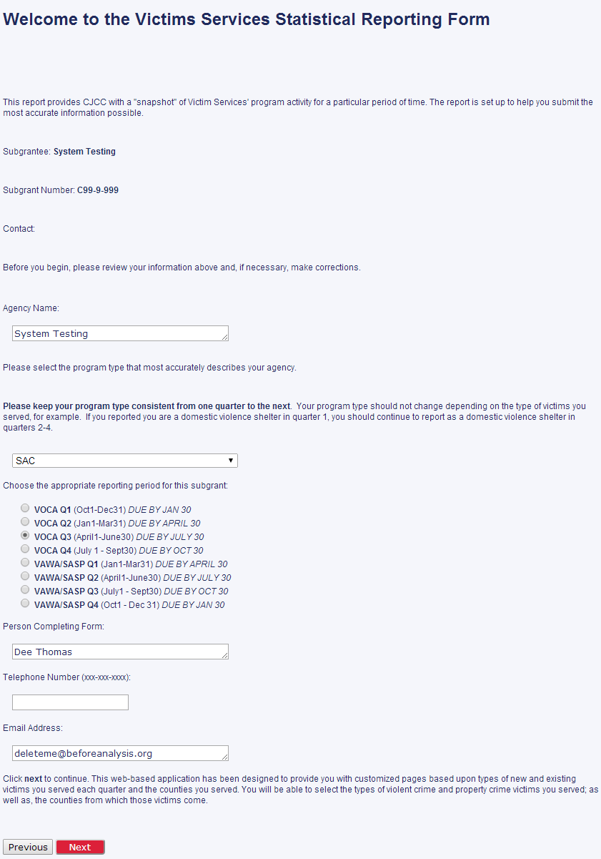
Welcome: Grant Info
Displays information about your CJCC grant including agency name and grant number
Must select your Program Type from the drop down list. Keep consistent every quarter
Select the appropriate reporting period for your funding type. Dates are shown next to each period.
Enter your name, phone number, and email address before clicking NEXT
Navigating the VSSR: What to Expect

Slide 19
Part 1: New Victimizations
Covers Information About
New Victim Services
New Victim Types
New Victim Demographics
Navigating the VSSR: What to Expect

Slide 20
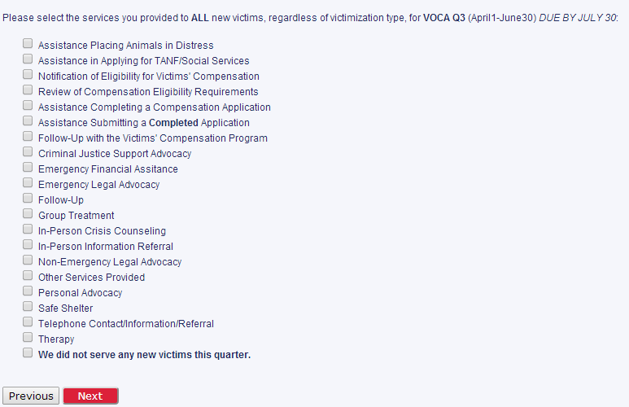
Part 1: New Victimizations
Before proceeding, you must select all services you provided for your new victims during the reporting period.
Regardless of victimization type, you will select all services you provided to new victims this quarter.
It will make sense why as you progress through the VSSR.
Navigating the VSSR: What to Expect

Slide 21
Part 1: New Victimizations
Victimizations are grouped by kind
Against Person
Child Crimes
Against Women
Other Violent Crimes
Property Crimes
These questions appear as you progress through Part 1.
If you served a victimization listed in the question, select yes. The VSSR will then proceed to demographic questions about your victims
If you select no, it will proceed to the next “screener” question.
Navigating the VSSR: What to Expect

Slide 22
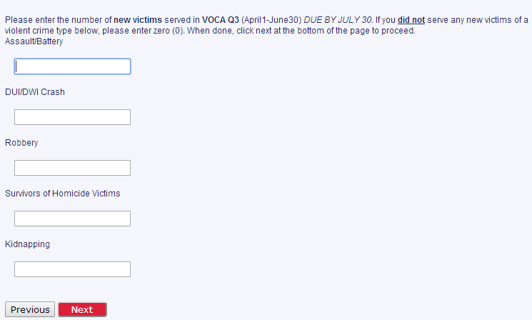
Part 1: New Victimizations
This screen will require you to enter the total number of new victims served for each victimization type listed.
If you didn’t serve a particular victimization in the group, simply enter ‘0’ in that field to continue.
Navigating the VSSR: What to Expect

Slide 23
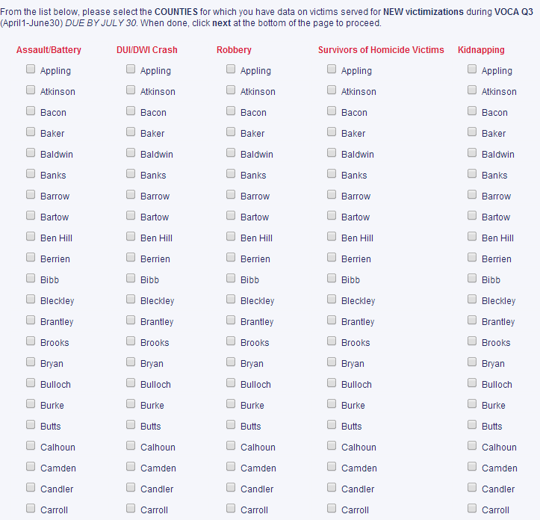
Part 1: New Victimizations
This screen will require you select the counties of victimization for each victim that you served.
You will need to do this for each victimization type you served. If you didn’t serve a victimization, don’t select counties in that column.
If you have served 15+ counties for a single victimization, select STATEWIDE in lieu of selecting each county.
Navigating the VSSR: What to Expect

Slide 24
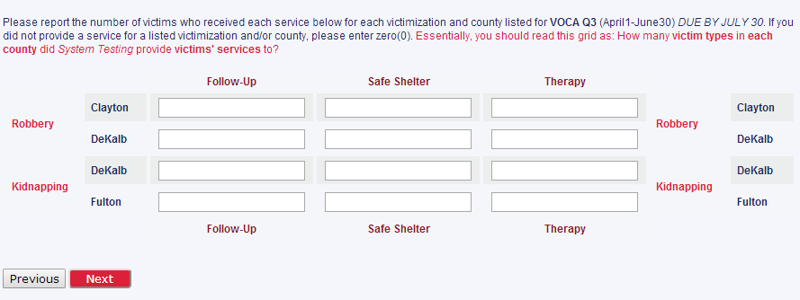
Part 1: New Victimizations
Services Grid
This grid requires that you enter the number of victims that received each service in each county.
For example, below you should enter how many Robbery victims in Clayton county received Follow-Up, Safe Shelter, or Therapy
Navigating the VSSR: What to Expect

Slide 25
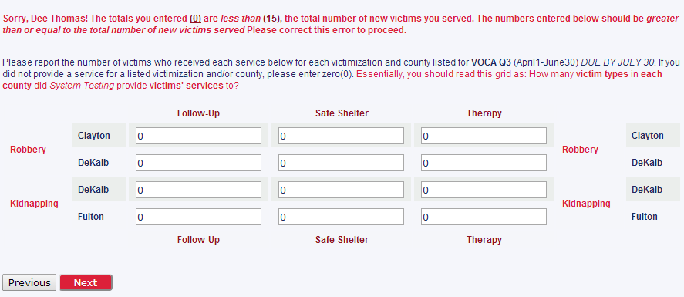
Part 1: New Victimizations
Services Grid
The numbers in the services grid should be greater than or equal to the number of victims you reported serving. Your errors will appear in red above the grid.
Navigating the VSSR: What to Expect

Slide 26
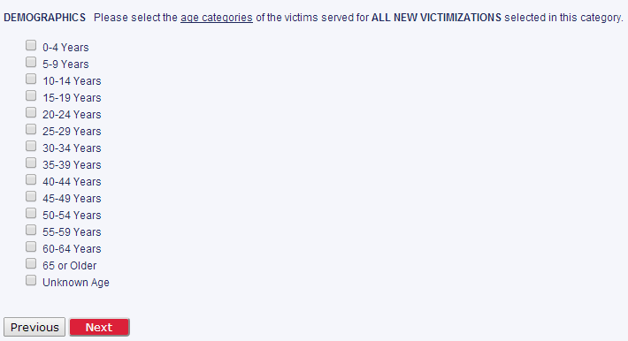
Part 1: New Victimizations
Age Demographics
This screen will require you select the age groups of the victims you served this reporting period.
Selecting the groups that you served will filter the Age Grid that will appear on the next page.
Navigating the VSSR: What to Expect

Slide 27
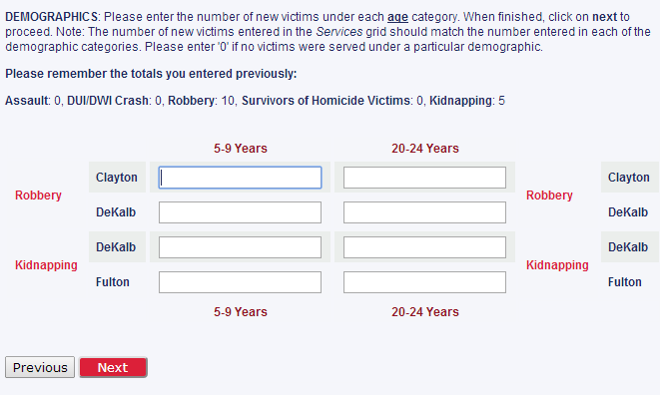
Part 1: New Victimizations
Age Grid
Like the services grid, you will enter the number of victims served in each age group per victimization.
If you didn’t serve a particular age group for a county or victimization, enter ‘0’ to proceed.
Numbers entered in grid must equal total number of victims reported.
Navigating the VSSR: What to Expect

Slide 28
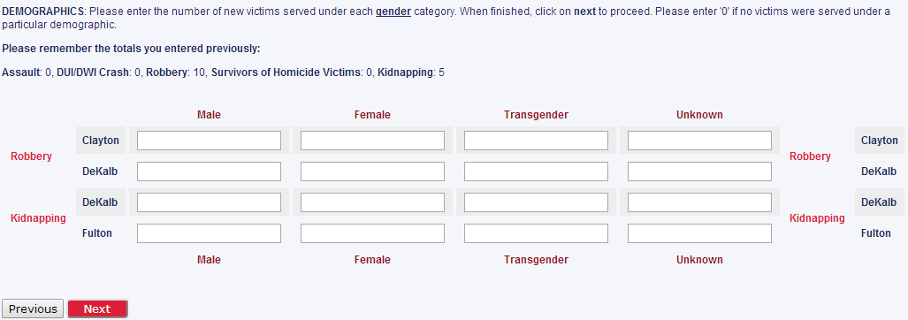
Part 1: New Victimizations
Gender Grid
Same instructions apply for this grid as the previous grids.
Navigating the VSSR: What to Expect

Slide 29
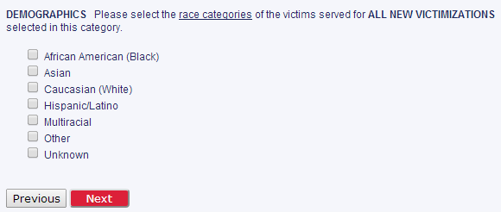
Part 1: New Victimizations
Race Demographics
This screen will require you select the race groups of the victims you served this reporting period.
Selecting the groups that you served will filter the Race Grid that will appear on the next page.
Navigating the VSSR: What to Expect

Slide 30
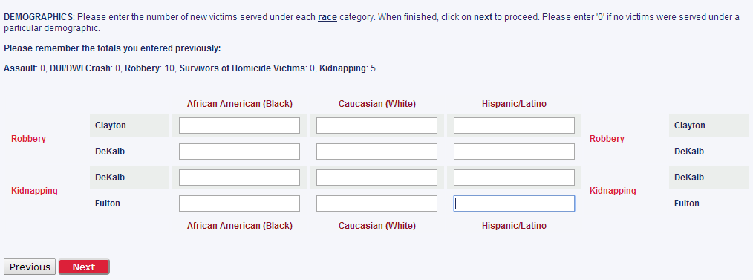
Part 1: New Victimizations
Race Grid
Same instructions apply for this grid as the previous grids.
Navigating the VSSR: What to Expect

Slide 31
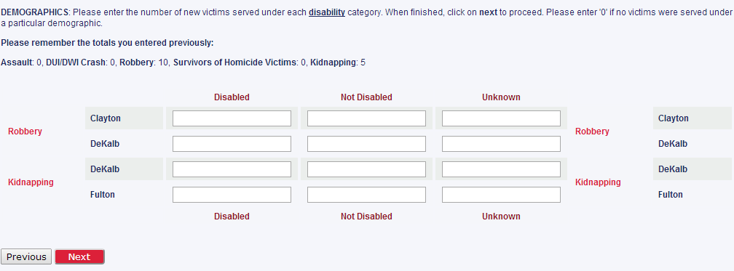
Part 1: New Victimizations
Disability Grid
Same instructions apply for this grid as the previous grids.
Navigating the VSSR: What to Expect

Slide 32
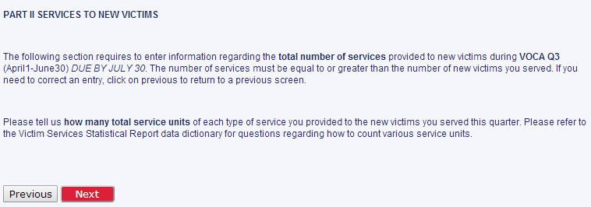
Part 2: Services to New Victims
This section counts UNITS of service for new victims. We know you’ve provided new services, now we want to know how many times.
Navigating the VSSR: What to Expect

Slide 33
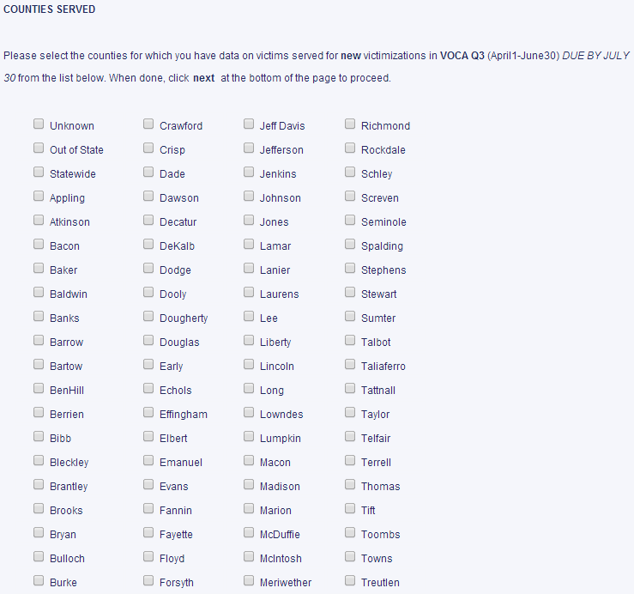
Part 2: Services to New Victims
On this screen, you’ll select all the counties of victimization that you provided services to in order to filter the next grid.
Navigating the VSSR: What to Expect

Slide 34
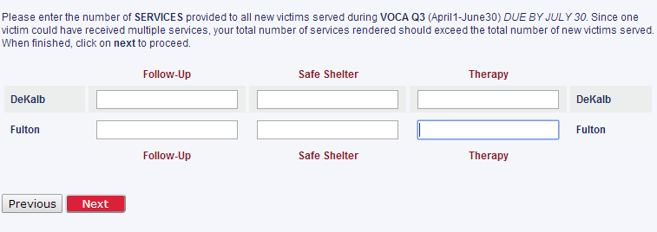
Part 2: Services to New Victims
On this screen, you’ll enter the number of times you performed each service for a new victimization that occurred in the county.
These services will populate based on the choices you made in Part 1. Ta-da!
Navigating the VSSR: What to Expect

Slide 35
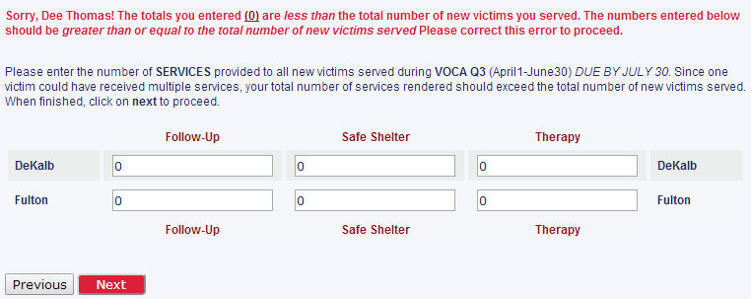
Part 2: Services to New Victims
The numbers in the services grid should be greater than or equal to the number of victims you reported serving. Your errors will appear in red above the grid.
Navigating the VSSR: What to Expect

Slide 36
Part 3: Existing Victims
This section gives us county, victimization, and service type information for existing victims.
Navigating the VSSR: What to Expect

Slide 37
Part 3: Existing Victims
If you’re still serving victims that you reported serving in a previous quarter with CJCC funds, you will select yes
If you are not serving victims as described above, you will select no.
Navigating the VSSR: What to Expect

Slide 38
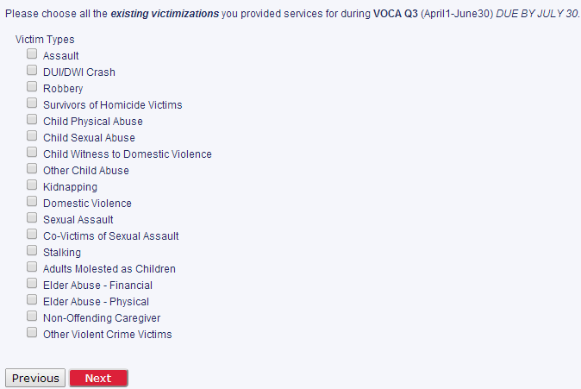
Part 3: Existing Victims
So You’ve Got Existing Victims…
Select the types of victims that you’re currently serving…
Navigating the VSSR: What to Expect

Slide 39
Part 3: Existing Victims
So You’ve Got Existing Victims…
After you’ve selected the types of victims you’re serving, tell us how many you’re serving.
Navigating the VSSR: What to Expect

Slide 40
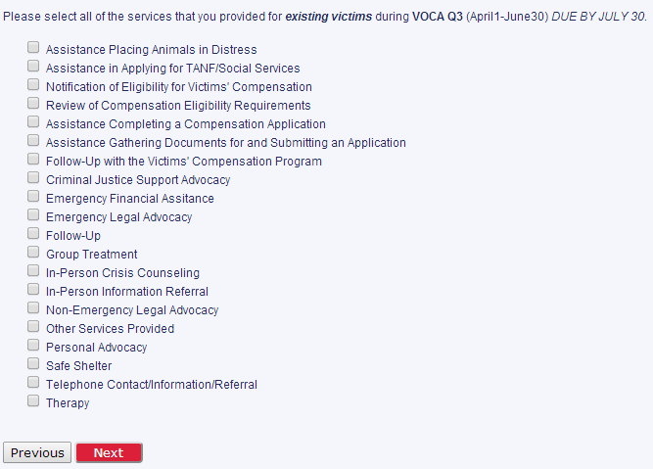
Part 3: Existing Victims
So You’ve Got Existing Victims…
Now we’re curious about the kinds of services you’re providing.
Select all services that apply for the existing victims you serve.
Navigating the VSSR: What to Expect

Slide 41
Part 3: Existing Victims
So You’ve Got Existing Victims…
Now tell us how many times you’ve provided each service to your existing victims.
Navigating the VSSR: What to Expect

Slide 42
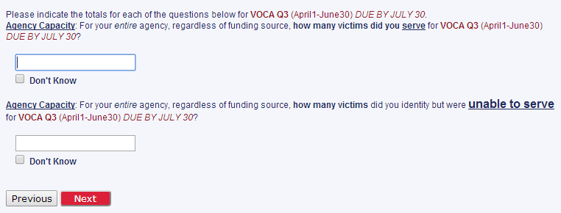
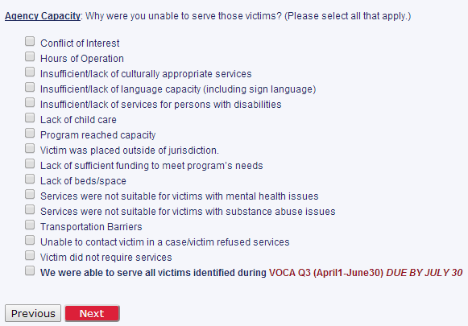
Part 4: Agency Capacity
This section is for informational purposes only.
We would like to know:
How many victims your agency served this period
How many you couldn’t serve
And the reasons you couldn’t provide service.
Navigating the VSSR: What to Expect

Slide 43
Part 5: Summary Page
This section provides a summary of your responses. Please PRINT and SAVE a copy by right-clicking on the screen and selecting “Print page” and “Save.” Make sure to file the digital and hard copies with your grant files, as we may request them for site visits, desk reviews, grant applications and other circumstances.
You have not submitted your VSSR until you click the red NEXT button at the bottom of the page!
Navigating the VSSR: What to Expect

Slide 44
Part 6: Submit!
You are done!
Please PRINT and SAVE a copy by right-clicking on the screen and selecting “Print page” and “Save.” Make sure to file the digital and hard copies with your grant files.
Navigating the VSSR: What to Expect

Slide 45
Remember….
Your user ID and password will not change over the grant year
You cannot “log out” of the system by a process but, if you close the window of the survey, it will save your information. You may login again after 10 minutes.
If your survey is completely broken, frozen, or otherwise on fire, please email Dee (dionna.thomas@cjcc.ga.gov)
If you have questions about defining a victim or service type, how to count your victims, need your VSSR login reset, or other programmatic questions, please email Betty (betty.barnard@cjcc.ga.gov)

Slide 46
Common Errors
Failure to prorate data
Not entering zeros
Data validation errors
Confusing new victim services with existing victim services
“Logging out”
Not submitting

Slide 47
Resources at cjcc.georgia.gov
VOCA
Reporting page: http://cjcc.georgia.gov/outcome-performance-tools-1
Subgrantee Manual http://cjcc.georgia.gov/sites/cjcc.georgia.gov/files/2014%20VOCA%20Subgrantee%20Manual.pdf
VAWA
Reporting page: http://cjcc.georgia.gov/reporting-1
Subgrantee Manual http://cjcc.georgia.gov/sites/cjcc.georgia.gov/files/2014%20VAWA%20Subgrantee%20Manual.pdf
SASP
Reporting page: http://cjcc.georgia.gov/reporting-0
Subgrantee Manual http://cjcc.georgia.gov/sites/cjcc.georgia.gov/files/2014%20SASP%20Subgrantee%20Manual.pdf
Everyone
VSSR Guide: http://cjcc.georgia.gov/sites/cjcc.georgia.gov/files/2014_VSSR_Guide_0.pdf

Slide 48
Q & A
?

Slide 49
Conclusion
Remember to look at the website and CONTACT us for help! We’re here for you!
Betty Barnard – betty.barnard@cjcc.ga.gov – 404-654-5691
Dee Thomas – dionna.thomas@cjcc.ga.gov – 404-654-5695
Create reminders for deadlines
Delays your reimbursements
Per special conditions, subject to a reduction in your federal award amount
Thanks – this is important and we appreciate you

